Slide 1
Capital Market Line and Beta
Corporate Finance
Presented by Dimitar Todorov

Slide 2
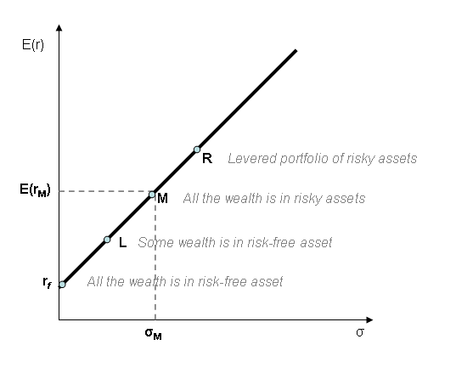
Capital Market Line
Capital market line (CML) shows graphically the relationship between risk measured by standard deviation and return of portfolios consisting of risk-free asset and market portfolio in all possible proportions.
Point M represents the market portfolio:
completely diversified;
carries only systematic risk;
its expected return = expected market return as a whole.

Slide 3
CML Equation
$E\left(R_{C}\right)=R_{F}+ σ_{C}\frac{E\left(R_{M}\right) − R_{F}}{σ_{M}}$
$E\left(R_{C}\right)$ - expected return of portfolio C
$R_{F}$ - risk-free rate
$σ_{C}$ - standard deviation of portfolio C return
$σ_{M}$ - standard deviation of the market return
$E\left(R_{M}\right)$ - expected return of a market portfolio

Slide 4
Example 1
Assume that the current risk-free rate is 3%, expected market return is 18% and standard deviation of a market portfolio is 9%. Suppose there are two portfolios:
Portfolio A has standard deviation of 6%;
Portfolio B has standard deviation of 15%.
What is the expected return of the two portfolios?

Slide 5
Expected return
CML
32%
30%
27%
24%
21%
18%
15%
12%
9%
6%
3%
0%
B
M
Portfolio B risk premium, 25%
A
Market risk premium, 15%
Portfolio A risk premium, 10%
0%
6%
9%
15%
Standard Deviation

Slide 6
Limitations of CML
Assumptions of the Capital Market Line and the Capital Asset Pricing Model may not hold true in the real world.
Differing taxes and transaction costs between various investors.
In real market conditions investors can lend at lower rate than borrow.
Real markets are not strongly efficient and investors have unequal information.
Not all investors are rational or risk-averse.
Standard deviation isn’t the only risk measurement.
Risk-free assets do not exist.

Slide 7
Beta
The beta coefficient indicates whether an investment is more or less volatile than the overall market.
β < 1 suggests that the investment is less volatile than the market.
β > 1 suggests that the investment is more volatile than the market.
Beta measures risk that comes from exposure to market movements.
The market portfolio has a β = 1.
β < 0 occurs when investments follow the opposite direction of the market.

Slide 8
Cont.
Beta represents the risk of an investment that can’t be reduced by diversification.
Beta measures the amount of risk an investment adds to an already diversified portfolio.
Beta decay refers to the tendency for companies with high beta (β > 1) to have their beta decline towards the market beta (β = 1).

Slide 9
Formula for beta
$β= \frac{Cov(R_{a}, R_{M})}{Var(R_{M})}$ or $β= \frac{\sum_{i=1}^{n}{(k_{i} − k)(p_{i} − p)}}{\sum_{i=1}^{n}{{(p_{i} − p)}^{2}}}$
$Cov(R_{a}, R_{M})$ is the covariance between the return of a given security and market return.
$Var(R_{M})$ is the variance of market return.
$k_{i}$ is the observed return of a security in time period i.
$k$ is the expected return of a security.
$p_{i}$ is the observed return of a market portfolio.
$p$ is the expected return of a market portfolio.

Slide 10
Example 2
Assume stock A has had the following return over the last 3 years:
The expected return of stock A is 7% and the expected market return is 5%.
What is the beta of stock A?
 | Year 1 | Year 2 | Year 3
Return of stock A, % | 4 | 6 | 11
Market return, % | 5 | 7 | 3

Slide 11
Beta of a portfolio
The beta of a portfolio is a weighted average of all beta coefficients of its constituent securities.
$β= \sum_{i=1}^{N}{w_{i}β_{i}}$
$w_{i}$ is the proportion of a given security in the portfolio.
$β_{i}$ is the beta of a given security.
$N$ is the number of securities in a portfolio.

Slide 12
Example 3
Assume that portfolio ABC consists of 3 stocks with the following proportions and beta coefficients:
25% of stock A with β_{A} = 1.7;
45% of stock B with β_{B} = 0.3;
30% of stock C with β_{C} = 1.2;
What is the beta coefficient of portfolio ABC?

Slide 13
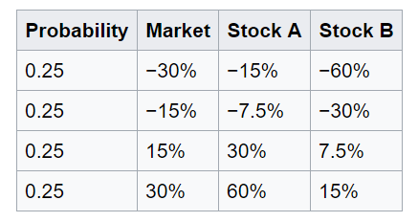
Criticism
Beta views risk solely from the perspective of market prices, failing to take into consideration specific business fundamentals or economic developments.
Price level is ignored.
Beta doesn’t account for the influence investors can have on the riskiness of their holdings.
Beta assumes that upside potential = downside risk for any investment.
In reality past volatility does not reliably predict future performance

Slide 14
Thank you for your attention!

