Slide 1
Business Models for Startups: From Concept to Scale
Strategies to grow startups from ideas to success
Dr. Zornitsa Yordanova
Notes:
AI-generated content may be incorrect. --- This presentation explores the fundamental concepts of business models tailored for startups, guiding from initial ideas to scalable growth. We will examine different model types, their strategic importance, and practical tools to design and implement effective business strategies.

Slide 2
Today's Agenda Overview
Introduction to Business Models for Startups
Business Model vs. Business Plan
Overview of Common Startup Business Models
Deep Dive: B2B, B2C, B2G, and Platform Models
Subscription, Usage-Based, Licensing, and Marketplace Models
Value Creation, Delivery, and Capture
Business Model Canvas: Step-by-Step Explanation
Key Partners, Activities, and Resources
Revenue Streams and Cost Structures
Scalability and Growth Logic
Notes:
We will begin with an introduction to business models and their critical role in startup success. Next, we will clarify the distinction between business models and business plans. We will then review common startup business models and dive deeper into specific types. The presentation covers value creation, the Business Model Canvas, partnerships, revenue streams, and concludes with scalability and growth strategies.

Slide 3
Introduction to Business Models for Startups
Notes:
Understanding what a business model is and why it matters is essential for any startup. This section outlines how business models underpin startup success and highlights examples of impactful models in the real world.

Slide 4

Defining a business model and its importance for startups
Business Model Definition
A business model explains how a startup creates, delivers, and captures value to succeed in the market.
Guiding Strategic Decisions
It guides startups in making informed strategic decisions and optimising resource allocation.
Path to Sustainability
A clear business model helps startups establish sustainability and plan for growth effectively.
Notes:
--- A business model describes how a startup creates, delivers, and captures value. It's crucial because it guides strategic decisions and resource allocation, helping startups establish a clear path to sustainability and growth. Image source: AI-generated

Slide 5
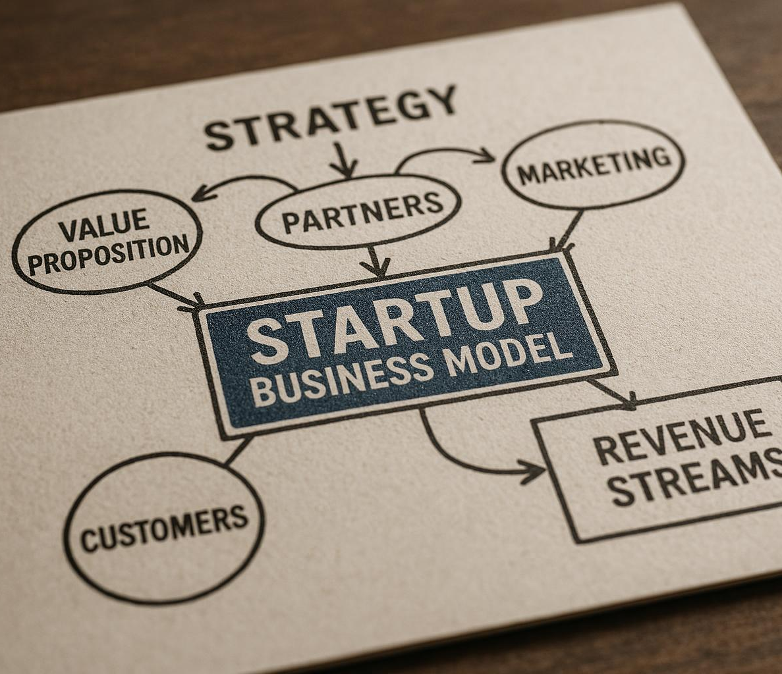
How business models enable startup success
Aligning Customer Needs
Successful business models precisely meet customer needs to create value and build loyalty.
Revenue-Generating Activities
Startups focus on activities that directly generate revenue to ensure sustainable growth.
Reducing Risk
Validated business models reduce uncertainty and risk in startup ventures.
Focus on Validated Opportunities
Startups succeed by focusing efforts on opportunities proven through validation.
Notes:
--- Effective business models align customer needs with revenue-generating activities, enabling startups to focus their efforts on validated opportunities, reducing risk and improving chances of success. Image source: AI-generated

Slide 6

Real-world impact of strong business models
Market Transformation
Innovative business models enable startups to transform entire markets by addressing unmet needs effectively.
Industry Disruption
Strong business models disrupt traditional industries by introducing new ways of delivering services and products.
Rapid Scaling
Robust models allow companies to scale quickly and reach global audiences with agility and innovation.
Notes:
--- Numerous startups have transformed markets by innovating their business models. Companies like Airbnb and Uber exemplify how a robust model can disrupt industries and scale rapidly. Image source: AI-generated

Slide 7
Business Model vs. Business Plan
Notes:
This section clarifies the differences between a business model and a business plan, explains when to use each tool, and discusses how integrating both supports startup strategy.

Slide 8
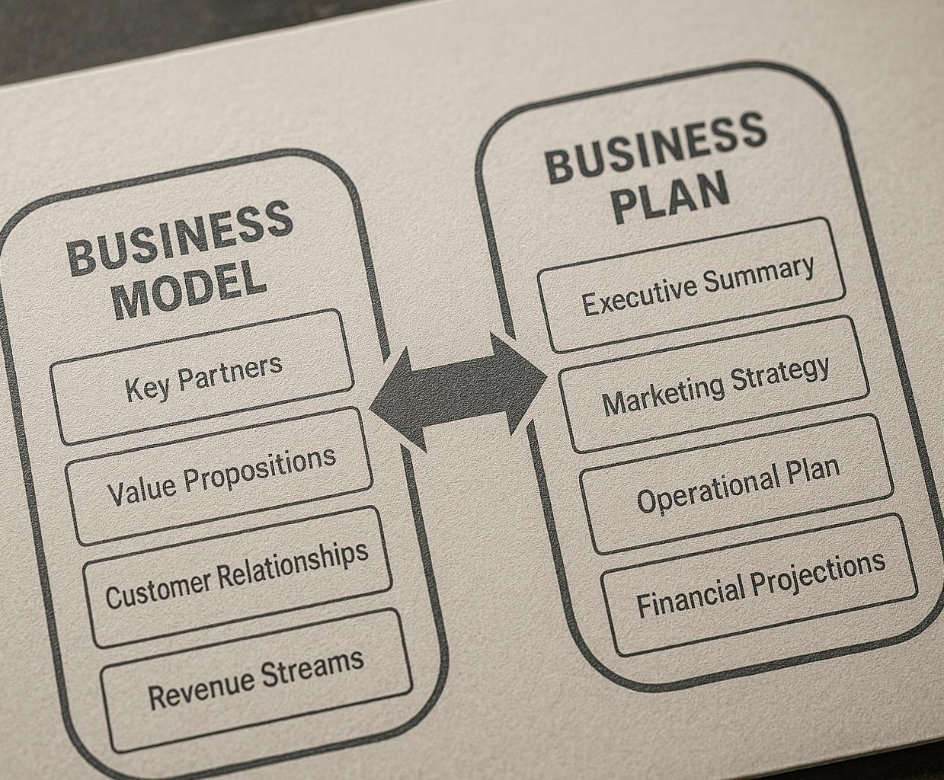
Key differences between business models and business plans
Definition of Business Model
A business model describes how a company creates and captures value conceptually.
Definition of Business Plan
A business plan details objectives, strategies, and financial projections to implement the business model.
Purpose Comparison
The business model provides a framework, while the business plan serves as an operational guide.
Notes:
--- A business model is a conceptual framework outlining how value is created and captured, while a business plan is a detailed document that operationalises the model with objectives, strategies, and financial projections. Image source: AI-generated

Slide 9

When to use each: context and purpose
Early Use of Business Model
A business model helps test assumptions and design value creation in the early stages of a venture.
Transition to Business Plan
A business plan details execution strategies and is essential when preparing for funding or operations.
Notes:
--- Use a business model early to test assumptions and design value creation. Transition to a business plan when preparing for funding or operational execution to detail how the model will be realised. Image source: AI-generated

Slide 10
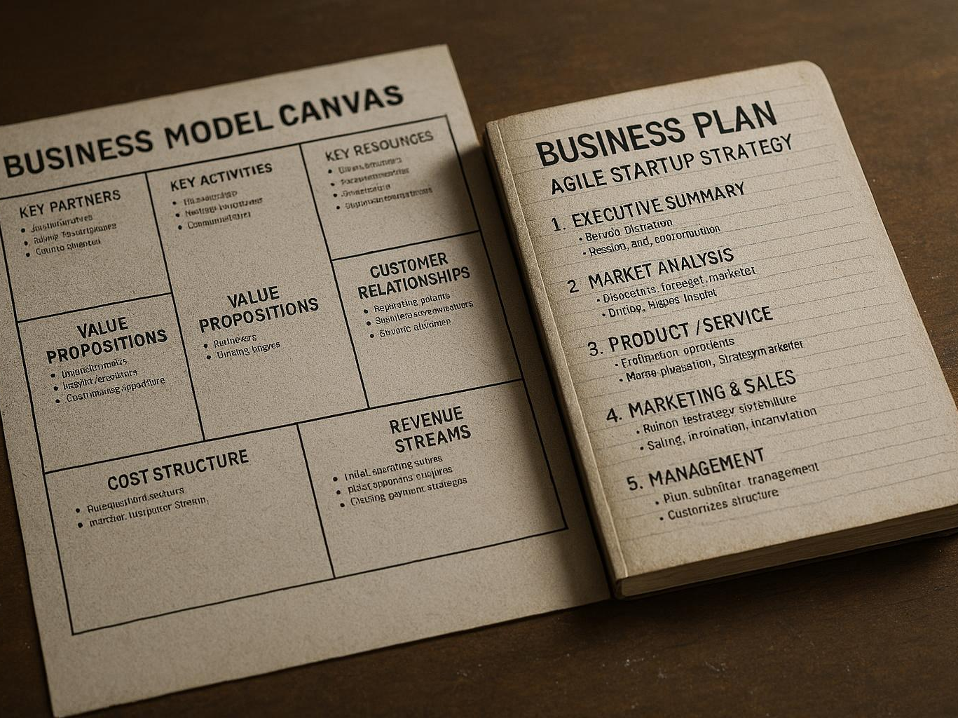
Integrating models and plans for startup strategy
Business Model Flexibility
A flexible business model allows startups to adapt quickly to market changes and customer needs.
Structured Business Plan
A structured business plan provides a clear roadmap for startups to achieve their goals with defined milestones.
Agile Startup Strategy
Integrating models and plans ensures startups remain agile yet focused on their strategic objectives.
Notes:
--- Combining the flexibility of the business model with the structure of the business plan ensures startups remain agile while having a roadmap to achieve their goals. Image source: AI-generated

Slide 11
Overview of Common Startup Business Models
Notes:
Startups adopt varied business models depending on their target markets and revenue strategies. This section outlines common models including B2B, B2C, B2G, platform, subscription, usage-based, licensing, marketplace, and hybrids.

Slide 12
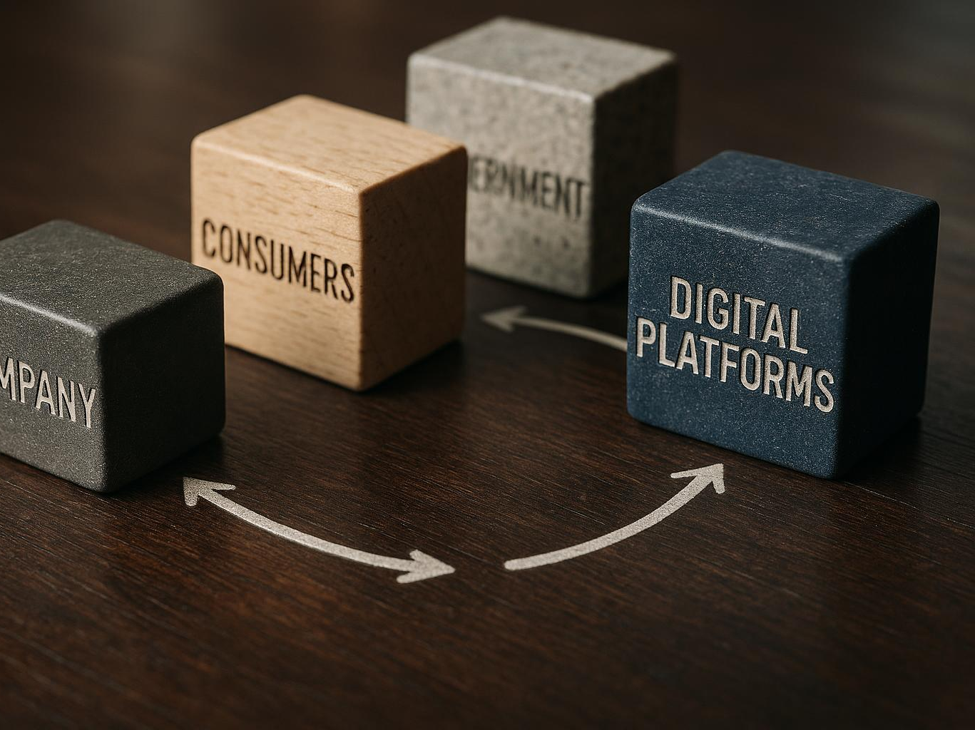
B2B, B2C, B2G, and platform models
Business-to-Business (B2B)
B2B involves selling products or services directly to other businesses rather than individual consumers.
Business-to-Consumer (B2C)
B2C targets individual consumers with products or services designed for personal use or consumption.
Business-to-Government (B2G)
B2G focuses on providing goods or services to government agencies and public sector clients.
Platform Business Models
Platform models create ecosystems that enable connections among multiple users benefiting from network effects.
Notes:
--- B2B focuses on selling to businesses, B2C targets individual consumers, B2G involves government clients, and platform models create ecosystems that connect multiple users through network effects. Image source: AI-generated

Slide 13
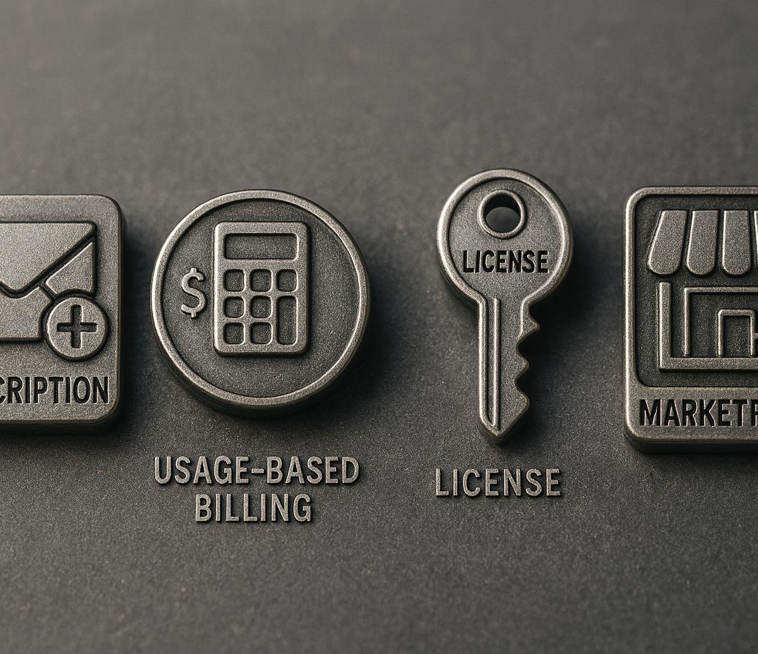
Subscription, usage-based, licensing, and marketplace models
Subscription Model
Generates recurring revenue through regular customer payments, ensuring steady cash flow.
Usage-Based Model
Charges customers based on consumption, promoting flexible and fair billing.
Licensing Model
Monetises intellectual property by granting rights to use products or technology.
Marketplace Model
Facilitates transactions between buyers and sellers, creating a platform for exchange.
Notes:
--- Subscription models generate recurring revenue, usage-based charge per consumption, licensing monetises intellectual property, and marketplace models facilitate transactions between buyers and sellers. Image source: AI-generated

Slide 14
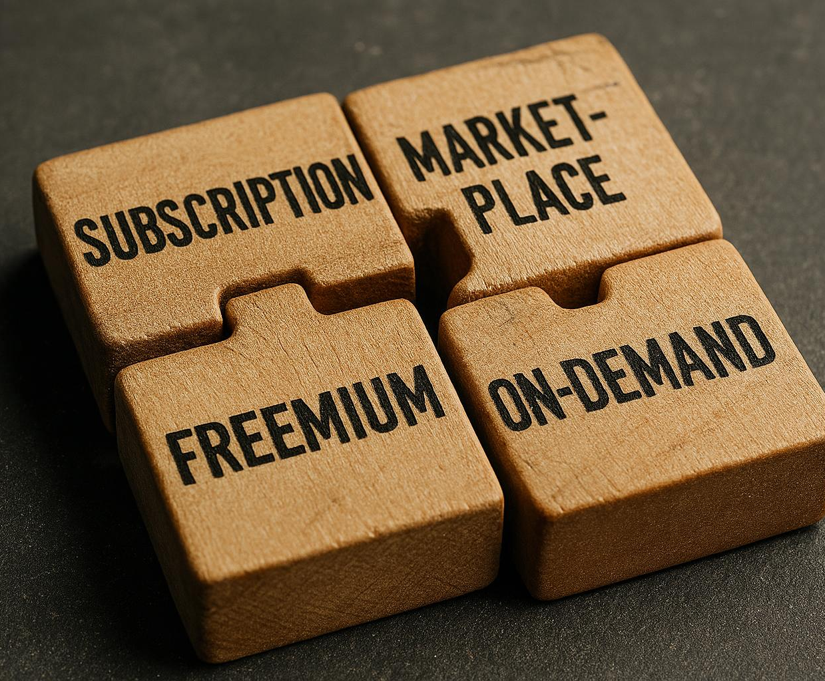
Hybrid and emerging models
Combination of Business Models
Startups blend subscription and marketplace models to create flexible revenue streams and enhance customer experiences.
Freemium Approach
Freemium models offer basic services for free while charging for premium features, attracting broad users and monetizing selectively.
On-Demand Services
On-demand services provide customers with immediate access to products or services, increasing convenience and satisfaction.
Notes:
--- Startups increasingly combine models, such as subscription plus marketplace, or adopt new approaches like freemium or on-demand services to tailor revenue streams and customer value propositions. Image source: AI-generated

Slide 15
Deep Dive: B2B, B2C, B2G, and Platform Models
Notes:
Here we explore the characteristics, advantages, and strategic considerations for B2B, B2C, B2G, and platform business models, highlighting their unique opportunities and challenges.

Slide 16

Characteristics and advantages of B2B
Longer Sales Cycles
B2B transactions typically have longer sales cycles due to complex decision-making processes.
Higher Transaction Values
B2B deals usually involve higher transaction values compared to consumer sales.
Strong Customer Relationships
Building long-term relationships is key in B2B for trust and repeated business.
Customised Solutions
B2B offers opportunities for tailored solutions to meet specific client needs.
Notes:
--- B2B models often involve longer sales cycles with higher transaction values, building strong customer relationships and offering opportunities for customised solutions. Image source: AI-generated

Slide 17

B2C and B2G: unique opportunities and challenges
B2C Market Characteristics
B2C targets mass markets with rapid product adoption but demands intensive marketing efforts.
B2G Market Characteristics
B2G involves navigating compliance and negotiation to secure stable, large government contracts.
Notes:
--- B2C focuses on mass markets with fast adoption but requires significant marketing. B2G requires compliance and negotiation but offers stable, large contracts. Image source: AI-generated

Slide 18

Platform models: network effects and value creation
User Interactions Facilitation
Platforms enable seamless interactions between diverse users, fostering engagement and collaboration.
Network Effects Growth
The value of a platform increases as more participants join, enhancing user benefits and engagement.
Scalable Value Creation
Network effects drive scalable growth by continuously increasing the platform's value for all users.
Notes:
--- Platforms thrive by facilitating interactions between users, creating network effects where the value grows as more participants join, leading to scalable growth. Image source: AI-generated

Slide 19
Subscription, Usage-Based, Licensing, and Marketplace Models
Notes:
This section delves into the revenue dynamics and strategic use of subscription, usage-based, licensing, and marketplace models in startups.

Slide 20

Subscription models: recurring revenue and retention
Predictable Revenue Stream
Subscription models generate steady and predictable income for startups through recurring payments.
Customer Loyalty
Subscription services encourage longer customer relationships, increasing loyalty and reducing churn.
Easier Financial Forecasting
Recurring revenue allows startups to make more accurate and confident financial forecasts.
Notes:
--- Subscription models provide predictable and recurring revenue streams, encouraging customer loyalty and easier forecasting for startups. Image source: AI-generated

Slide 21

Usage-based and licensing: monetising by consumption and IP
Usage-based Monetisation
Charges customers based on how much they consume, aligning cost with actual usage for fair pricing.
Licensing Monetisation
Uses intellectual property rights to generate revenue by granting usage rights or access licenses.
Flexible Monetisation Models
Combining usage and licensing models offers adaptability to different business needs and customer preferences.
Notes:
--- Usage-based models charge customers according to consumption levels, while licensing models capitalise on intellectual property rights, offering flexibility in monetisation. Image source: AI-generated

Slide 22
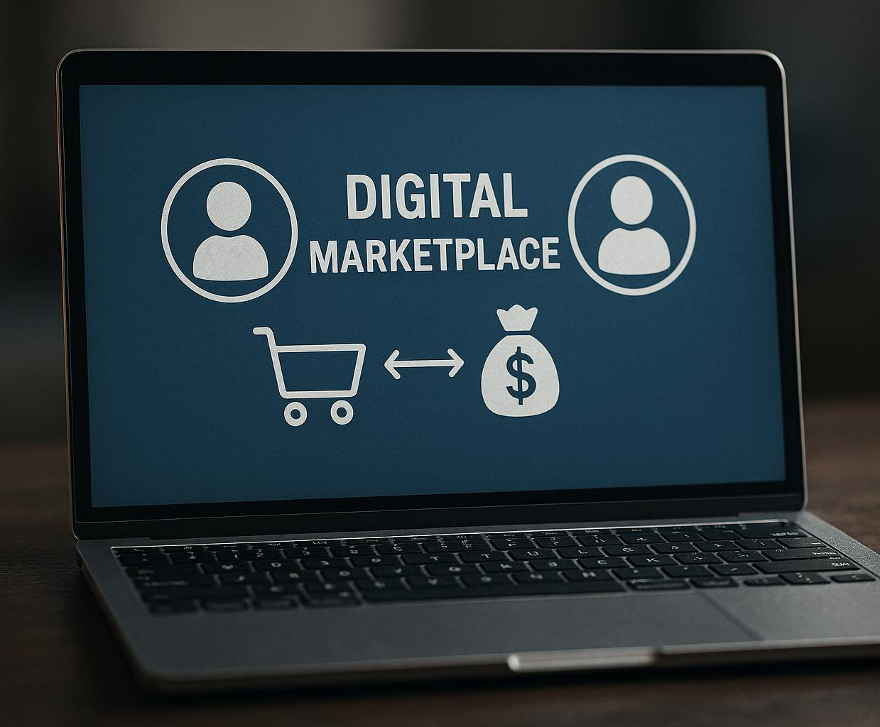
Marketplace models: matching buyers and sellers
Connecting Supply and Demand
Marketplaces efficiently link buyers and sellers to facilitate smooth commercial transactions.
Revenue Through Commissions
Marketplaces often generate income by charging transaction fees or commissions on sales.
Notes:
--- Marketplaces create value by efficiently connecting supply and demand, often earning revenue through transaction fees or commissions. Image source: AI-generated

Slide 23
Value Creation, Delivery, and Capture
Notes:
We explore how startups create value for customers, deliver it effectively, and capture value through revenue streams to sustain their business.

Slide 24

How startups create value for customers
Addressing Customer Needs
Startups focus on understanding and solving core customer problems effectively.
Innovative Products and Services
They develop creative and unique offerings that differentiate them from competitors.
Benefit Delivery
Startups provide benefits such as convenience, cost savings, and improved user experience.
Notes:
--- Startups create value by addressing customer needs with innovative products or services that offer benefits like convenience, cost savings, or improved experience. Image source: AI-generated

Slide 25

Delivering value: channels and customer relationships
Selecting Delivery Channels
Choosing appropriate channels like online platforms and retail stores ensures effective product delivery to customers.
Building Customer Relationships
Strong customer relationships foster satisfaction and loyalty, critical for long-term business success.
Notes:
--- Effective delivery involves selecting the right channels such as online platforms or retail and building strong customer relationships to ensure satisfaction and loyalty. Image source: AI-generated

Slide 26

Capturing value: revenue streams
Definition of Capturing Value
Capturing value means generating revenue through various streams to ensure financial sustainability.
Sales Revenue Stream
Sales involve direct exchange of goods or services for money, forming a primary revenue source.
Subscriptions and Licensing
Subscriptions and licensing create recurring revenue by granting access or usage rights over time.
Advertising Revenue
Advertising generates income by promoting products or services to targeted audiences.
Notes:
--- Capturing value refers to generating revenue through diverse streams like sales, subscriptions, licensing, or advertising, essential for financial sustainability. Image source: AI-generated

Slide 27
Business Model Canvas: Step-by-Step Explanation
Notes:
The Business Model Canvas is a strategic tool that visualises key components of a business model. This section provides an overview and practical guidance for startups.

Slide 28
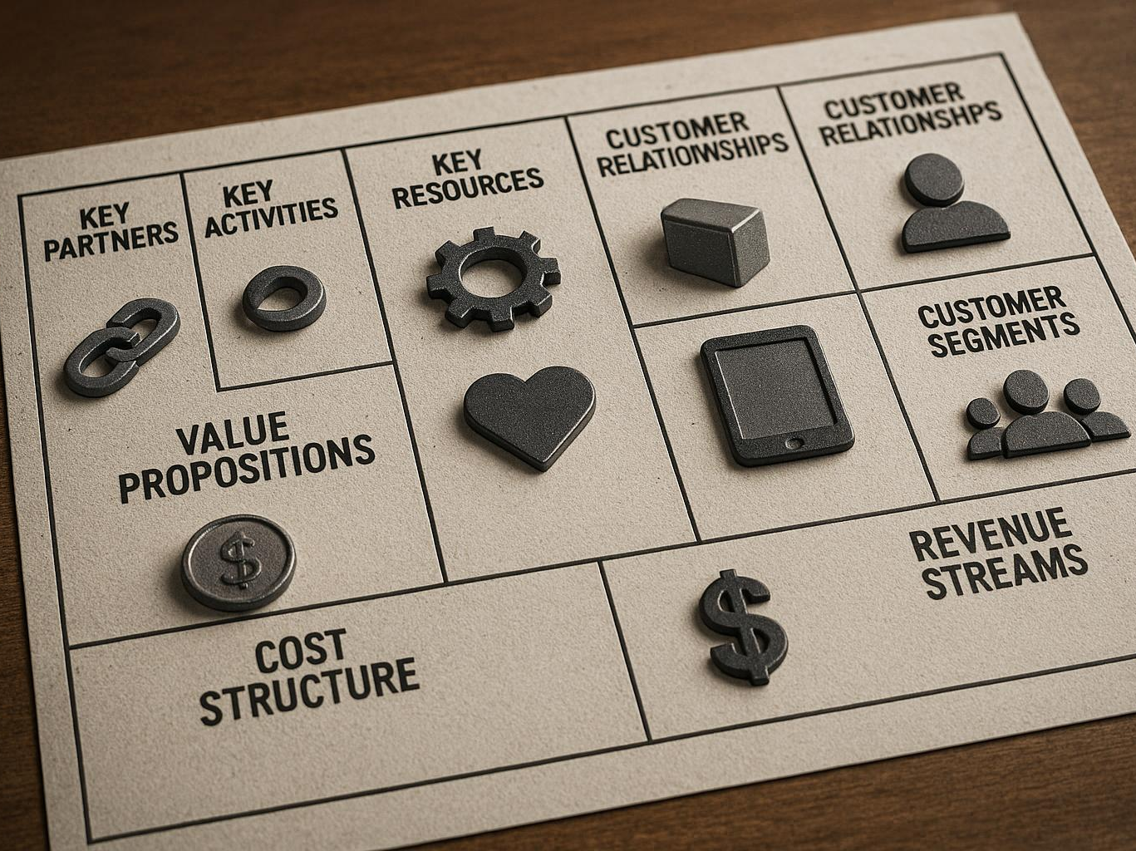
Overview of the Business Model Canvas
Nine Building Blocks
The Business Model Canvas consists of nine key components that collectively describe a business model.
Customer Segments and Value Propositions
Defines target customers and the unique value the business offers to meet their needs.
Channels and Customer Relationships
Describes how value is delivered and the types of relationships maintained with customers.
Revenue and Costs
Covers revenue streams and cost structures crucial for business profitability.
Notes:
--- The Canvas outlines nine building blocks including customer segments, value propositions, channels, customer relationships, revenue streams, key resources, activities, partners, and cost structures. Image source: AI-generated

Slide 29
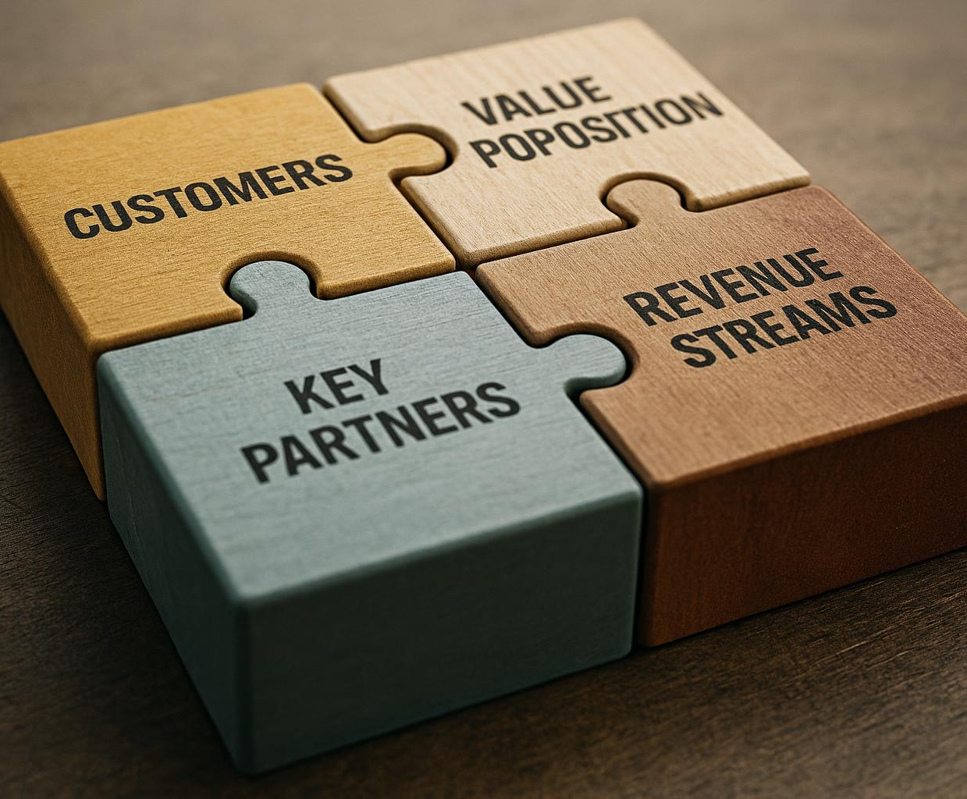
Breaking down each component
Critical Business Aspects
Each block signifies a fundamental part of the business crucial for success and sustainability.
Systematic Design
Understanding components enables startups to design business models methodically, ensuring alignment with goals.
Testing Assumptions
Breaking down components helps identify and test key business model assumptions effectively.
Notes:
--- Each block represents a critical aspect of the business. Understanding these components helps startups systematically design and test their business model assumptions. Image source: AI-generated

Slide 30

Practical example: filling out the Canvas
Canvas Completion Process
Demonstrating step-by-step how to fill out the business model Canvas effectively.
Aligning Value Propositions
Showing how to match value propositions with specific customer needs in the Canvas.
Considering Operational Factors
Including operational considerations to ensure business feasibility in the Canvas.
Notes:
--- We illustrate completing the Canvas with a startup example, demonstrating how to align value propositions with customer needs and operational considerations. Image source: AI-generated

Slide 31
Key Partners, Activities, and Resources
Notes:
Startups must identify strategic partners, core activities, and essential resources to successfully implement their business model and create value.

Slide 32

Identifying and leveraging key partners
Types of Key Partners
Key partners can be suppliers, distributors, or collaborators who enhance the startup’s strengths.
Risk Reduction
Partners help mitigate risks by sharing resources and responsibilities across operations.
Operational Optimisation
Leveraging partner capabilities leads to smoother and more efficient startup operations.
Notes:
--- Partners may include suppliers, distributors, or collaborators who complement the startup’s capabilities, helping reduce risks and optimise operations. Image source: AI-generated

Slide 33

Defining core business activities
Core Activities Overview
Core activities are essential tasks that enable a business to deliver its value proposition effectively.
Product Development
Product development is a primary activity that focuses on creating and improving products to meet customer needs.
Marketing and Customer Support
Marketing promotes products while customer support ensures satisfaction and retention.
Notes:
--- Core activities are the primary tasks required to deliver the value proposition, such as product development, marketing, or customer support. Image source: AI-generated

Slide 34

Mapping essential resources
Physical Resources
Physical resources encompass tangible assets like equipment, buildings, and inventory essential for business operations.
Intellectual Resources
Intellectual resources include patents, trademarks, copyrights, and proprietary knowledge that provide competitive advantage.
Human Resources
Human resources refer to the skills, expertise, and efforts of employees that drive business success.
Financial Resources
Financial resources consist of funds, investments, and capital essential for sustaining and growing the business.
Notes:
--- Resources include physical, intellectual, human, and financial assets critical for executing the business model effectively. Image source: AI-generated

Slide 35
Revenue Streams and Cost Structures
Notes:
Understanding different revenue types and cost behaviour is vital to maintain profitability and manage finances strategically.

Slide 36

Types of revenue streams for startups
Direct Sales
Startups generate revenue by selling products or services directly to customers, ensuring immediate cash flow.
Subscriptions
Subscription models provide recurring income by charging customers regularly for continued access to products or services.
Licensing
Licensing allows startups to earn revenue by granting permission to others to use their intellectual property.
Advertising and Fees
Advertising revenue and transaction fees generate income by monetizing user traffic or charging per transaction.
Notes:
--- Revenue can come from direct sales, subscriptions, licensing, advertising, or transaction fees, tailored to the startup’s business model. Image source: AI-generated

Slide 37
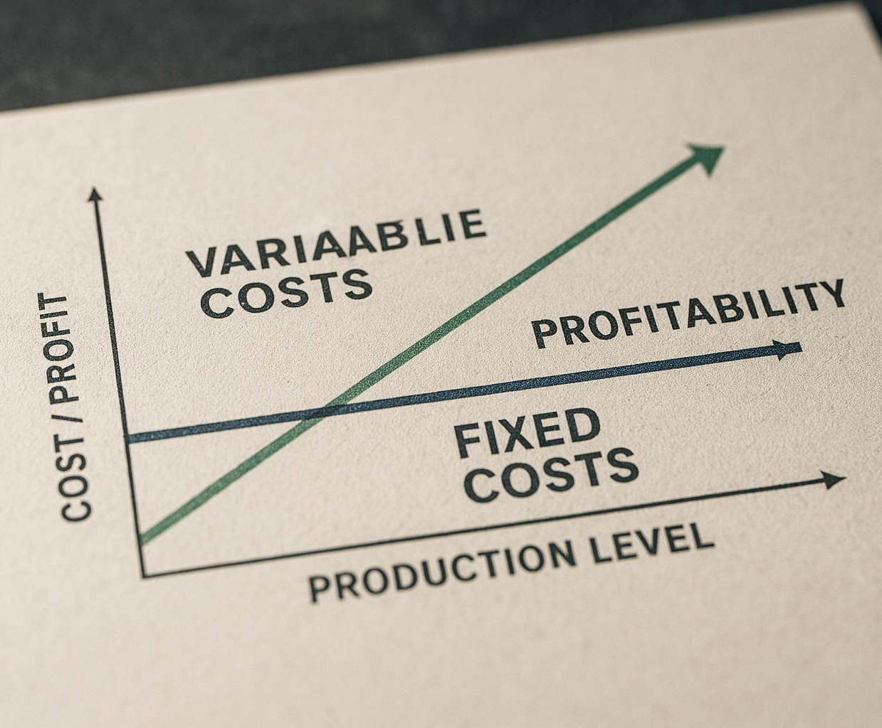
Understanding fixed and variable costs
Fixed Costs Characteristics
Fixed costs remain constant regardless of the level of production or output, ensuring predictable expenses.
Variable Costs Dynamics
Variable costs change directly with production output, increasing or decreasing as production fluctuates.
Impact on Profitability
Both fixed and variable costs influence a company's profitability and scalability decisions in production.
Notes:
--- Fixed costs remain constant regardless of production levels, while variable costs fluctuate with output, both impacting profitability and scalability. Image source: AI-generated

Slide 38
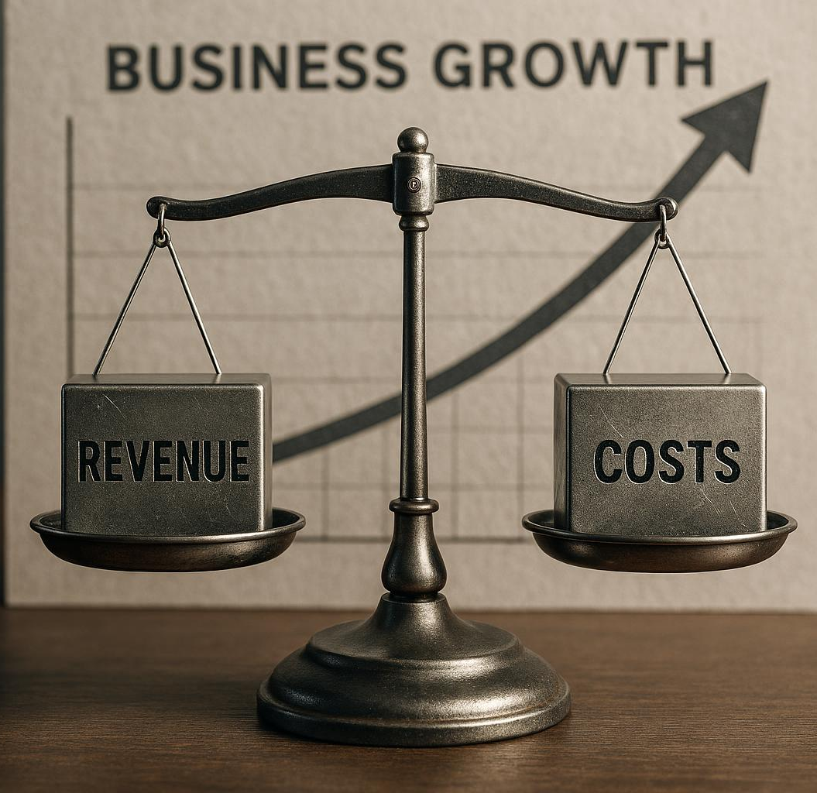
Optimising for profitability
Balance Revenue and Costs
Startups must balance generating revenue while managing expenses effectively to achieve profitability.
Scalable Business Models
Focus on scalable business models that allow growth without proportional cost increases.
Efficient Cost Management
Efficiently managing costs is key to maintaining high profit margins in startups.
Notes:
--- Startups should aim to balance revenue and costs, focusing on scalable models with high margins and efficient cost management. Image source: AI-generated

Slide 39
Scalability and Growth Logic
Notes:
The final section explains what makes a business model scalable, strategies for expanding a startup, and recognising key growth stages and inflection points.

Slide 40

What makes a model scalable
Revenue Growth Potential
Scalable models enable significant revenue growth without proportional increases in costs, enhancing profitability.
Leveraging Technology
Technology is a key enabler for scalability by automating processes and reaching wider audiences efficiently.
Network Effects
Network effects help scalable models grow as each additional user increases the value for all users.
Notes:
--- A scalable model can grow revenues significantly with limited incremental costs, often leveraging technology or network effects to achieve this. Image source: AI-generated

Slide 41

Strategies for scaling a startup
Market Expansion
Expanding into new markets helps startups reach a broader audience and increase revenue streams.
Product Diversification
Offering diverse products reduces risk and attracts different customer segments.
Partnership Development
Building strategic partnerships enhances resources, expertise, and market access.
Operational Optimisation
Optimising operations enables handling increased demand efficiently and maintaining quality.
Notes:
--- Scaling strategies include market expansion, product diversification, partnerships, and optimising operations to handle increased demand. Image source: AI-generated

Slide 42
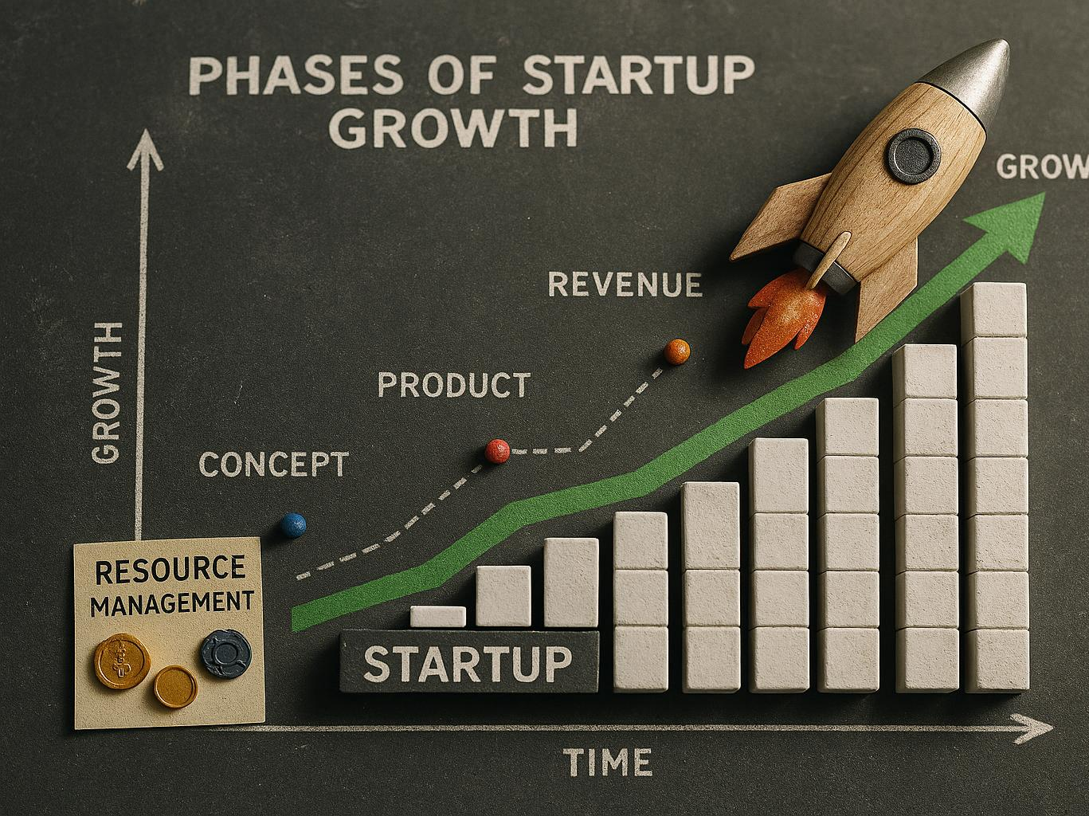
Growth stages and inflection points
Validation Phase
Startups validate their business model to confirm market fit and viability using limited resources.
Growth Phase
Rapid expansion requires scaling operations, increasing resources, and refining strategies to meet demand.
Notes:
--- Startups experience various growth phases, from validating their model to achieving rapid expansion, each requiring different approaches and resources. Image source: AI-generated

Slide 43
Conclusion
Importance of Business Models
Choosing the right business model is crucial for startup success and sustainable growth.
Understanding Key Components
Knowing the components and types of business models helps in refining and adapting strategies effectively.
Navigating Challenges and Opportunities
A refined business model equips entrepreneurs to overcome challenges and seize market opportunities.
Notes:
Building and scaling a successful startup relies on selecting and refining the right business model. Understanding the components, types, and strategies equips entrepreneurs to navigate challenges and seize opportunities.

