Slide 1
Customer Discovery and Problem Validation for Startups: A Practical Guide for Bachelor-Level Students
Dr. Zornitsa Yordanova
Effective techniques to validate startup ideas practically
Notes:
AI-generated content may be incorrect. --- This presentation provides a comprehensive guide to customer discovery and problem validation, essential steps for startup success. Designed for bachelor-level students, it covers key concepts, practical techniques, and best practices to help you validate your startup ideas effectively.

Slide 2
Agenda Overview
Understanding the Importance of Customer Discovery
Distinguishing Between Assumptions and Facts
The Meaning and Purpose of Validation
Types of Validation: Qualitative and Quantitative Approaches
Preparing for Effective Customer Interviews
Recruiting Suitable Interview Participants
Crafting Effective Interview Questions
Structuring and Flowing Customer Interviews
Avoiding Bias and Leading Questions in Interviews
Capturing Interview Notes and Key Insights
Notes:
We will explore the importance of customer discovery, distinguish assumptions from facts, understand validation purposes, review qualitative and quantitative validation methods, and learn how to prepare, conduct, and analyse customer interviews effectively.

Slide 3
Understanding the Importance of Customer Discovery
Notes:
Customer discovery is a crucial step in the startup journey, influencing investor confidence and startup success. This section highlights why investors prioritise validated ideas and how customer discovery impacts funding.

Slide 4

Why Customer Discovery Matters to Investors
Risk Reduction
Validated customer needs help investors minimize investment risks by ensuring product-market fit.
Market Understanding
Thorough customer discovery demonstrates deep insight into the target market and customer challenges.
Investment Likelihood
Startups showing evidence of customer discovery increase their chances of securing funding from investors.
Notes:
--- Investors seek startups with validated customer needs to reduce risk. Demonstrating thorough customer discovery shows market understanding and increases the likelihood of investment. Image source: AI-generated

Slide 5

Investor Expectations for Validated Ideas
Customer Insights Importance
Investors require authentic customer feedback to validate business ideas and reduce risk.
Evidence Over Assumptions
Backing ideas with evidence helps prove product-market fit and supports scalability.
Notes:
--- Investors expect founders to back their ideas with real customer insights and evidence, not just assumptions, to ensure product-market fit and scalability. Image source: AI-generated

Slide 6

Impact on Startup Success and Funding
Customer Discovery Importance
Understanding customer needs helps startups refine products and improve market fit effectively.
Product Refinement Benefits
Refining products based on discovery leads to better market acceptance and user satisfaction.
Enhanced Funding Opportunities
Successful discovery and product-market fit improve chances of attracting investor funding.
Startup Growth and Sustainability
Well-aligned products and funding contribute to long-term startup growth and sustainability.
Notes:
--- Successful customer discovery can lead to product refinement, better market fit, and increased funding opportunities, directly affecting startup sustainability and growth. Image source: AI-generated

Slide 7
Distinguishing Between Assumptions and Facts
Notes:
Differentiating assumptions from facts is essential for informed decision-making. This section explains how to identify and validate your startup hypotheses.

Slide 8

Defining Assumptions in Startup Ideation
Understanding Assumptions
Assumptions are unproven beliefs about customers or market conditions during startup ideation.
Importance of Recognition
Identifying assumptions directs validation efforts towards critical aspects of the business model.
Notes:
--- Assumptions are beliefs about your customers or market that lack evidence. Recognising these helps focus validation efforts on what really matters. Image source: AI-generated

Slide 9

How to Identify Factual Evidence
Definition of Factual Evidence
Factual evidence originates from data and validated insights collected directly from real customers.
Purpose of Factual Evidence
It confirms or refutes assumptions based on objective and verifiable information.
Notes:
--- Factual evidence comes from data and validated insights gathered from real customers, which can confirm or refute assumptions effectively. Image source: AI-generated

Slide 10
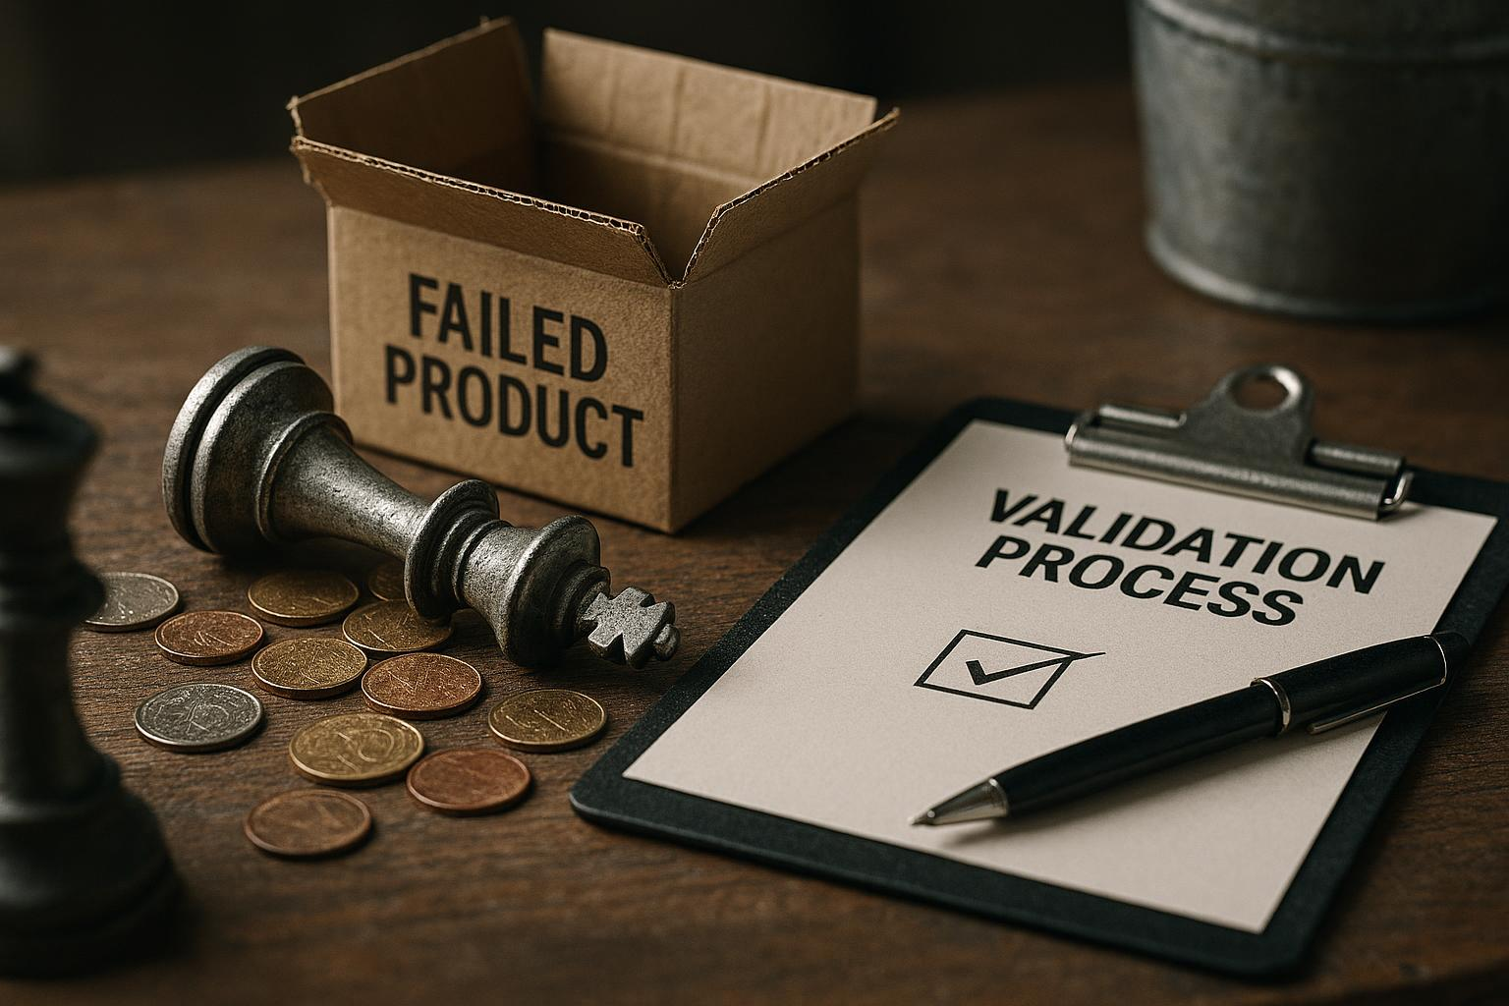
Risks of Building on Assumptions
Product Failure Risk
Building on unverified assumptions increases the likelihood of product failures in the market.
Wasted Resources
Assumptions can cause misallocation of time, money, and effort leading to wasted resources.
Missed Market Opportunities
Relying on assumptions may cause companies to miss valuable market opportunities and customer needs.
Need for Validation
Rigorous validation of assumptions is essential to avoid risks and ensure product success.
Notes:
--- Relying solely on assumptions can lead to product failures, wasted resources, and missed market opportunities, highlighting the need for rigorous validation. Image source: AI-generated

Slide 11
The Meaning and Purpose of Validation
Notes:
Validation confirms whether your startup ideas solve real problems for customers. This section clarifies what validation entails and its significance in the startup process.

Slide 12

What Validation Really Means
Definition of Validation
Validation involves testing ideas against real-world data to confirm their effectiveness and relevance.
Purpose of Validation
The goal is to ensure solutions truly meet customer needs and solve real problems effectively.
Notes:
--- Validation is the process of testing hypotheses against real-world data to ensure your solution addresses genuine customer needs. Image source: AI-generated

Slide 13

Validation in the Startup Context
Product Refinement
Validation enables startups to improve their product based on real customer feedback and insights.
Understanding Customer Behaviour
Startups gain critical understanding of customer needs and preferences through validation processes.
Risk Reduction
Validation helps minimize risks by testing ideas before large investments and scaling.
Notes:
--- In startups, validation helps refine the product, understand customer behaviour, and reduce risks before significant investment and scaling. Image source: AI-generated

Slide 14

Benefits of Robust Validation
Improved Decision-Making
Robust validation helps startups make better decisions by aligning products with customer needs and market demand.
Increased Investor Confidence
Effective validation builds investor trust by demonstrating a viable market fit and reducing risks.
Higher Startup Success
Validation raises the chances of startup success by ensuring offerings meet real market demands.
Notes:
--- Effective validation improves decision-making, increases investor confidence, and enhances the likelihood of startup success by aligning offerings with market demand. Image source: AI-generated

Slide 15
Types of Validation: Qualitative and Quantitative Approaches
Notes:
Validation can be qualitative or quantitative. This section outlines these approaches and how to select the appropriate method for your startup.

Slide 16

Overview of Qualitative Validation
Customer Insights Gathering
Qualitative validation focuses on collecting detailed customer insights through direct interactions like interviews.
Observation Techniques
Observations help understand customer motivations and behaviours in natural settings during qualitative validation.
Notes:
--- Qualitative validation involves gathering detailed customer insights through interviews and observations to understand motivations and behaviours. Image source: AI-generated

Slide 17
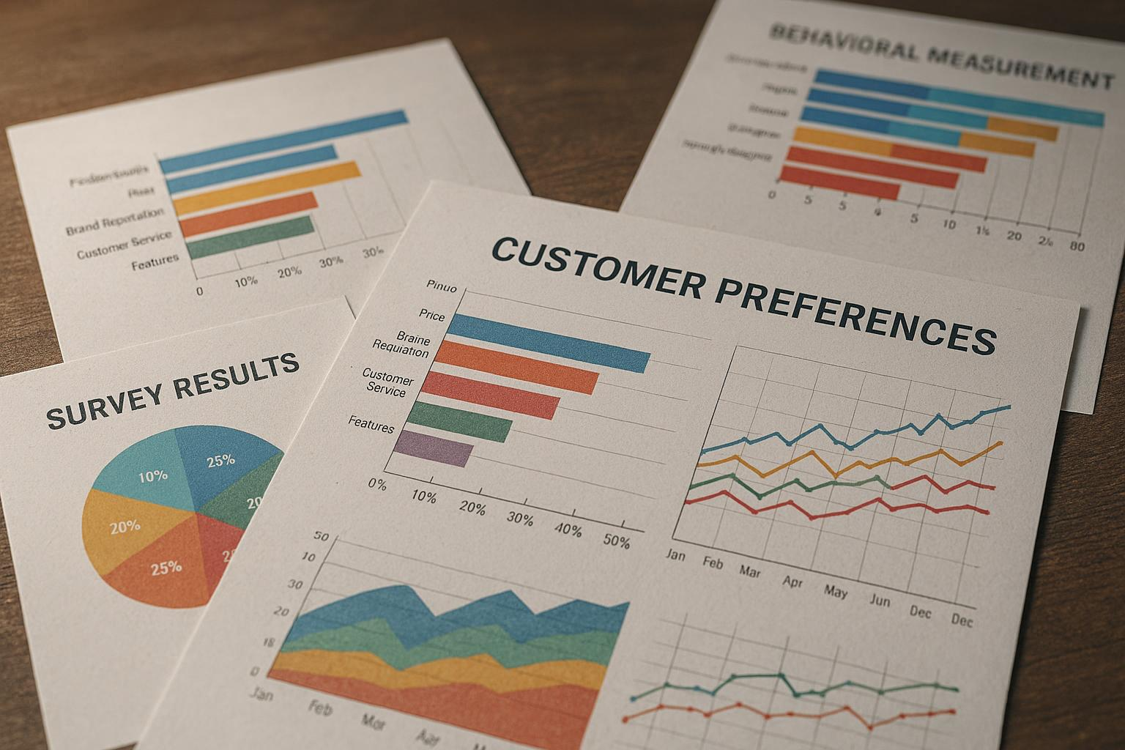
Quantitative Validation Techniques
Numerical Data Utilisation
Quantitative validation relies on numerical data to objectively assess customer preferences and behaviours.
Surveys and Analytics
Surveys and data analytics tools collect large-scale customer information for precise validation.
Notes:
--- Quantitative validation uses numerical data, such as surveys and analytics, to measure customer preferences and behaviours at scale. Image source: AI-generated

Slide 18
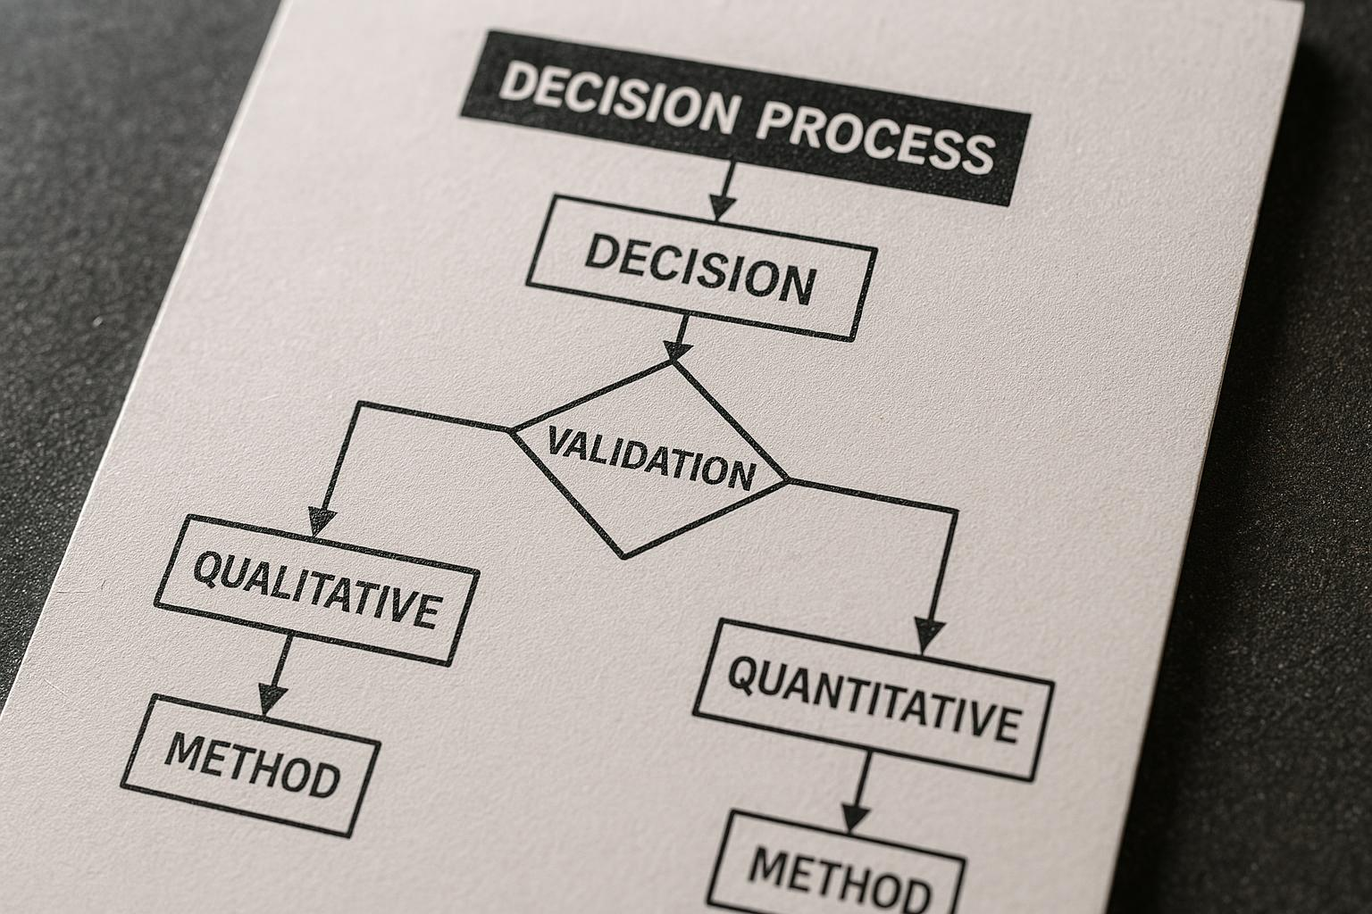
Choosing the Right Validation Method
Method Selection Criteria
Choose validation methods based on startup stage, objectives, and problem characteristics.
Qualitative Methods Overview
Qualitative methods explore insights, opinions, and motivations useful in early startup stages.
Quantitative Methods Overview
Quantitative methods provide measurable data and statistical analysis, ideal for testing hypotheses.
Notes:
--- Selecting between qualitative and quantitative methods depends on your startup stage, objectives, and the nature of the problem you are validating. Image source: AI-generated

Slide 19
Preparing for Effective Customer Interviews
Notes:
Proper preparation is key to successful interviews. This section covers setting objectives, researching your audience, and crafting interview guides.

Slide 20

Setting Clear Interview Objectives
Define Learning Goals
Clearly identify what information you want to obtain from interviews to guide the process.
Focus Interview Questions
Develop questions that directly align with the objectives to gather relevant data.
Support Validation Goals
Ensure collected data effectively supports the validation of your project's hypotheses or assumptions.
Notes:
--- Define what you want to learn from interviews to focus questions and ensure the data collected supports your validation goals. Image source: AI-generated

Slide 21

Researching Your Target Audience
Know Your Audience
Understanding the audience allows for tailored interviews that resonate with their specific needs and experiences.
Improve Feedback Relevance
Tailored interviews enhance the quality and usefulness of feedback received from participants.
Notes:
--- Understanding your audience helps tailor interviews to their context and increases the relevance and quality of feedback. Image source: AI-generated

Slide 22

Designing Interview Guides
Structured Interview Guides
Design interview guides that are well-organized and focused on key validation topics to ensure comprehensive data collection.
Open-Ended Questions
Use open-ended questions to encourage detailed and thoughtful responses from interviewees, yielding richer insights.
Notes:
--- Create structured guides with open-ended questions that encourage detailed responses and cover your key validation points. Image source: AI-generated

Slide 23
Recruiting Suitable Interview Participants
Notes:
Finding the right participants ensures you gather relevant insights. This section discusses profiles, outreach, and ethical considerations.

Slide 24

Identifying Ideal Customer Profiles
Define Target Characteristics
Identify key traits that best represent your ideal customers for focused marketing and recruitment.
Focus Recruitment Efforts
Concentrate efforts on segments that align with your ideal customer profile to improve efficiency.
Notes:
--- Define characteristics of customers who best represent your target market to focus your recruitment efforts effectively. Image source: AI-generated

Slide 25

Outreach Strategies and Channels
Social Media Outreach
Social media platforms are effective channels to engage and reach a wide audience quickly and interactively.
Email Communication
Email provides a direct and professional method to contact and follow up with potential participants.
Networking Channels
Utilizing networks and professional groups helps efficiently connect with targeted participants and communities.
Notes:
--- Use appropriate channels like social media, email, or networks to contact potential participants efficiently. Image source: AI-generated

Slide 26

Incentives and Ethics in Recruitment
Fair Incentives
Provide participants with fair and appropriate incentives to encourage participation without coercion.
Transparency in Recruitment
Maintain transparent communication about recruitment goals, procedures, and incentives to build trust.
Respecting Privacy and Consent
Ensure participants’ privacy is protected and obtain informed consent before recruitment.
Notes:
--- Offer fair incentives while ensuring transparency and respecting participants’ privacy and consent. Image source: AI-generated

Slide 27
Crafting Effective Interview Questions
Notes:
Well-designed questions elicit useful data. This section highlights how to avoid pitfalls and align questions with your validation aims.

Slide 28

Characteristics of Good vs Bad Interview Questions
Good Interview Questions
Good questions are clear, open-ended, and unbiased, facilitating detailed and honest responses from interviewees.
Bad Interview Questions
Bad questions are leading, confusing, or restrictive, potentially biasing answers or limiting information gathered.
Notes:
--- Good questions are clear, open-ended, and unbiased, while bad questions may lead, confuse, or limit responses. Image source: AI-generated

Slide 29

Examples and Pitfalls to Avoid
Avoid Yes/No Questions
Yes/no questions limit responses and reduce the depth of feedback or discussion.
Avoid Leading Questions
Questions suggesting answers hinder honest and detailed feedback from participants.
Encourage Storytelling
Use open-ended questions that promote storytelling and rich, detailed feedback.
Notes:
--- Avoid yes/no questions or those suggesting answers; strive for questions that encourage storytelling and detailed feedback. Image source: AI-generated

Slide 30
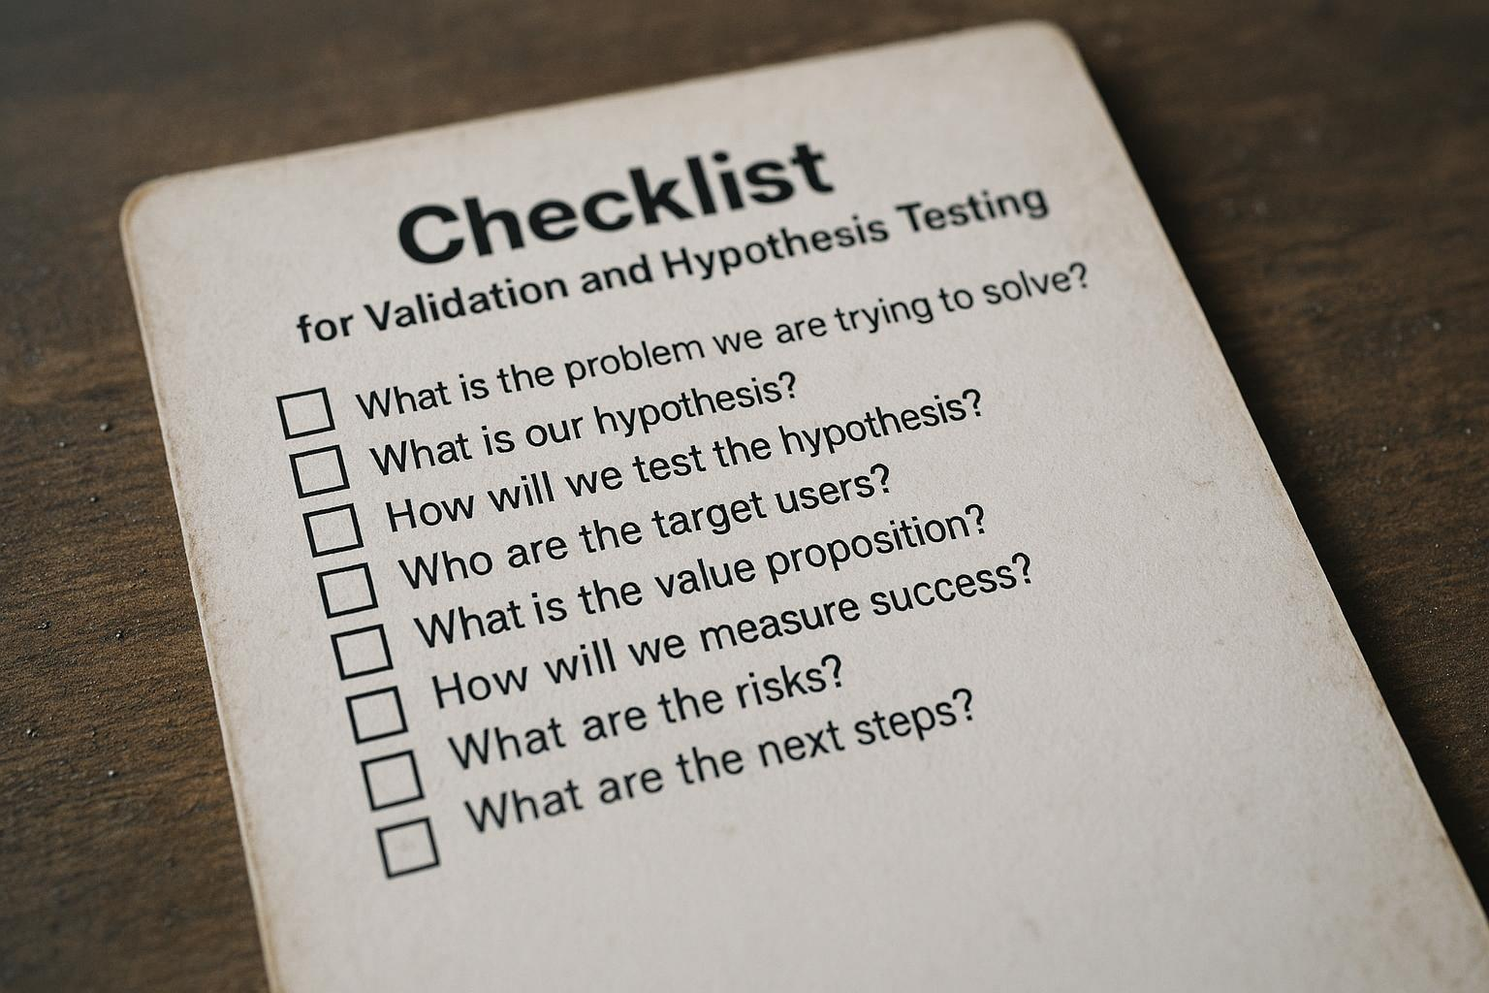
Aligning Questions with Validation Goals
Purposeful Question Design
Design questions that have a clear purpose related to the specific hypothesis being tested.
Link to Validation Goals
Ensure each question directly supports validation of assumptions or hypotheses for accurate results.
Notes:
--- Ensure every question is purposeful and linked directly to the hypotheses or assumptions you need to validate. Image source: AI-generated

Slide 31
Structuring and Flowing Customer Interviews
Notes:
A well-structured interview builds rapport, stays on track, and maximises insight. This section guides the interview process.

Slide 32

Recommended Interview Structure
Start with Introductions
Begin the interview by introducing participants to build rapport and set a comfortable tone.
Core Questions
Focus on essential questions that gather detailed and relevant information from the interviewee.
Closing Remarks
End the interview with closing remarks to summarise and ensure all points are covered.
Notes:
--- Start with introductions, move to core questions, and finish with closing remarks to ensure a smooth flow and complete insights. Image source: AI-generated

Slide 33

Building Rapport and Trust
Create Comfortable Environment
Establish a welcoming space that fosters ease and openness in conversations.
Show Empathy
Demonstrate understanding and compassion to make others feel valued and heard.
Active Listening
Listen carefully and attentively to encourage honest and open responses.
Notes:
--- Create a comfortable environment by showing empathy and listening actively, encouraging honest and open responses. Image source: AI-generated

Slide 34

Managing Interview Flow and Time
Maintain Interview Focus
Ensure the interview stays on topic to cover essential subjects efficiently.
Allow Flexibility
Adapt the flow to participant responses while guiding the discussion purposefully.
Respect Time
Manage interview duration carefully to value the participant’s schedule.
Notes:
--- Keep the interview focused yet flexible, respecting the participant’s time while covering all key topics effectively. Image source: AI-generated

Slide 35
Avoiding Bias and Leading Questions in Interviews
Notes:
Minimising bias is critical for objective data. This section highlights common biases and strategies to maintain neutrality.

Slide 36

Types of Bias in Customer Interviews
Confirmation Bias
Occurs when interviewers seek information that confirms their existing beliefs, leading to skewed results.
Social Desirability Bias
Respondents answer questions in a manner that will be viewed favourably by others, affecting honesty.
Interviewer Bias
Interviewer’s behaviour or tone influences respondent’s answers, impacting data validity.
Notes:
--- Be aware of confirmation, social desirability, and interviewer biases that can skew data and affect results validity. Image source: AI-generated

Slide 37

Strategies to Avoid Leading Questions
Use Neutral Language
Employ neutral and unbiased language to avoid influencing participant answers during questioning.
Ask Open-ended Questions
Use open-ended questions to encourage authentic, detailed responses without leading the participant.
Notes:
--- Use neutral language and open-ended questions to prevent influencing participant answers, ensuring authentic feedback. Image source: AI-generated

Slide 38

Ensuring Objective Data Collection
Accurate Interview Recording
Ensure all interviews are recorded precisely to capture complete and reliable data.
Maintaining Neutrality
Remain neutral during data collection to avoid influencing responses or outcomes.
Critical Data Review
Review collected data critically to identify biases and ensure findings are valid.
Notes:
--- Record interviews accurately, remain neutral, and review data critically to maintain the integrity of your findings. Image source: AI-generated

Slide 39
Capturing Interview Notes and Key Insights
Notes:
Effective note-taking and insight organisation are crucial for analysing and applying interview data.

Slide 40
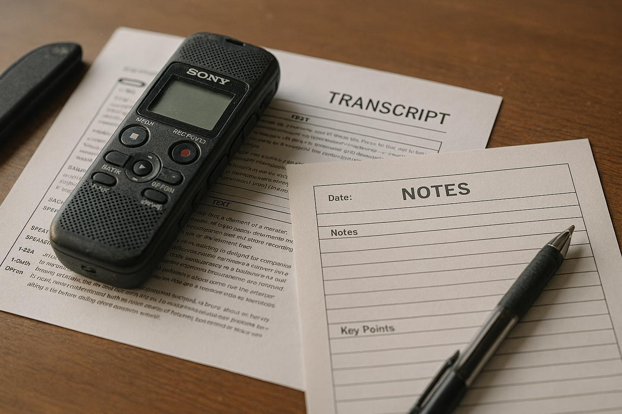
Methods for Accurate Note-Taking
Use of Recordings
Record interviews to ensure accurate and complete capture of information for later review.
Transcripts for Accuracy
Transcripts provide a reliable written record that helps verify and analyze interview data thoroughly.
Structured Templates
Templates guide note-taking, helping organise key information systematically and consistently.
Notes:
--- Use tools like recordings, transcripts, or structured templates to capture detailed and reliable interview data. Image source: AI-generated

Slide 41
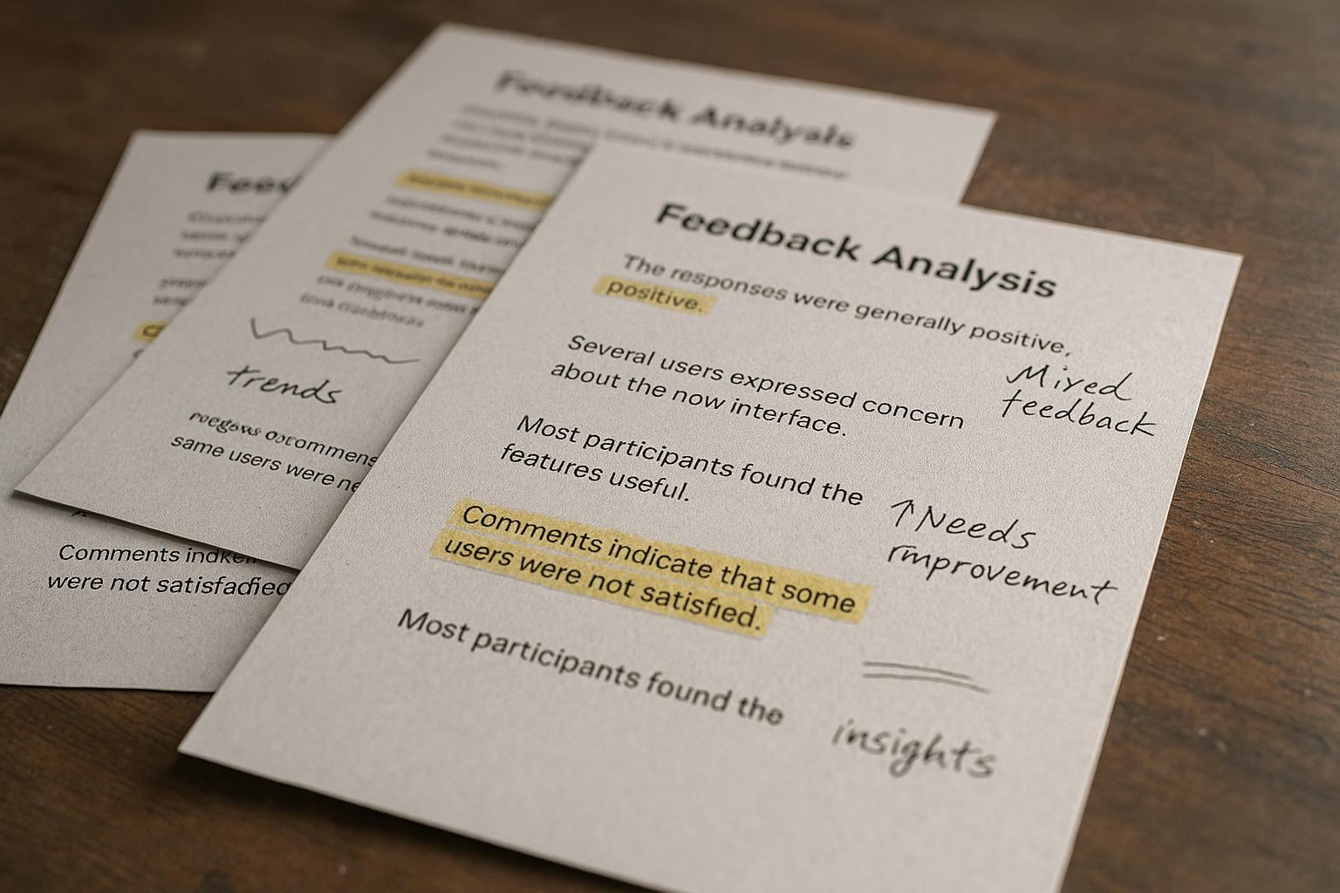
Highlighting Critical Feedback
Important Quotes Identification
Spot and highlight significant quotes that provide valuable feedback during validation.
Recurring Themes Recognition
Detect patterns and recurring themes within the feedback to guide further improvements.
Surprising Insights Discovery
Identify unexpected insights that can critically influence validation decisions.
Notes:
--- Identify and mark important quotes, recurring themes, and surprising insights that inform your validation process. Image source: AI-generated

Slide 42

Organising Insights for Analysis
Systematic Note Collation
Gather all relevant notes systematically to ensure comprehensive data collection for analysis.
Categorisation for Patterns
Categorise notes effectively to identify patterns and insights that guide strategic decisions.
Data-Driven Decisions
Use the identified patterns to make informed and data-driven decisions for startup growth.
Notes:
--- Collate and categorise notes systematically to spot patterns and make data-driven decisions for your startup. Image source: AI-generated

Slide 43
Conclusion: Mastering Customer Discovery and Validation
Customer Insight Importance
Understanding customer needs is vital for developing effective and market-relevant solutions that solve real problems.
Investor Confidence
Validated problems and solutions increase investor trust and support for startup ventures.
Enhanced Success Chances
Comprehensive discovery and validation processes significantly boost startup success rates and market acceptance.
Notes:
Mastering customer discovery and problem validation equips startups with critical insights to develop solutions that truly meet market needs, increase investor confidence, and enhance chances of success.

