Slide 1
Designing the Value Proposition and Business Model: A Practical Guide for Startup Students
Essential strategies for creating compelling startup offerings
Dr. Zornitsa Yordanova
Notes:
AI-generated content may be incorrect. --- This presentation provides a comprehensive guide for startup students on designing effective value propositions and business models. We will explore key concepts, frameworks, and practical steps to help you develop compelling offerings that resonate with customers and stand out in the competitive landscape.

Slide 2
Presentation Roadmap
Understanding the Value Proposition
Applying Jobs-to-Be-Done Thinking
Exploring Pains, Gains, and Solutions
Value Proposition Canvas: A Step-by-Step Guide
Translating Insights into Clear Value
Analysing the Competitive Landscape
Substitutes, Status Quo, and Customer Choice
Differentiation and Strategic Positioning
Why Customers Would Choose Your Solution
Lean Canvas and Business Model Canvas Overview
Notes:
We will cover understanding the value proposition, applying jobs-to-be-done thinking, exploring customer pains and gains, using the Value Proposition Canvas, translating insights into clear value, analysing the competitive landscape, understanding substitutes and status quo, differentiating strategically, why customers choose your solution, and an overview of Lean and Business Model Canvases.

Slide 3
Understanding the Value Proposition
Notes:
A value proposition defines the unique value your startup offers to customers. It is essential to understand what it is and what it is not, and why it plays a critical role in startup success.

Slide 4
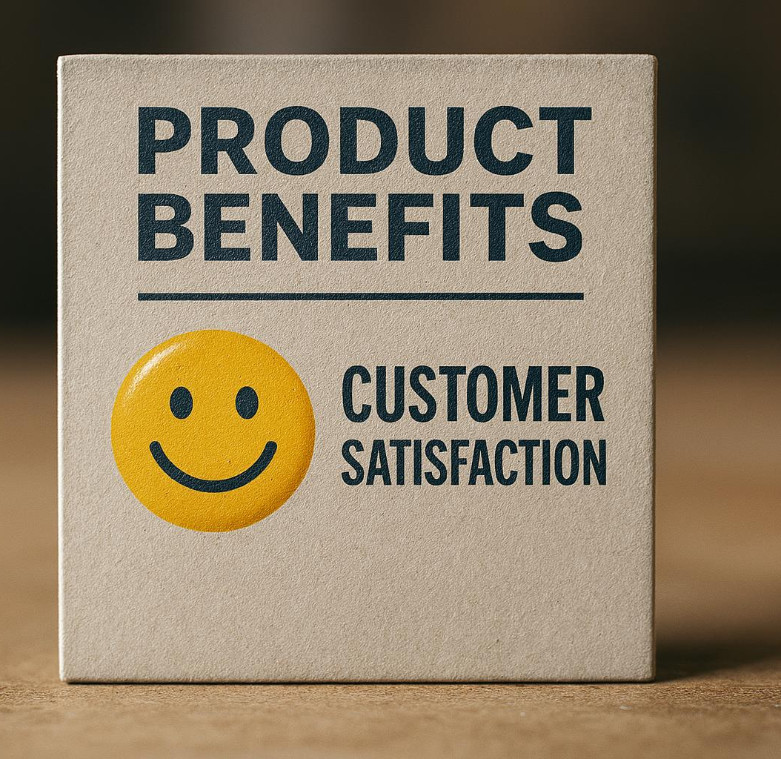
Defining what a value proposition is
Clear Customer Benefit
A value proposition clearly states how a product solves customer problems or improves their situation effectively.
Specific Delivered Benefits
It outlines specific benefits the product delivers to meet customer needs and expectations.
Motivates Customer Purchase
A value proposition explains why the ideal customer should choose your product over competitors.
Notes:
--- A value proposition is a clear statement that explains how your product solves customers' problems or improves their situation, delivers specific benefits, and tells the ideal customer why they should buy from you. Image source: AI-generated

Slide 5
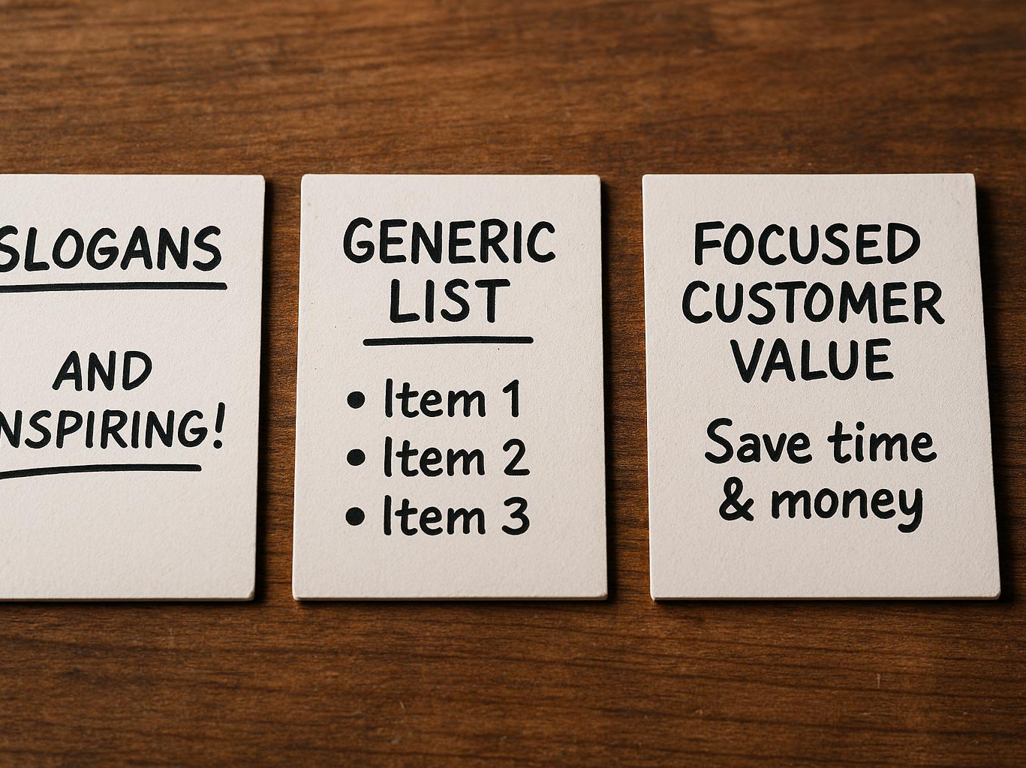
What a value proposition is not
Not Just a Slogan
A value proposition is more than a catchy slogan; it must clearly communicate customer benefits.
Not a Feature List
Listing features alone does not create value; focus on how features solve customer problems.
Must Address Customer Needs
A value proposition must directly address and meet the unique needs of customers effectively.
Differentiates from Competitors
It clearly distinguishes your offering from competitors to attract and retain customers.
Notes:
--- It is not just a slogan, a feature list, or a generic statement. It must be focused on the customer’s needs and differentiate your offering from competitors. Image source: AI-generated

Slide 6

The role of a value proposition in startup success
Guiding Product Development
A clear value proposition directs product features to meet customer needs effectively and efficiently.
Supporting Marketing Strategies
Value propositions help craft marketing messages that resonate and attract the target audience.
Enhancing Customer Retention
Communicating unique value clearly helps startups retain customers by meeting their expectations.
Notes:
--- An effective value proposition guides product development, marketing, and sales efforts, helping startups attract and retain customers by clearly communicating unique value. Image source: AI-generated

Slide 7
Applying Jobs-to-Be-Done Thinking
Notes:
Jobs-to-be-Done (JTBD) thinking helps understand the underlying tasks customers want to accomplish, their pains, and desired gains, enabling startups to design meaningful solutions.

Slide 8
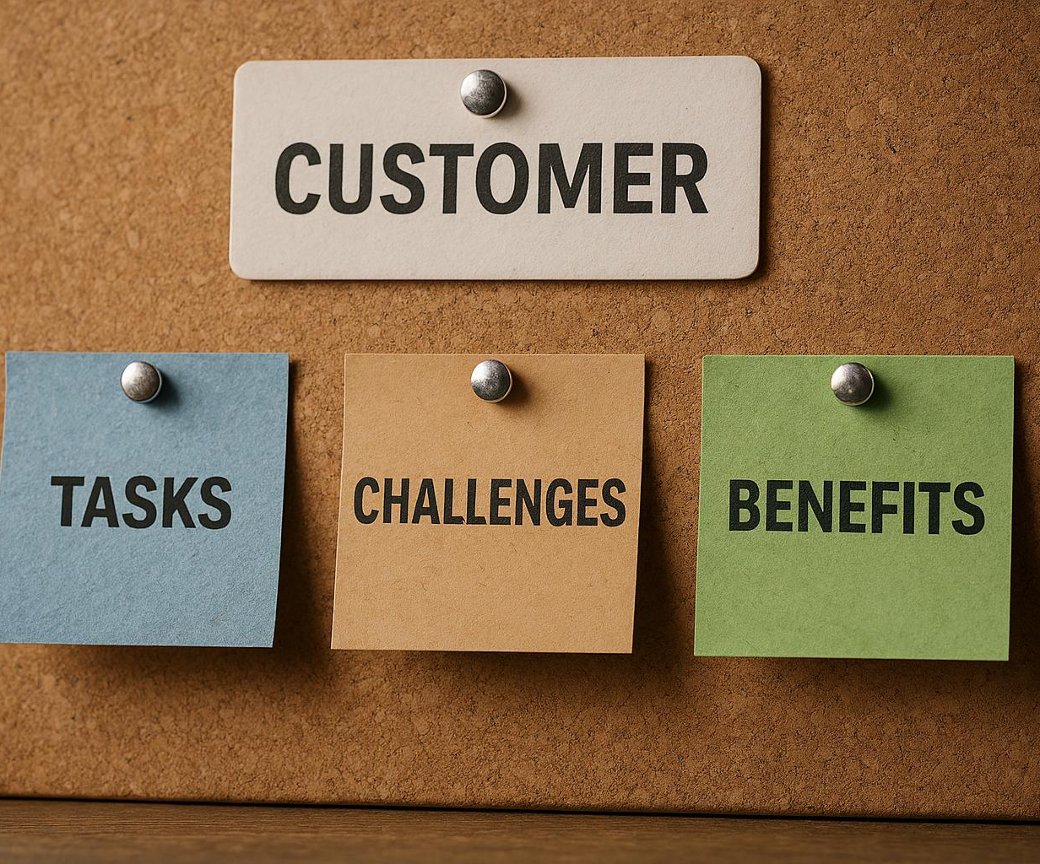
Understanding customer jobs, pains, and gains
Customer Jobs Definition
Customer jobs are the specific tasks or problems customers aim to address with products or services.
Customer Pains Explained
Pains represent the obstacles and frustrations customers experience while trying to complete their jobs.
Customer Gains Overview
Gains are the positive outcomes or benefits customers wish to achieve through products or services.
Notes:
--- Customer jobs are the tasks or problems customers seek to solve. Pains are obstacles or frustrations, while gains are the benefits customers want to achieve. Image source: AI-generated

Slide 9

Identifying core problems your startup addresses
Customer Problem Focus
Identify the main problems your customers face that your startup aims to solve effectively.
Creating Real Value
Ensure your product or service delivers real value by addressing significant customer needs.
Driving Demand
Solving core problems generates genuine demand and a strong customer base for your startup.
Notes:
--- Focus on the key customer problems that your product or service can effectively solve to create real value and demand. Image source: AI-generated

Slide 10

Mapping customer jobs to potential solutions
Align Offerings with Customer Jobs
Match your products and services precisely to the tasks customers want to accomplish for higher satisfaction.
Address Customer Pains
Identify and solve customer pain points to reduce friction and improve the user experience.
Enhance Customer Gains
Focus on enhancing benefits and positive outcomes customers seek from your offerings.
Notes:
--- Align your offerings with the specific jobs customers need done, ensuring your solutions address pains and enhance gains. Image source: AI-generated

Slide 11
Exploring Pains, Gains, and Solutions
Notes:
Deeply understanding customer pains and desired gains is vital to designing solutions that truly matter and resonate with your target market.

Slide 12

Uncovering customer pains
Emotional Challenges
Understand customers' feelings and frustrations to address their emotional needs effectively.
Functional Challenges
Identify practical problems customers encounter in using products or services and provide solutions.
Financial Challenges
Recognise customers' financial constraints and offer cost-effective alternatives or value propositions.
Notes:
--- Identify the emotional, functional, and financial challenges customers face which your startup can alleviate. Image source: AI-generated

Slide 13

Recognising desired gains
Customer Convenience
Customers often seek convenience that simplifies their tasks and saves them time effectively.
Cost Savings
Reducing expenses or maximizing value is a major benefit customers aim to achieve.
Enhanced Experience
Improving the overall user or customer experience adds value and satisfaction.
Notes:
--- Determine the outcomes or benefits customers seek to gain, such as convenience, cost savings, or enhanced experience. Image source: AI-generated

Slide 14

Designing solutions that matter
Address Customer Pains
Focus on developing solutions that alleviate specific customer pain points effectively.
Deliver Valued Gains
Ensure your product or service provides meaningful benefits that customers truly value.
Differentiate Value Proposition
Create unique value propositions to stand out from competitors in the market.
Notes:
--- Develop products or services that effectively reduce pains and deliver valued gains to differentiate your value proposition. Image source: AI-generated

Slide 15
Value Proposition Canvas: A Step-by-Step Guide
Notes:
The Value Proposition Canvas is a practical tool that helps startups design, test, and iterate their value propositions by focusing on customer profiles and offerings.

Slide 16
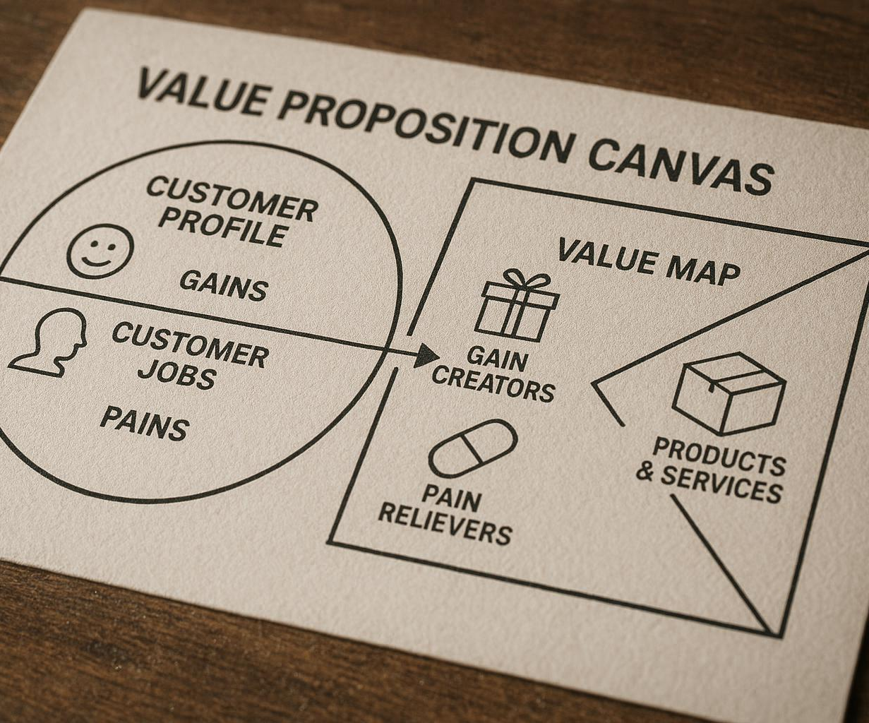
Overview of the Value Proposition Canvas
Customer Profile Components
The customer profile includes jobs, pains, and gains that describe customer activities and challenges.
Value Map Elements
The value map consists of products, pain relievers, and gain creators addressing customer needs.
Alignment for Success
Ensuring alignment between the customer profile and value map is essential for delivering successful value propositions.
Notes:
--- The canvas consists of two parts: the customer profile (jobs, pains, gains) and the value map (products, pain relievers, gain creators), which must align for success. Image source: AI-generated

Slide 17
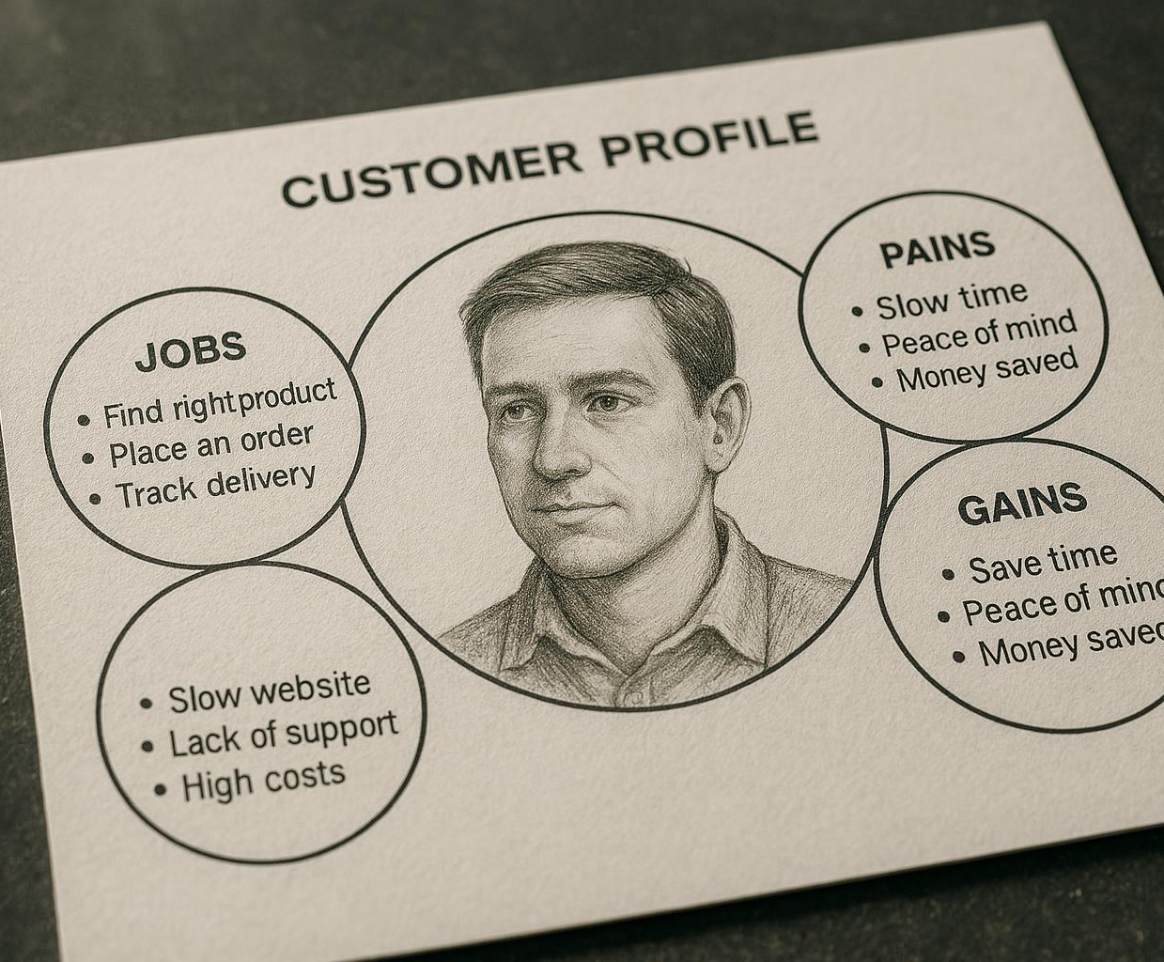
Filling out the customer profile
Customer Jobs
Identify the tasks and goals customers aim to achieve with the product or service.
Customer Pains
Understand the challenges and frustrations customers face while trying to complete their jobs.
Customer Gains
Recognize the benefits and positive outcomes customers expect from the product or service.
Notes:
--- Document the specific jobs customers want to accomplish, their pains, and gains to understand their needs comprehensively. Image source: AI-generated

Slide 18
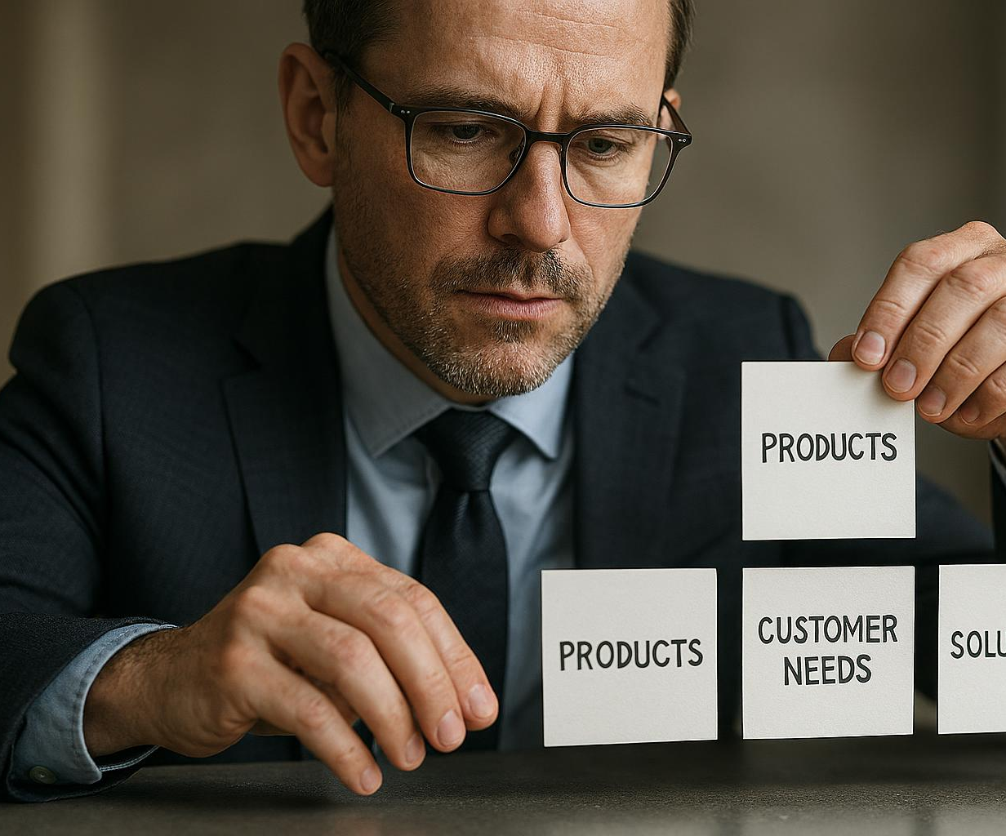
Aligning your offering with customer needs
Customer Jobs Understanding
Identify key customer tasks and challenges to tailor your offerings precisely to their needs.
Pain Relievers Focus
Develop products and services that effectively alleviate specific customer pain points.
Gain Creators Alignment
Design offerings that add value by creating benefits customers desire.
Notes:
--- Ensure your products and services map to pain relievers and gain creators that address the identified customer jobs effectively. Image source: AI-generated

Slide 19
Translating Insights into Clear Value
Notes:
Synthesising research insights into a compelling value proposition statement and communicating it clearly is key to stakeholder buy-in and customer engagement.

Slide 20

Synthesising research findings
Customer Data Integration
Combine diverse customer data sources to gain comprehensive insights into user behaviour and preferences.
Market Research Analysis
Analyse market research to identify trends and opportunities relevant to your startup's growth.
Identify Core Value Drivers
Use research findings to pinpoint core value drivers that shape customer decisions and business success.
Notes:
--- Combine customer data and market research to identify core value drivers and opportunities for your startup. Image source: AI-generated

Slide 21
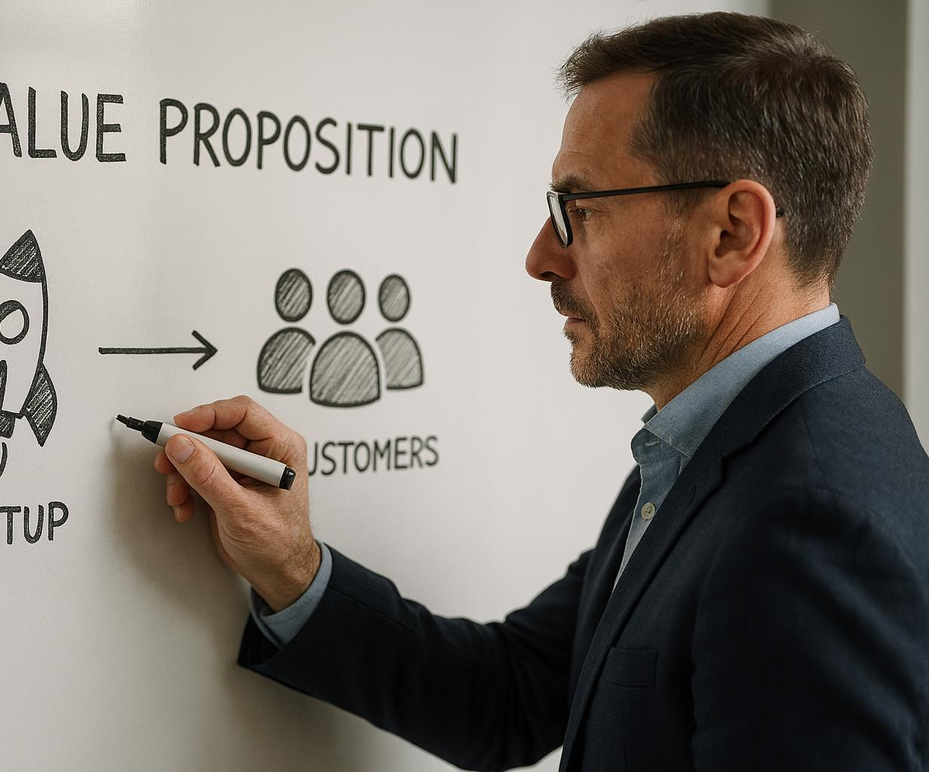
Formulating a compelling value proposition statement
Clear and Concise Messaging
Create a brief statement that clearly expresses your startup's unique value to customers.
Unique Customer Benefits
Highlight how your startup uniquely benefits customers compared to competitors.
Notes:
--- Craft a concise statement that communicates the unique benefits and value your startup delivers to customers. Image source: AI-generated

Slide 22

Communicating value to stakeholders
Clear Value Proposition
Present a concise and compelling value proposition tailored to stakeholder interests and needs.
Engaging Stakeholders
Build trust and enthusiasm by engaging investors, partners, and customers with relevant information.
Driving Adoption
Use persuasive communication to encourage stakeholders to support and adopt your offering.
Notes:
--- Effectively present your value proposition to investors, partners, and customers to build support and drive adoption. Image source: AI-generated

Slide 23
Analysing the Competitive Landscape
Notes:
Understanding your competitors helps position your startup strategically and identify areas for differentiation.

Slide 24

Identifying direct competitors
Understanding Competitors
Identify businesses that offer similar products or services meeting the same customer needs.
Targeting Customer Needs
Focus on competitors addressing the same customer demands and market segments.
Notes:
--- Recognise businesses offering similar products or services targeting the same customer needs. Image source: AI-generated

Slide 25

Recognising indirect competitors
Understanding Alternative Solutions
Identify products or services that fulfill the same customer need differently from your offering.
Customer Substitution Choices
Analyse what substitutes customers might choose instead of your product or service.
Notes:
--- Consider alternative solutions or substitutes that customers might use instead of your offering. Image source: AI-generated

Slide 26

Mapping the competitive ecosystem
Market Player Visualization
Mapping market players helps identify key competitors and collaborators in the ecosystem.
Understanding Competitive Dynamics
Visualising relationships reveals competitive pressures and potential opportunities in the market.
Notes:
--- Visualise the market players and their relationships to better understand competitive dynamics and opportunities. Image source: AI-generated

Slide 27
Substitutes, Status Quo, and Customer Choice
Notes:
Customers often choose between your solution, substitutes, or maintaining the status quo; understanding these dynamics is crucial for adoption.

Slide 28

Understanding substitutes in the market
Definition of Substitutes
Substitutes are products or services that fulfill the same customer needs through different approaches or features.
Customer Needs Focus
Understanding how substitutes meet the same customer needs helps businesses identify competitive threats and opportunities.
Notes:
--- Identify alternative products or services that satisfy the same customer needs differently. Image source: AI-generated

Slide 29

Assessing the status quo as competition
Customer Preference for Familiarity
Customers often prefer sticking with current solutions due to comfort and habit, resisting change.
Challenge to Adoption
New solutions must overcome customer inertia and perceived risks to gain acceptance.
Notes:
--- Recognise that customers may prefer to keep their current solutions or routines rather than adopt new ones. Image source: AI-generated

Slide 30

How inertia affects customer decisions
Psychological Barriers
Customers often resist change due to comfort with familiar choices and fear of the unknown.
Practical Barriers
Practical obstacles like time, effort, or cost discourage customers from switching to new offerings.
Impact on Behaviour
Inertia leads to customer loyalty but also limits openness to new products or services.
Notes:
--- Understand psychological and practical barriers that prevent customers from changing behaviour or switching to your offering. Image source: AI-generated

Slide 31
Differentiation and Strategic Positioning
Notes:
Creating unique value and positioning your startup effectively against competitors is vital for market success.

Slide 32

Creating unique value
Distinctive Attributes
Focus on features that clearly differentiate your product from competitors in the market.
Meaningful Differences
Ensure the differences add significant value and resonate with customer needs and preferences.
Notes:
--- Identify attributes of your product or service that distinguish it meaningfully from alternatives. Image source: AI-generated

Slide 33

Positioning against competition
Clear Messaging
Craft concise and compelling messages that communicate your unique value proposition effectively.
Market Positioning
Position your brand strategically to highlight strengths and attract your target customer segment.
Notes:
--- Develop clear messaging and market positioning that highlights your strengths and appeals to your target segment. Image source: AI-generated

Slide 34

Crafting a memorable message
Concise Communication
Keep your message brief and focused to make it easy to understand and remember.
Impactful Messaging
Use powerful words and meaningful content to resonate with your audience deeply.
Value Proposition Focus
Highlight the unique benefits of your offering to engage and persuade effectively.
Notes:
--- Use concise and impactful communication to ensure your value proposition resonates and is easily recalled. Image source: AI-generated

Slide 35
Why Customers Would Choose Your Solution
Notes:
Understanding and highlighting the reasons customers prefer your solution helps build trust and drive adoption.

Slide 36

Highlighting key benefits
Clear Value Proposition
Communicate how your solution solves customer problems effectively and efficiently.
Customer Advantages
Highlight tangible benefits such as cost savings, improved productivity, or enhanced experience.
Competitive Edge
Showcase unique features that distinguish your solution from competitors.
Notes:
--- Clearly articulate the primary advantages and value your solution delivers to customers. Image source: AI-generated

Slide 37

Overcoming barriers to adoption
Cost Concerns
Addressing cost barriers helps customers see the value and affordability of your solution.
Usability Challenges
Improving usability ensures customers find the solution easy and efficient to use.
Building Trust
Establishing trust through transparency and reliability encourages customer adoption.
Notes:
--- Address potential concerns such as cost, usability, or trust issues that might prevent customers from choosing your solution. Image source: AI-generated

Slide 38

Building trust and credibility
Use of Testimonials
Leverage customer testimonials to demonstrate reliability and build trust with potential clients.
Proof Points
Provide clear proof points to validate claims and reinforce credibility with evidence.
Transparent Communication
Maintain open and honest communication to reassure customers and foster trust.
Notes:
--- Establish reliability through testimonials, proof points, and transparent communication to reassure customers. Image source: AI-generated

Slide 39
Lean Canvas and Business Model Canvas Overview
Notes:
These strategic tools help startups design and test their business models and value propositions effectively.

Slide 40

Comparing the two canvases
Lean Canvas Focus
Lean Canvas targets startups by emphasizing risk management and rapid iteration for new ventures.
Business Model Canvas Focus
Business Model Canvas provides a broad framework suitable for established businesses to map business components.
Notes:
--- Lean Canvas focuses on startups and risk management, while Business Model Canvas offers a broader framework for established businesses. Image source: AI-generated

Slide 41
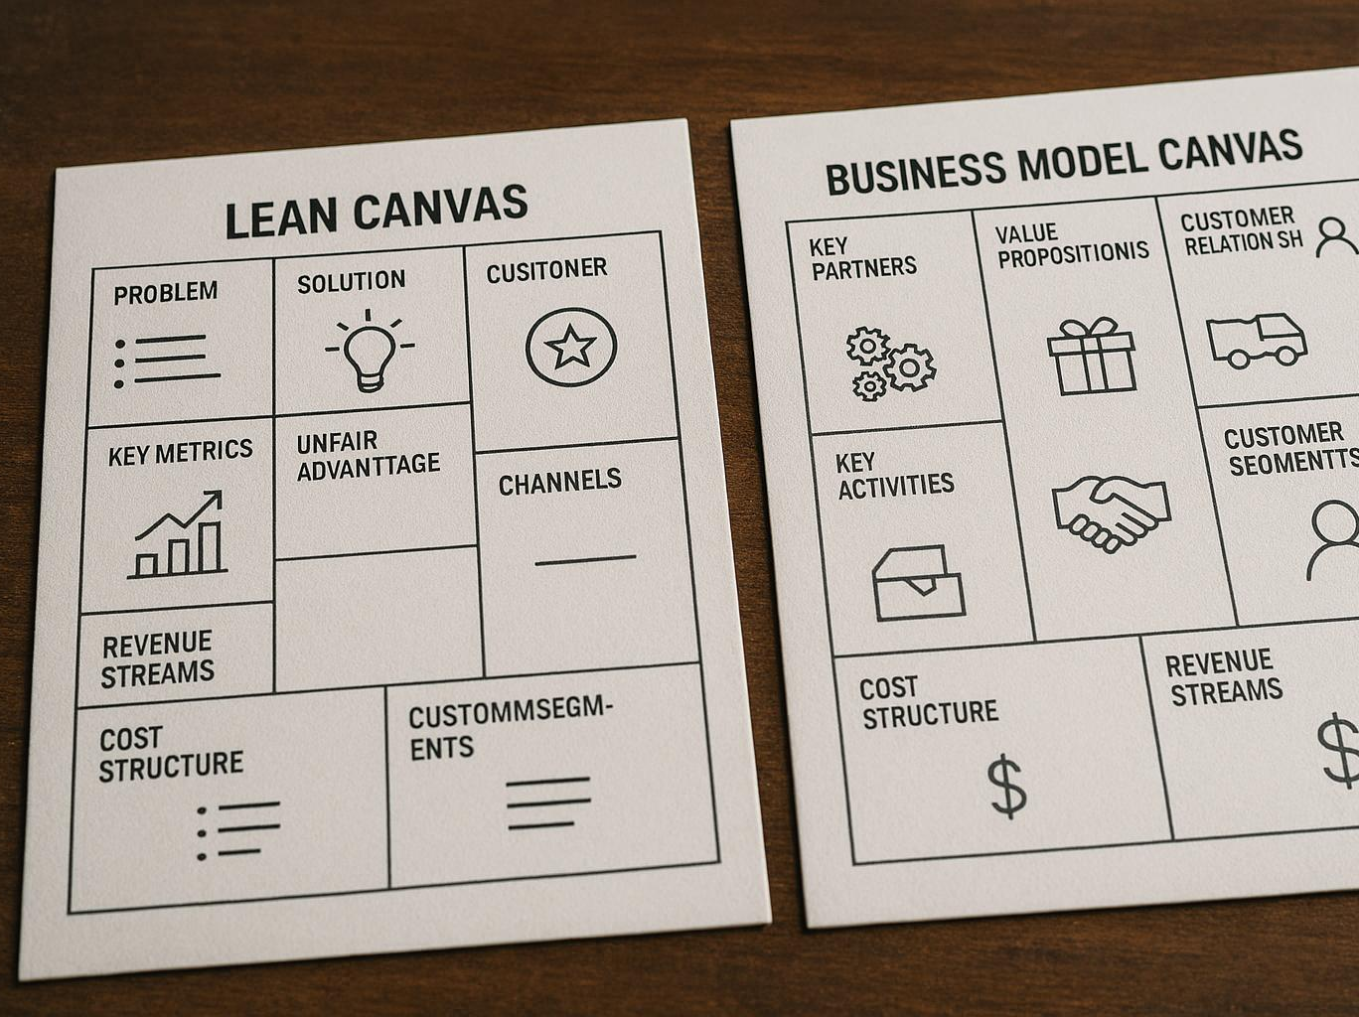
When to use each tool
Lean Canvas Usage
Lean Canvas is ideal for early-stage startups to quickly iterate and validate business ideas.
Business Model Canvas Usage
Business Model Canvas suits detailed planning and clear communication of business strategies.
Notes:
--- Use Lean Canvas in early stages to iterate quickly; use Business Model Canvas for detailed planning and communication. Image source: AI-generated

Slide 42

Key components of a business model
Customer Segments
Defines the specific groups of customers a business aims to serve for targeted value delivery.
Value Propositions
Describes the unique value and benefits offered to customers to meet their needs effectively.
Channels
Represents the means by which value propositions are delivered to customers efficiently.
Revenue Streams and Cost Structure
Revenue streams detail how income is generated; cost structure outlines business expenses and resource allocation.
Notes:
--- Understand elements such as customer segments, value propositions, channels, revenue streams, and cost structure essential for any business. Image source: AI-generated

Slide 43
Conclusion
Value Proposition Importance
A compelling value proposition is crucial for attracting and retaining customers in startups.
Understanding Customer Needs
Deep customer insight guides effective product design and market fit strategies.
Applying Practical Frameworks
Using structured business models and frameworks supports clear strategic planning.
Competitive Analysis & Communication
Analysing competitors and clearly communicating value strengthens market position.
Notes:
Designing a compelling value proposition and business model is critical for startup success. By understanding customer needs deeply, applying practical frameworks, analysing competition, and communicating clear value, startup students can build strong foundations for their ventures.

