Slide 1
From Prototype to Traction: Navigating Early Startup Growth for Student Founders
Strategies for transforming ideas into successful startups
Dr. Zornitsa Yordanova
Notes:
AI-generated content may be incorrect. --- This presentation guides student founders through the critical journey from creating a prototype to gaining early traction in their startup. We will explore essential concepts, strategies, and practical examples to help you understand and navigate early-stage startup growth effectively.

Slide 2
Agenda Overview: Driving Early Startup Traction
Understanding Traction in Early-Stage Startups
Types of Early Traction and Selecting the Right Metrics
User Acquisition Strategies for Early Startups
B2B Versus B2C Traction Approaches
Measuring Engagement, Retention, and Feedback Loops
Navigating Traction Pitfalls and Investor Expectations
Learning from Real-World Cases and Student Exercises
Notes:
Today's discussion covers understanding traction, identifying relevant metrics, user acquisition strategies, differences between B2B and B2C approaches, measuring engagement, avoiding common pitfalls, and learning from real-world cases.

Slide 3
Understanding Traction in Early-Stage Startups
Notes:
Before embarking on growth strategies, it is vital to grasp what traction means at the prototype and MVP stage, why it is important, and how it differs from overall growth metrics.

Slide 4
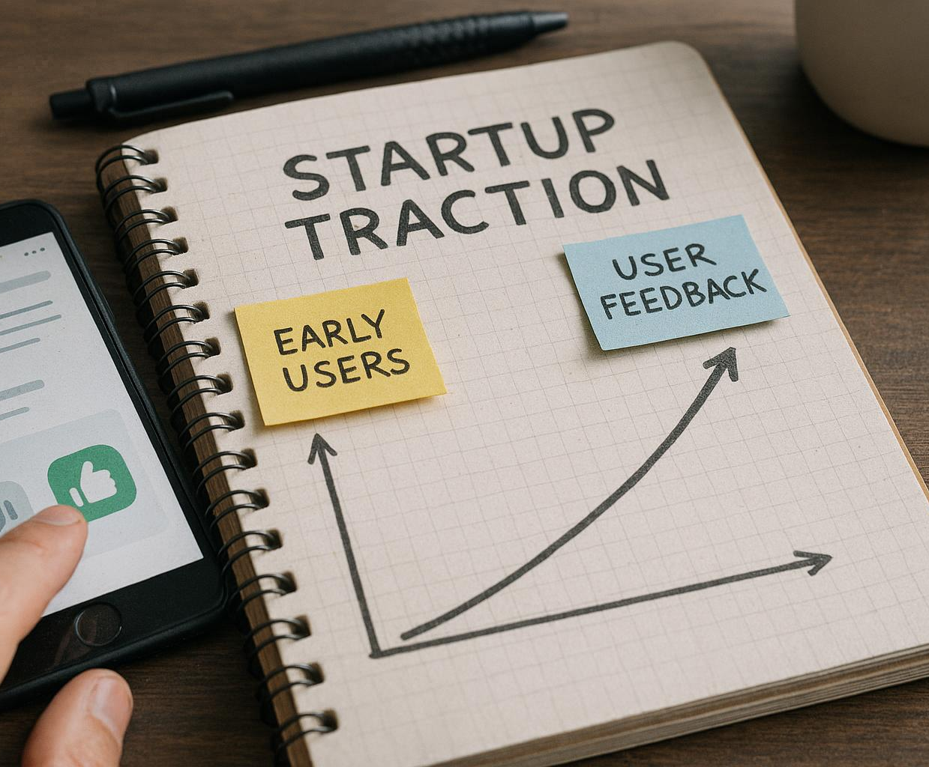
Defining Traction for Prototypes and MVPs
Early User Engagement
Traction is shown by initial user interactions that indicate genuine interest in the prototype or MVP.
Validated Interest
Traction confirms that the product concept resonates with the target audience through measurable feedback.
Notes:
--- Traction at early stages refers to validated interest or engagement with your product, often through initial user interactions or feedback. It reflects proof that your concept resonates with the target audience. Image source: AI-generated

Slide 5

Why Early Traction Matters
Market Validation
Early traction demonstrates that the market accepts your product, confirming demand and viability.
Product Refinement
Initial traction provides valuable user insights to improve and tailor your product effectively.
Building Momentum
Gaining early traction creates momentum that drives further growth and success.
Investor Credibility
Early traction boosts credibility with potential investors and partners, increasing funding opportunities.
Notes:
--- Early traction signals market validation, helps refine your product, and builds momentum. It also increases credibility with potential investors and partners. Image source: AI-generated

Slide 6
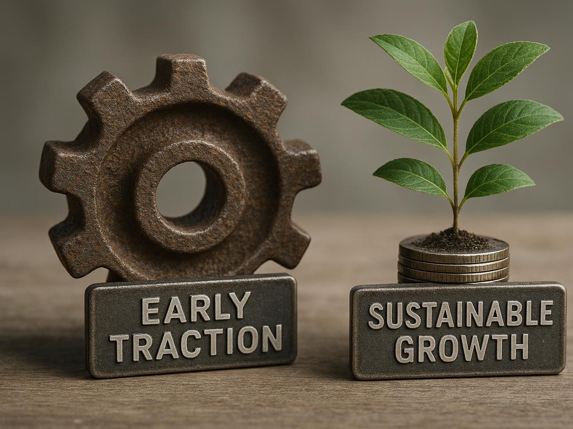
Traction Versus Growth: Key Distinctions
Definition of Traction
Traction represents initial meaningful user engagement or validation of a product or service.
Meaning of Growth
Growth refers to scaling the user base or increasing revenues beyond initial traction.
Link Between Traction and Growth
Early traction is essential as the foundation to achieve sustainable growth over time.
Notes:
--- Traction focuses on initial meaningful engagement or validation, whereas growth refers to scaling user base or revenues. Early traction is a prerequisite foundation for sustainable growth. Image source: AI-generated

Slide 7
Types of Early Traction and Selecting the Right Metrics
Notes:
Choosing the right traction indicators is crucial and varies by startup. This section explores common forms of traction and how to identify the metrics that matter most for your business.

Slide 8

Different Forms of Early Traction: Sign-ups, Usage, Feedback
User Sign-ups
User sign-ups indicate initial interest and help measure the product's early adoption potential.
Active Usage
Active usage reflects ongoing engagement and validates the product’s value to users.
Customer Feedback
Customer feedback provides insights into user satisfaction and areas for improvement.
Notes:
--- Early traction can take many forms such as user sign-ups, active usage, customer feedback, or meaningful interactions that validate the product's value proposition. Image source: AI-generated

Slide 9

Choosing Relevant Traction Metrics for Your Startup
Align Metrics to Business Model
Choose traction metrics that directly reflect your startup's core business model and strategic objectives.
SaaS Focus on Active Users
SaaS startups should prioritise tracking active users to gauge customer engagement and growth.
Marketplace Emphasises Transactions
Marketplaces often focus on transaction volume to measure platform vitality and revenue potential.
Notes:
--- Select metrics aligned with your business model and goals. For example, a SaaS startup may prioritise active users, while a marketplace might focus on transaction volume. Image source: AI-generated

Slide 10

Tracking and Interpreting Initial Traction Data
Consistent Measurement
Regular tracking of key metrics ensures reliable data for identifying early trends.
Trend Spotting
Analyzing data helps detect patterns that inform strategic decisions.
Validating Assumptions
Data analysis confirms or challenges initial hypotheses to refine strategies.
Guiding Decisions
Insights from data direct product and marketing choices for better outcomes.
Notes:
--- Consistent measurement and careful analysis help spot trends, validate assumptions, and guide product and marketing decisions effectively. Image source: AI-generated

Slide 11
User Acquisition Strategies for Early Startups
Notes:
Acquiring your first users is challenging but essential. We will review common channels, outreach techniques, onboarding best practices, and leveraging partnerships.

Slide 12

Common Early User Acquisition Channels
Social Media Platforms
Social media channels enable reaching broad audiences quickly with targeted content and engagement strategies.
Content Marketing
Content marketing helps attract and retain users by providing valuable, relevant information tailored to their interests.
Referrals and Networks
Referrals and campus networks leverage personal connections and communities to grow user base organically.
Events and Engagement
Hosting events allows direct user interaction and builds community engagement around the product or service.
Notes:
--- Channels include social media, content marketing, referrals, campus networks, and events. Choosing the right channel depends on your audience and resources. Image source: AI-generated

Slide 13
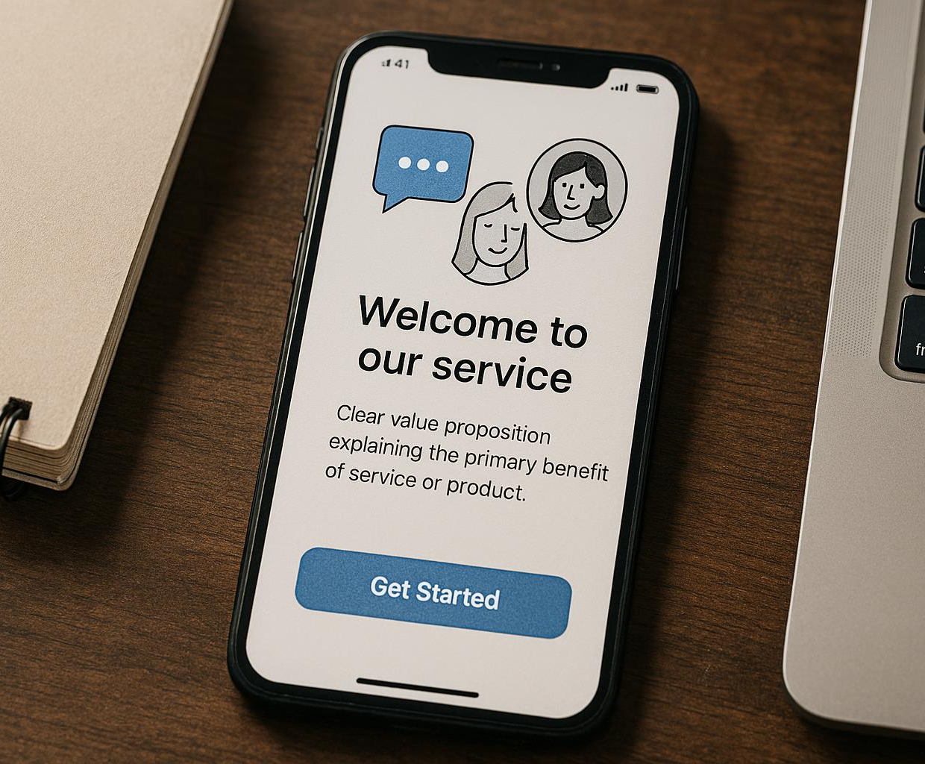
Outreach Tactics and Onboarding Best Practices
Personalised Communication
Effective outreach uses tailored messages to engage the target audience and build meaningful connections.
Clear Value Propositions
Communicating clear benefits convinces users of the product's value and encourages engagement.
Engaging Onboarding Experience
Onboarding should be simple and interactive, helping users quickly experience core product features.
Notes:
--- Effective outreach involves personalised communication and clear value propositions. Onboarding should be simple, engaging, and encourage users to experience core product benefits quickly. Image source: AI-generated

Slide 14

Pilot Projects, Letters of Intent (LOIs), and Partnerships
Early Partner Collaboration
Working with early partners helps validate market demand and establish trust in B2B relationships.
Securing Letters of Intent
Obtaining LOIs signals commitment from potential clients and strengthens credibility before full contracts.
Running Pilot Projects
Pilot projects demonstrate product viability and build confidence among stakeholders and clients.
Notes:
--- Collaborating with early partners, securing LOIs, and running pilot projects validate demand and build credibility, especially in B2B contexts. Image source: AI-generated

Slide 15
B2B Versus B2C Traction Approaches
Notes:
Traction strategies differ significantly between B2B and B2C startups due to distinct customer behaviours and sales cycles. Understanding these differences is key to success.

Slide 16

Differences in User Acquisition and Engagement
B2B Relationship Building
Business-to-business acquisition relies on developing strong relationships and involves longer sales cycles.
B2C Broad Reach
Business-to-consumer acquisition targets a wide audience for rapid user growth via marketing and communities.
Notes:
--- B2B typically requires relationship-building and longer sales processes, while B2C focuses on broad reach and rapid user adoption through marketing and communities. Image source: AI-generated

Slide 17

B2B Pilots, LOIs, and Relationship Building
Pilots to Demonstrate Product Fit
Conduct pilot projects to show product effectiveness and suitability for business customers.
Letters of Intent (LOIs)
Secure LOIs to confirm customer interest and commitment before full-scale deployment.
Building Strong Relationships
Develop strong customer relationships to encourage repeat business and gain referrals.
Notes:
--- Establish pilots and LOIs to demonstrate product fit and secure commitments from business customers. Strong relationships often drive repeat business and referrals. Image source: AI-generated

Slide 18
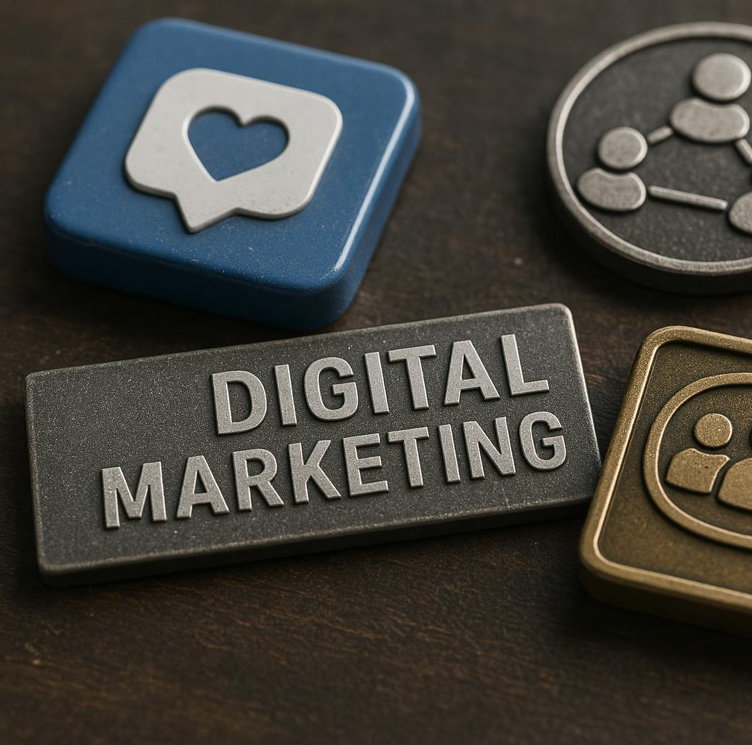
B2C Growth Through Communities and Digital Marketing
Social Media Leverage
B2C startups use social media platforms to reach wide audiences and build brand awareness effectively.
Influencer Marketing
Engaging influencers helps startups gain credibility and attract users through trusted voices.
Community Engagement
Building active communities encourages user retention and fosters loyalty at scale.
Notes:
--- B2C startups leverage social media, influencer marketing, and community engagement to attract and retain users quickly and at scale. Image source: AI-generated

Slide 19
Measuring Engagement, Retention, and Feedback Loops
Notes:
Beyond initial acquisition, sustained engagement and retention are vital. Feedback loops enable continuous product improvement based on user insights.

Slide 20
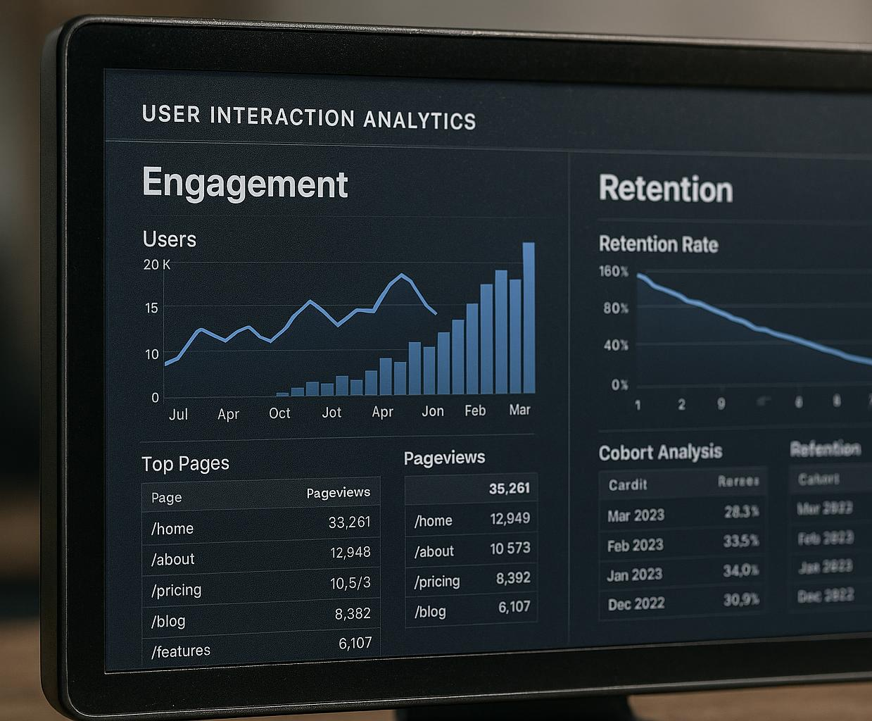
Tracking User Engagement and Retention
Monitor User Interaction
Track how users engage with your product to understand their behaviour and preferences over time.
Identify Engagement Patterns
Detect trends and patterns in user activity that indicate product value or potential issues.
Reduce User Churn
Find areas needing improvement to retain users and decrease churn rates effectively.
Notes:
--- Monitor how users interact with your product over time, identifying patterns that suggest value or areas needing improvement to reduce churn. Image source: AI-generated

Slide 21
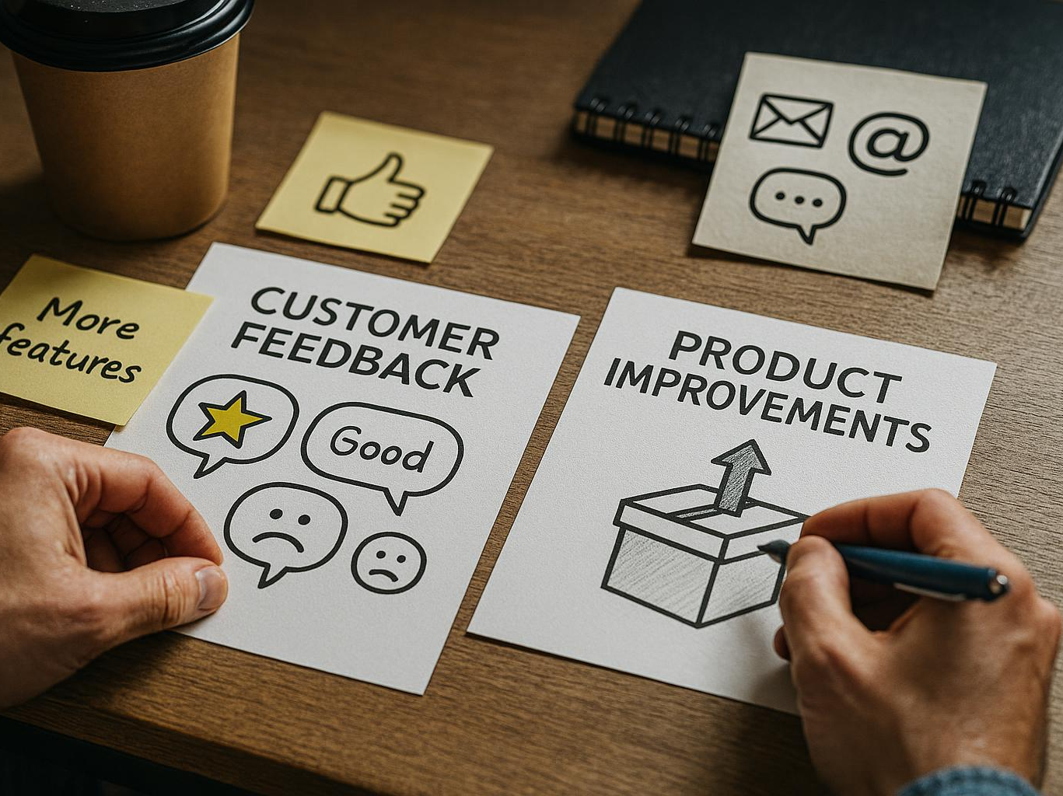
Building Effective Feedback Loops
Encourage Regular Feedback
Promote frequent user feedback to gather valuable insights for product development and improvement.
Prioritise Product Changes
Use collected feedback to prioritise and implement effective product changes that meet user needs.
Enhance Satisfaction and Loyalty
Effective feedback loops increase user satisfaction and build long-term customer loyalty.
Notes:
--- Encourage users to share feedback regularly and use this to prioritise product changes, enhancing user satisfaction and loyalty. Image source: AI-generated

Slide 22
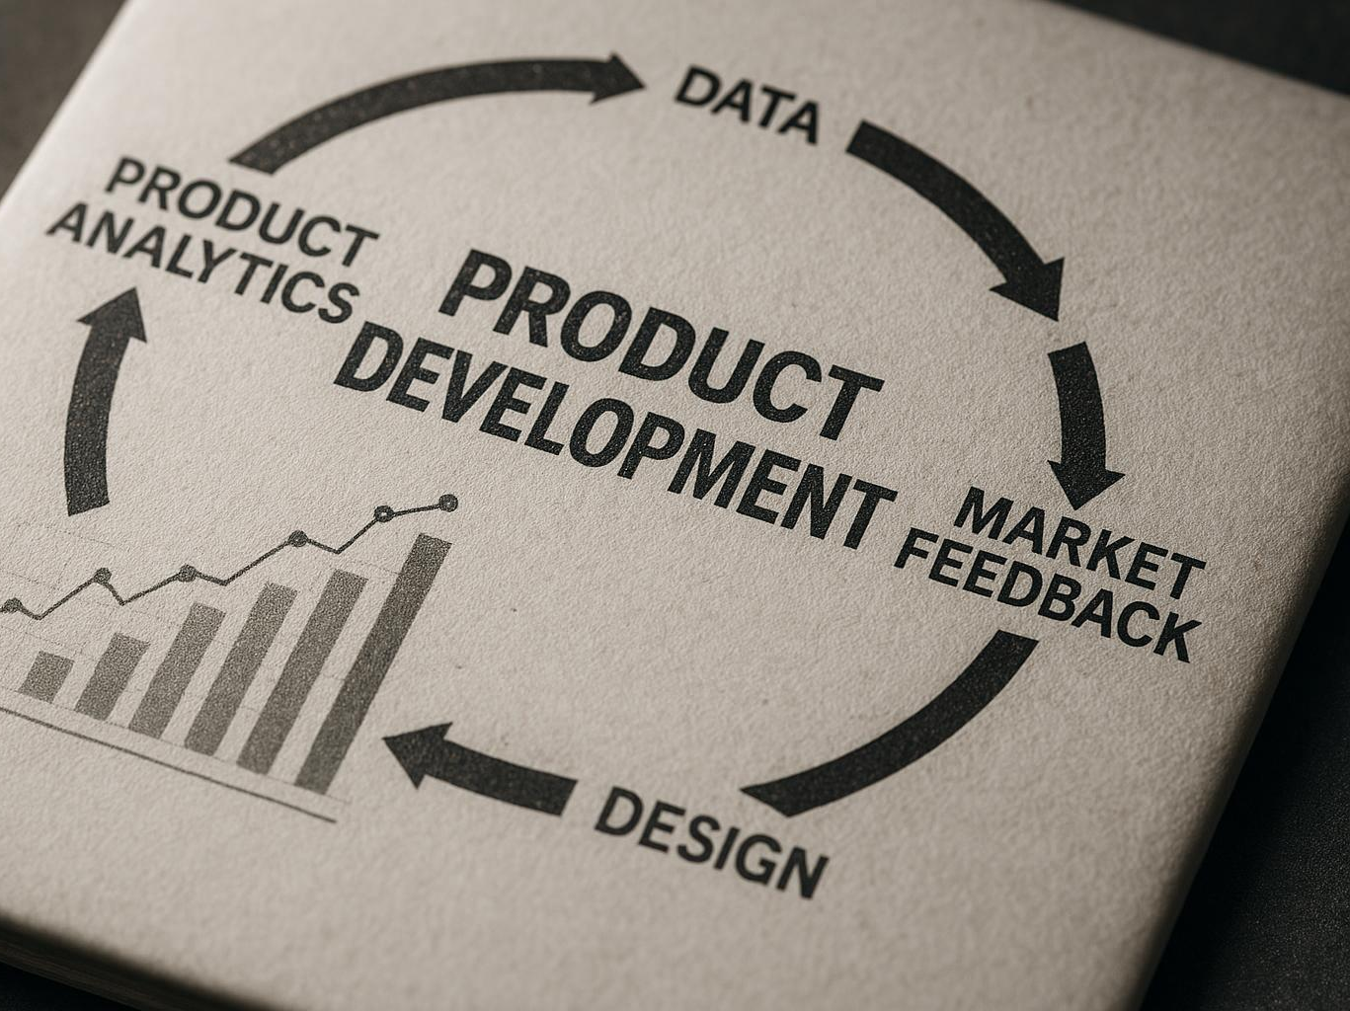
Iterating the Product Based on Traction Insights
Leverage Traction Data
Utilize traction data to understand user behaviour and product performance effectively.
Iterative Refinement
Continuously improve the prototype or MVP based on feedback and data insights.
Market Alignment
Align product features and design with market needs to enhance success potential.
Notes:
--- Use traction data to refine your prototype or MVP iteratively, ensuring alignment with market needs and increasing chances of success. Image source: AI-generated

Slide 23
Navigating Traction Pitfalls and Investor Expectations
Notes:
Understanding common mistakes and investor priorities helps you avoid setbacks and present your traction data compellingly during fundraising.

Slide 24
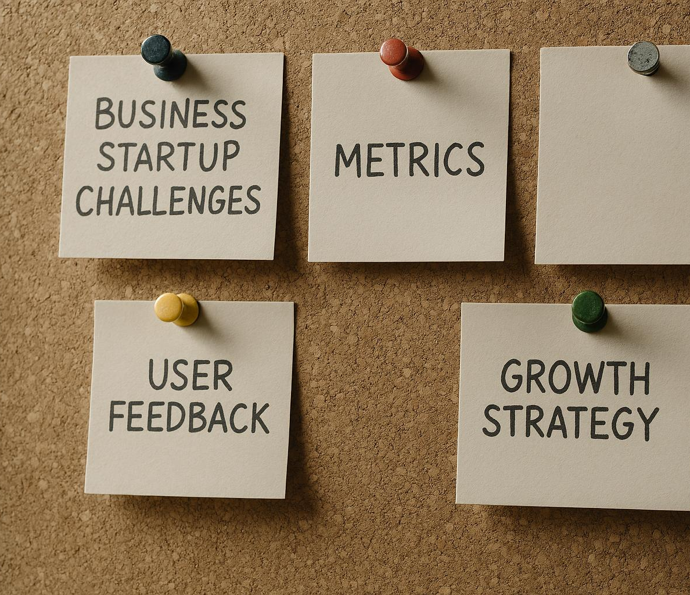
Common Early-Stage Traction Pitfalls and How to Avoid Them
Vanity Metrics Trap
Focusing on vanity metrics can mislead progress and hinder real growth potential for startups.
Ignoring User Feedback
Neglecting genuine user feedback prevents improvement and adaptation to customer needs.
Premature Scaling Risks
Scaling too early can strain resources and cause operational challenges in early stages.
Mitigating Risks
Awareness and disciplined strategies help startups avoid these pitfalls and ensure sustainable growth.
Notes:
--- Pitfalls include focusing on vanity metrics, neglecting genuine user feedback, or scaling prematurely. Awareness and discipline help mitigate these risks. Image source: AI-generated

Slide 25

Investor Perspectives on Traction and Validation
Meaningful Traction
Investors value traction that shows real user engagement and sustainable growth indicators.
Validated Product-Market Fit
Validation comes from customer feedback and market demand aligning with the product offering.
Beyond Superficial Numbers
Investors assess deeper data that reflects long-term potential, not just initial success.
Notes:
--- Investors look for meaningful, validated traction that demonstrates product-market fit and growth potential, beyond superficial numbers. Image source: AI-generated

Slide 26

Documenting Traction for Fundraising and Pitching
Traction Metrics
Showcase key performance indicators to demonstrate business growth and market validation effectively.
User Stories
Include compelling user testimonials to personalize impact and validate product value.
Growth Strategies
Present clear plans for scaling that build investor confidence and support fundraising efforts.
Notes:
--- Clear, concise documentation of traction metrics, user stories, and growth strategies strengthens your fundraising narrative and credibility. Image source: AI-generated

Slide 27
Learning from Real-World Cases and Student Exercises
Notes:
Examining case studies and engaging in practical exercises helps solidify understanding and prepares you for real-world startup challenges.

Slide 28

Case Examples of Early-Stage Traction
Illustration of Startup Success
Real startups demonstrate effective traction strategies that drive early growth and market entry.
Lessons Learned
Examining challenges faced by startups offers valuable insights into what works and what does not.
Path to Growth
Early traction is crucial for establishing momentum that leads to sustainable business expansion.
Notes:
--- Real startups illustrate successful traction strategies, highlighting what worked and lessons learned on the path to growth. Image source: AI-generated

Slide 29

Student Exercises and Weekly Traction Experiments
Testing Assumptions
Conduct experiments regularly to validate your startup assumptions and reduce risks effectively.
Data Collection
Gather meaningful data through weekly traction experiments to inform decision-making and strategy.
Iterative Improvement
Use reflection and experiment results to continuously enhance your startup’s traction and growth.
Notes:
--- Regular experiments and reflection allow you to test assumptions, gather data, and iteratively improve your startup’s traction. Image source: AI-generated

Slide 30

Transitioning from Early Traction to Investor Readiness
Scaling Validated Traction
Focus on expanding proven business metrics to show robust market demand and growth potential.
Refining Investor Pitch
Enhance and tailor pitches to clearly communicate value proposition and investment opportunity.
Roadmap for Sustainable Growth
Present a strategic plan demonstrating long-term growth and profitability to attract investors.
Notes:
--- Preparing for investment involves scaling validated traction, refining pitches, and demonstrating a clear roadmap for sustainable growth. Image source: AI-generated

Slide 31
Conclusion: Mastering Early Traction for Startup Success
Understanding Traction
Grasping the concept of traction is essential for early startup success and informed decision-making.
Measuring Key Metrics
Tracking the right metrics helps evaluate progress and guides strategic adjustments effectively.
Choosing Effective Strategies
Selecting and implementing suitable strategies accelerates traction and attracts investment opportunities.
Learning from Experience
Continuous learning and adaptation from experiences improve startup resilience and long-term growth.
Notes:
Successfully navigating early traction stages is critical for startup viability. By understanding traction, measuring the right metrics, choosing effective strategies, and learning from experience, student founders can confidently progress towards sustainable growth and investment readiness.

