Slide 1
From Startup Ideas to Real Market Problems: A Practical Guide for Aspiring Entrepreneurs
Dr. Zornitsa Yordanova
Essential steps to develop impactful and investable startups
Notes:
AI-generated content may be incorrect. --- This presentation guides aspiring entrepreneurs through the critical journey of transforming startup ideas into solutions addressing real market problems. We'll explore essential concepts and practical techniques to help build investable startups.

Slide 2
Startup Journey Overview
Introduction to the Startup Journey
What Makes a Startup Idea Investable?
Ideas vs Problems vs Opportunities
Problem-First vs Solution-First Thinking
Common Student Startup Idea Traps
Techniques for Generating Startup Ideas
Filtering Ideas: Pain, Frequency, and Willingness to Pay
Defining a Clear Problem Statement
Identifying the Ideal Customer Profile (ICP)
Buyer vs User Distinction
Notes:
We'll cover foundational concepts including the startup process, what makes ideas investable, the difference between ideas and real problems, approaches to problem-solving, common pitfalls, idea generation, filtering ideas, defining problems clearly, identifying ideal customers, and understanding buyers versus users.

Slide 3
Introduction to the Startup Journey
Notes:
This section introduces the startup lifecycle and the accelerator approach. It highlights why understanding real market problems is vital for success and outlines the objectives and roadmap for this presentation.

Slide 4

Overview of the Startup Process and Accelerator Approach
Startup Process Stages
The startup process includes ideation, validation, building products, and scaling the business effectively.
Role of Accelerators
Accelerators provide mentorship, resources, and validation frameworks to help startups grow faster.
Notes:
--- The startup process involves ideation, validation, building, and scaling. Accelerators help by providing mentorship, resources, and validation frameworks to speed up this journey effectively. Image source: AI-generated

Slide 5

Why Understanding Real Problems Is Critical for Startup Success
Solving Genuine Problems
Successful startups identify and address authentic customer issues that need solutions.
Ensuring Product-Market Fit
Focusing on real pain points helps startups create products that truly meet market needs.
Driving Adoption and Investment
Addressing real problems increases user adoption rates and attracts potential investors.
Notes:
--- Startups succeed when they solve genuine problems that customers face. Focusing on real pain points ensures product-market fit and increases chances of adoption and investment. Image source: AI-generated

Slide 6

Presentation Objectives and Roadmap
Identify Market Problems
Learn to recognize authentic market challenges that startups can address for meaningful impact.
Idea Generation and Filtering
Develop skills to brainstorm, evaluate, and filter innovative ideas for startup viability.
Positioning for Success
Understand strategies to position your startup effectively for growth and competitive advantage.
Notes:
--- Our goal is to equip you with practical knowledge to identify real market problems, generate and filter ideas effectively, and position your startup for success. We'll proceed step-by-step through key concepts and actionable techniques. Image source: AI-generated

Slide 7
What Makes a Startup Idea Investable?
Notes:
This section explores criteria investors look for in startup ideas, emphasising the importance of scalability, strong teams, traction, and sizable markets, alongside solving significant problems.

Slide 8

Investor Criteria: Scalability, Team, Traction, and Market Size
Scalable Business Models
Investors prioritise startups with business models that can grow rapidly without proportionate cost increases.
Strong and Complementary Teams
Capable teams with complementary skills increase investor confidence in startup success.
Proven Traction or Validation
Demonstrated market traction or product validation reassures investors of potential returns.
Large or Growing Market
Startups targeting sizeable or rapidly expanding markets attract investor interest for growth potential.
Notes:
--- Investors seek startups with scalable business models, capable and complementary teams, proven traction or validation, and large or growing market opportunities to maximise returns. Image source: AI-generated

Slide 9

Importance of Solving Real and Painful Problems
Addressing Real Problems
Investable ideas must focus on real problems that customers experience and want to solve urgently.
Ensuring Market Demand
Solving painful problems guarantees demand, making the idea attractive for investment and growth.
Clear Revenue Path
Effective solutions create a clear path to revenue by meeting urgent customer needs.
Notes:
--- An investable idea addresses a real, painful problem that customers urgently want solved, ensuring demand and a clear path to revenue. Image source: AI-generated

Slide 10

Visual: Investable Idea Checklist
Checklist Purpose
The checklist helps entrepreneurs evaluate the viability of their startup ideas before seeking investment.
Key Attributes
It summarises essential attributes such as market potential, innovation, and scalability for investable ideas.
Entrepreneur Self-Assessment
Entrepreneurs can self-assess their concepts using the checklist to identify strengths and gaps effectively.
Notes:
--- An illustrative checklist summarises key attributes of investable ideas to help entrepreneurs self-assess their startup concepts effectively. Image source: AI-generated

Slide 11
Ideas vs Problems vs Opportunities
Notes:
This section clarifies distinctions between startup ideas, real market problems, and market opportunities, essential for targeting the right ventures.

Slide 12

Defining a Startup Idea
Startup Idea Definition
A startup idea is a proposed solution or concept intended to create value in the market.
Need for Validation
Validation of the idea against real problems and opportunities is crucial for startup success.
Notes:
--- A startup idea is a proposed solution or concept that aims to create value. However, it needs validation against real problems and opportunities to succeed. Image source: AI-generated

Slide 13

What Constitutes a Real Market Problem
Definition of Market Problem
A market problem is a notable pain point or inefficiency faced by customers without adequate solutions.
Demand Gap Importance
Market problems represent a gap in demand where current solutions fail to satisfy customer needs.
Notes:
--- A market problem is a significant pain point or inefficiency experienced by customers that lacks satisfactory solutions and represents a demand gap. Image source: AI-generated

Slide 14

Spotting Opportunities in the Market
Identifying Problems
Opportunities often emerge by recognising existing problems that require practical solutions.
Unmet Needs
Discovering unmet consumer needs creates potential for new products or services in the market.
Leveraging New Trends
Emerging technologies and market trends enable innovative and competitive solutions.
Notes:
--- Opportunities arise when problems exist or unmet needs are discovered, or when new technologies or trends enable innovative solutions. Image source: AI-generated

Slide 15
Problem-First vs Solution-First Thinking
Notes:
Examining two thinking approaches: starting with a problem to solve versus starting with a solution and seeking a problem, highlighting risks and benefits.

Slide 16

Understanding Problem-First Approaches
Identifying Real Problems
Start by clearly identifying genuine and validated problems that need solutions.
Developing Targeted Solutions
Develop solutions specifically designed to address the identified problems effectively.
Market Acceptance Likelihood
Addressing real problems increases chances of solution acceptance in the market.
Notes:
--- Problem-first thinking begins with identifying a real, validated problem, then developing solutions that address it, increasing the likelihood of market acceptance. Image source: AI-generated

Slide 17

Risks of Solution-First Thinking
Ignoring Market Demand
Creating solutions without understanding customer needs can lead to products with no real demand.
Resource Wastage
Building unwanted products wastes time, money, and effort, harming business sustainability.
Poor Product-Market Fit
Lack of alignment between product features and market needs results in low adoption and failure.
Notes:
--- Solution-first risks include building products without market demand, resulting in wasted resources and poor product-market fit. Image source: AI-generated

Slide 18

Real-World Examples of Both Approaches
Problem-First Success
Approaching challenges by identifying core problems leads to effective solutions and successful outcomes.
Solution-First Challenges
Starting with solutions without understanding the problem often causes difficulties and project failures.
Notes:
--- We will explore examples where problem-first approaches led to success and where solution-first thinking caused challenges or failures. Image source: AI-generated

Slide 19
Common Student Startup Idea Traps
Notes:
This section highlights common pitfalls that student entrepreneurs encounter when developing startup ideas.

Slide 20

Falling in Love with Your Idea
Emotional Attachment Risks
Attachment to ideas may lead entrepreneurs to overlook objective feedback from customers.
Impact on Judgement
Strong attachment can cloud judgement and hinder clear decision making in business development.
Need for Objective Validation
Entrepreneurs must seek customer validation to objectively evaluate and improve their ideas.
Notes:
--- Entrepreneurs often become attached to their idea, which can cloud judgement and hinder objective validation with customers. Image source: AI-generated

Slide 21

Building for Yourself, Not a Market
Personal Preference Focus
Developing products solely on personal preferences may ignore wider customer needs.
Market Needs Assessment
Assessing broader market needs is essential to increase product adoption and growth.
Notes:
--- Creating products based on personal preferences without assessing broader market needs limits potential adoption and growth. Image source: AI-generated

Slide 22

Assuming Problems Exist Without Evidence
Risk of False Assumptions
Assuming problems without evidence can lead to focusing on issues that may not actually exist.
Importance of Customer Validation
Validating problems with real customers ensures solutions address genuine needs and challenges.
Avoiding Wasted Resources
Building solutions for unverified problems wastes time, money, and effort.
Notes:
--- Assuming a problem is real without customer validation risks developing solutions for non-existent or minor issues. Image source: AI-generated

Slide 23
Techniques for Generating Startup Ideas
Notes:
This section presents practical methods for generating startup ideas grounded in real market needs.

Slide 24

Observing Daily Frustrations and Inefficiencies
Identifying Pain Points
Observing daily frustrations helps entrepreneurs find common problems to address effectively.
Spotting Workflow Inefficiencies
Analyzing workflow inefficiencies reveals opportunities to improve processes and productivity.
Notes:
--- By paying close attention to common pain points and workflow inefficiencies, entrepreneurs can identify valuable problem areas. Image source: AI-generated

Slide 25

Reverse Engineering Successful Startups
Problem Identification
Successful startups begin by clearly identifying real-world problems that need innovative solutions.
Solution Development
They develop effective, practical solutions that address the needs of their target market.
Inspiration for New Ideas
Studying these startups inspires new idea generation and informed entrepreneurial strategies.
Notes:
--- Analyzing how successful startups identified problems and built solutions can inspire and inform new idea generation. Image source: AI-generated

Slide 26
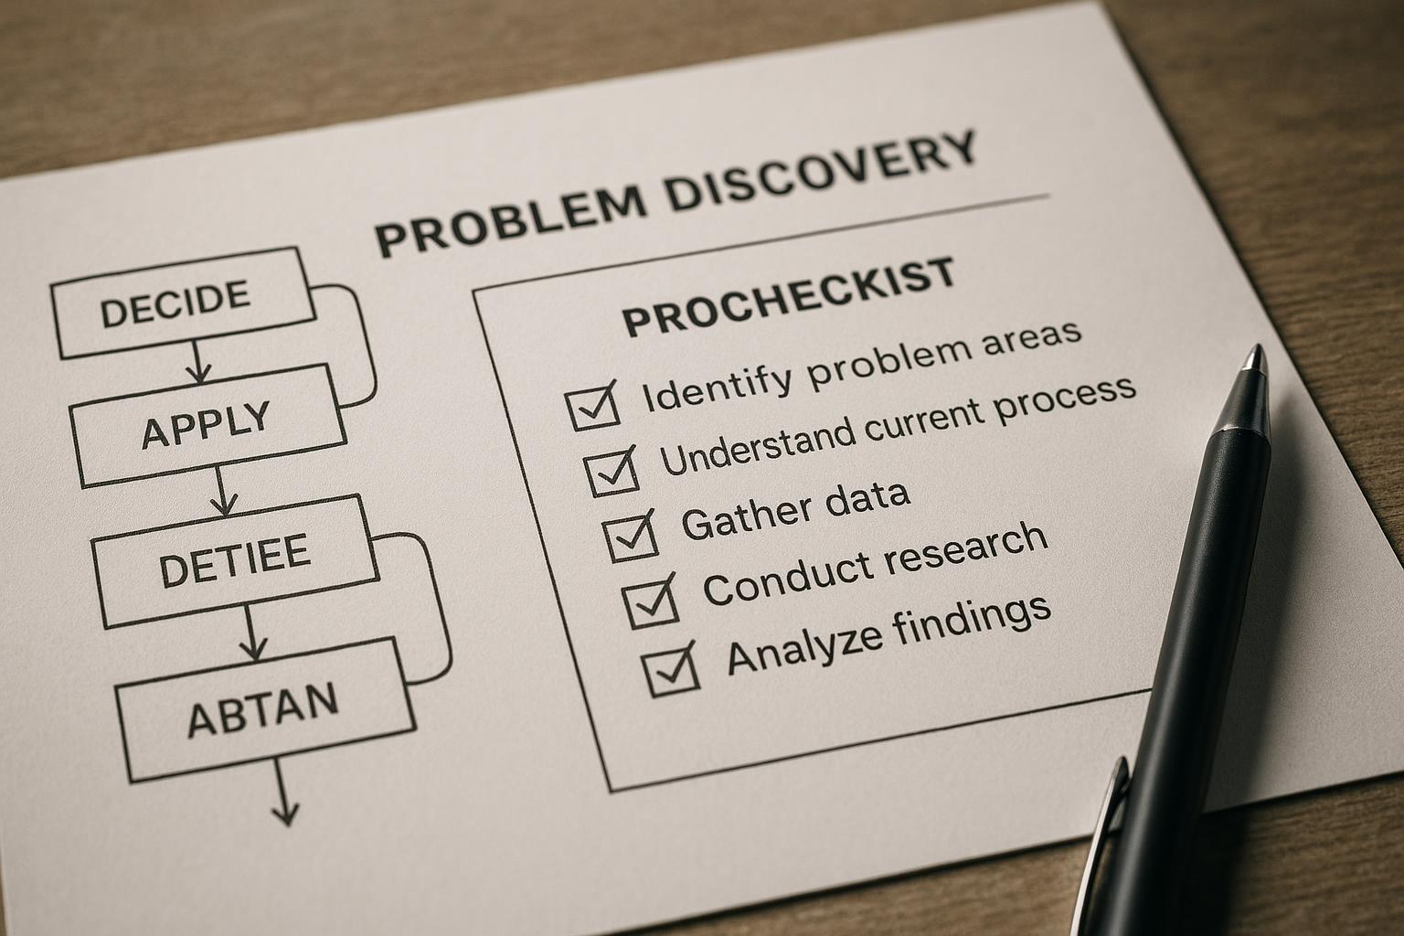
Using Problem Discovery Frameworks
Structured Frameworks
Frameworks provide a methodical approach to uncovering and understanding problems effectively.
Systematic Problem Discovery
A systematic process ensures thorough identification and analysis of underlying issues.
Validation of Ideas
Validating problems ensures ideas are relevant and address real market needs.
Notes:
--- Structured frameworks guide systematic problem discovery and validation to ensure ideas target real market needs. Image source: AI-generated

Slide 27
Filtering Ideas: Pain, Frequency, and Willingness to Pay
Notes:
This section explains how to evaluate and prioritise ideas based on pain severity, occurrence frequency, and customer willingness to pay.

Slide 28

Assessing Pain Severity and Urgency
Pain Severity Importance
Assessing how intense a customer's problem is helps identify critical issues needing immediate attention.
Urgency Assessment
Evaluating urgency determines how quickly a problem must be addressed to satisfy customer needs.
Prioritising Customer Problems
Combining severity and urgency assessments helps prioritise problems by potential value and impact.
Notes:
--- Understanding how intense and urgent a problem is for customers helps determine its priority and potential value. Image source: AI-generated

Slide 29
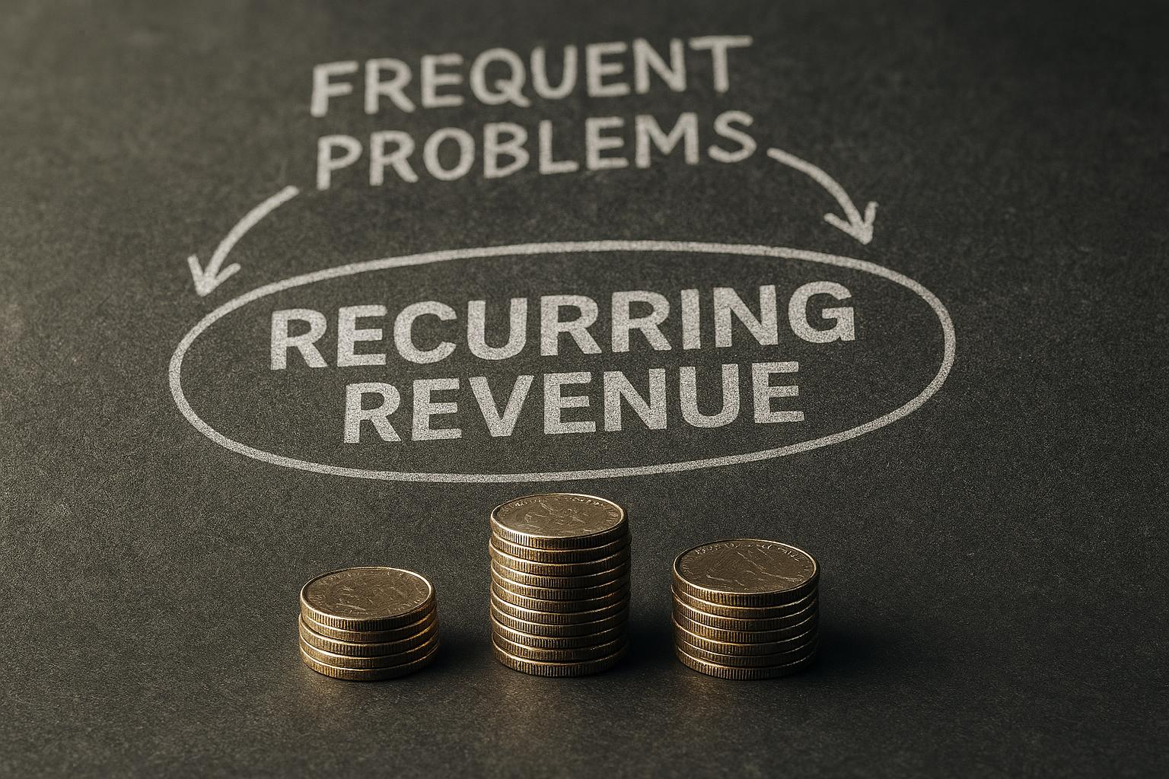
Evaluating How Often the Problem Occurs
Impact of Frequent Problems
Frequent problems generate ongoing demand that sustains business opportunities over time.
Recurring Revenue Opportunities
Sustained demand from frequent problems increases potential for steady recurring revenue streams.
Notes:
--- Frequent problems tend to create sustained demand, increasing the opportunity for recurring revenue streams. Image source: AI-generated

Slide 30

Determining if Customers Are Willing to Pay
Customer Payment Readiness
Validating if customers are willing to pay confirms demand and commercial potential for the solution.
Commercial Viability Signal
Willingness to pay is a key indicator that the product or service meets a market need effectively.
Notes:
--- A crucial validation step is confirming customers' readiness to spend money to resolve the problem, signalling commercial viability. Image source: AI-generated

Slide 31
Defining a Clear Problem Statement
Notes:
This section guides crafting concise and effective problem statements to anchor startup development and communication.

Slide 32
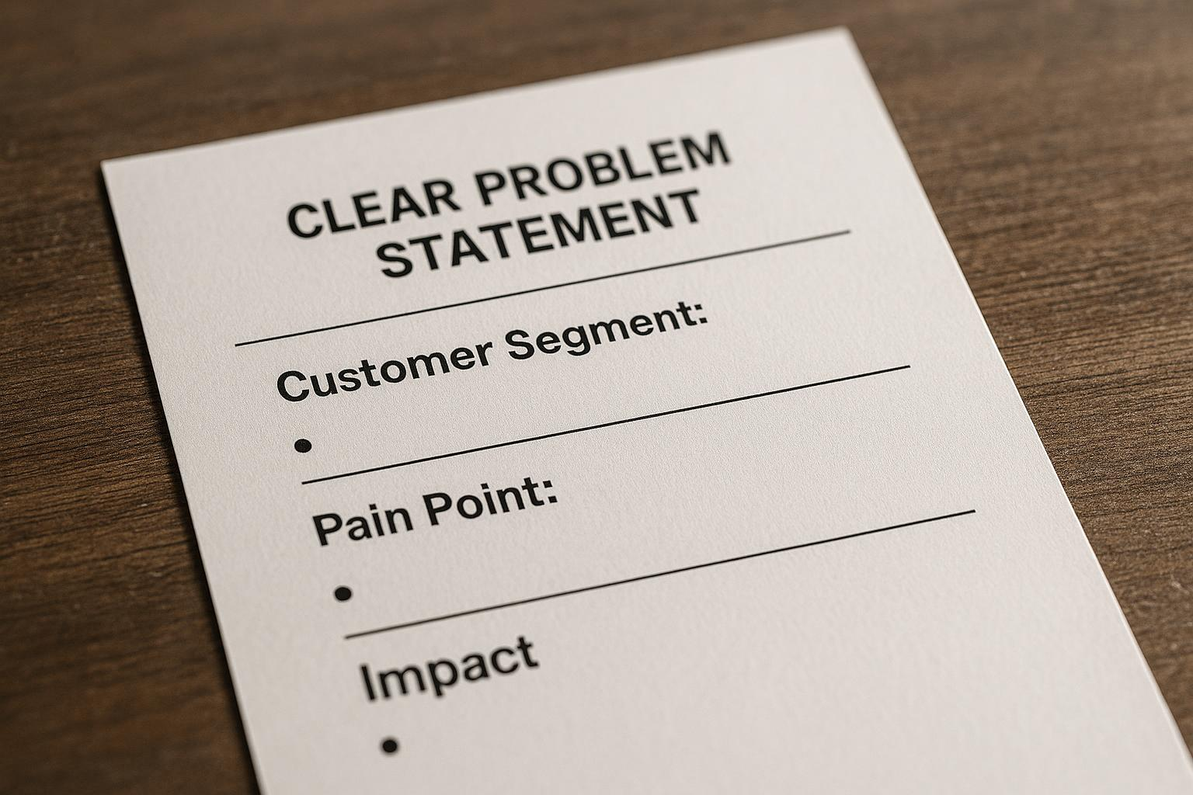
Structure of an Effective Problem Statement
Affected Customer Segment
Identify the specific group of customers who experience the problem to target solutions effectively.
Pain or Need
Define the core issue or unmet need that the customer segment faces to clarify the problem.
Problem Impact
Explain the consequences or effects of the problem to emphasize its significance.
Notes:
--- An effective problem statement clearly defines the affected customer segment, the pain or need, and the impact of the problem. Image source: AI-generated

Slide 33

Common Mistakes to Avoid
Avoid Vague Language
Use clear and precise language to ensure your message is easily understood and unambiguous.
No Unsupported Assumptions
Base your statements on evidence to maintain credibility and avoid misleading information.
Separate Solutions from Problems
Keep problem statements focused on issues without mixing in proposed solutions for clarity.
Notes:
--- Avoid vague language, assumptions without evidence, and mixing solutions within the problem statement to maintain clarity. Image source: AI-generated

Slide 34

Visual: Problem Statement Template
Purpose of Template
The template helps entrepreneurs clearly define and structure their problem statements effectively.
Practical Tool for Entrepreneurs
This tool assists entrepreneurs in refining their ideas to better communicate challenges they aim to solve.
Notes:
--- A template illustration provides a practical tool for entrepreneurs to construct and refine their problem statements. Image source: AI-generated

Slide 35
Identifying the Ideal Customer Profile (ICP)
Notes:
This section explains how defining the ideal customer boosts focus and effectiveness in targeting and growth strategies.

Slide 36
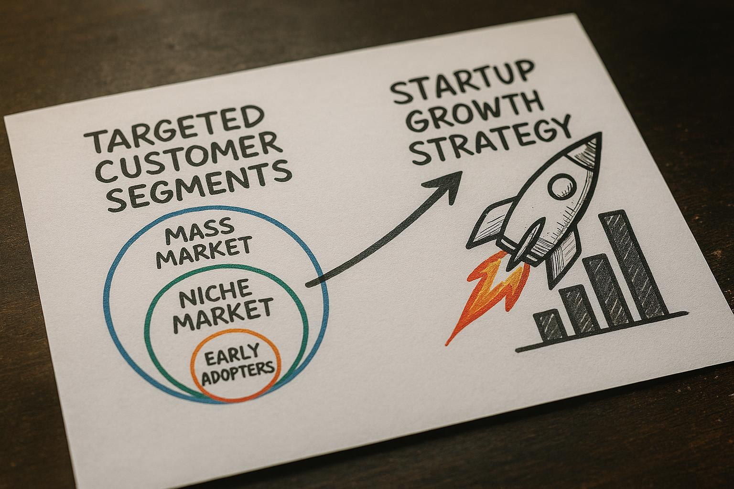
Why ICP Matters for Startups
Definition of ICP
Ideal Customer Profile (ICP) identifies the most valuable and receptive customer segments for startups.
Customer Prioritisation
Prioritising ICP allows startups to focus resources on customers with highest adoption potential and value.
Impact on Growth
Focusing on ICP accelerates growth by improving product-market fit and customer acquisition efficiency.
Notes:
--- ICP identification helps prioritise customer segments with the highest potential value and likelihood to adopt solutions. Image source: AI-generated

Slide 37

Steps to Build Your ICP
Demographic Analysis
Identify key demographic characteristics such as age, gender, and location to shape your ideal customer profile.
Behavioural Insights
Study customer behaviours and preferences to understand how they interact with products or services.
Pain Points Identification
Recognize common challenges and pain points your customers face to tailor solutions effectively.
Purchasing Power Assessment
Evaluate the purchasing capacity of your target audience for effective marketing and sales strategies.
Notes:
--- Building an ICP involves analysing demographics, behaviours, pain points, and purchasing power to create a detailed profile. Image source: AI-generated

Slide 38

Visual: ICP Example
Purpose of ICP Visual
Visual examples help in comprehending how to create and use ideal customer profiles effectively.
Utilising ICP
ICP visuals enable better targeting by illustrating key customer traits and preferences clearly.
Notes:
--- An example ICP visual aids understanding of how to compile and utilise ideal customer profiles effectively. Image source: AI-generated

Slide 39
Buyer vs User Distinction
Notes:
This section clarifies the important distinction between the buyer and the user, impacting product design and sales strategies.

Slide 40

Explaining the Difference
Role of the Buyer
The buyer makes the purchasing decision and completes the transaction for the product.
Role of the User
The user is the individual or group that actually uses and interacts with the product.
Distinct Individuals or Groups
Buyers and users can be different people or groups, highlighting diverse roles in product lifecycle.
Notes:
--- The buyer is the decision-maker who purchases the product, while the user is the person who actually uses it; these may be different individuals or groups. Image source: AI-generated

Slide 41

Examples in Real Markets
Enterprise Software Usage
Procurement teams purchase software, but employees are the actual users in enterprise settings.
Children’s Product Market
Parents buy products intended for children, who are the primary users of these items.
Notes:
--- Examples include enterprise software where procurement buys but employees use it, or children's products bought by parents but used by kids. Image source: AI-generated

Slide 42

Implications for Solution Design and Sales
Product Features Impact
Designing product features must align with both buyers’ and users’ distinct needs for effective solutions.
Marketing Messaging Strategies
Marketing messages should be tailored to resonate with both buyers and users for improved engagement.
Sales Approach Adaptation
Sales methods must consider the differing motivations and needs of buyers versus users to be successful.
Notes:
--- Understanding this distinction affects product features, marketing messaging, and sales approaches to address both buyers’ and users’ needs. Image source: AI-generated

Slide 43
Conclusion
Problem Identification
Clearly identifying the core problem ensures the startup addresses real market needs effectively.
Validation Process
Validating ideas with potential customers reduces risk and guides product development.
Customer Understanding
Deep understanding of customer needs drives impactful and relevant startup solutions.
Building Impactful Startups
Applying these principles improves chances to create investable and meaningful startups.
Notes:
Successfully transforming startup ideas into solutions for real market problems requires deliberate problem identification, validation, and customer understanding. Using these principles and tools will enhance your chances of building a startup that is both impactful and investable.

