Slide 1
MVP Development, Prototyping, and Go-To-Market Strategy: A Practical Guide for Startup Students
Essential steps to launch and grow your startup successfully
Dr. Zornitsa Yordanova
Notes:
AI-generated content may be incorrect. --- This presentation provides a comprehensive guide for startup students on developing a Minimum Viable Product (MVP), prototyping effectively, and crafting a successful go-to-market strategy. We will cover key concepts, practical steps, and strategies to help you launch and grow your startup.

Slide 2
Presentation Overview
Understanding Minimum Viable Product (MVP) Fundamentals
Selecting and Building Your MVP
Validating Your MVP Through Metrics and Iteration
Crafting a Go-To-Market Strategy for First User Acquisition
Building Traction and Demonstrating Early Success
Preparing For Investment and Strategic Growth
Notes:
Our journey begins with understanding MVP fundamentals, followed by selecting and building your MVP. We will then explore validating your MVP through metrics and iteration. Subsequently, we will cover crafting a go-to-market strategy, building traction, and finally preparing for investment and strategic growth.

Slide 3
Understanding Minimum Viable Product (MVP) Fundamentals
Notes:
In this section, we clarify what an MVP truly means, distinguish it from a full-scale product, and discuss how to design MVPs based on risk assessment to minimise wasted effort and maximise learning.

Slide 4
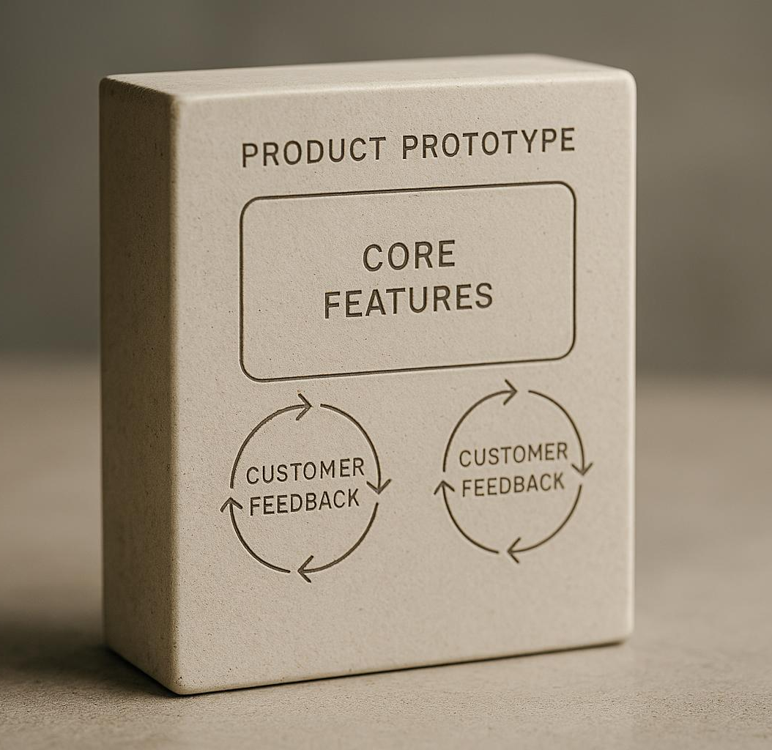
Defining the true meaning of an MVP
Simplest Product Version
An MVP is the most basic version of a product focusing only on essential features to test assumptions.
Validated Learning
It allows startups to gather real customer feedback and validated learning efficiently with minimal resources.
Core Functionalities
MVP focuses on solving primary customer problems by including only core functionalities initially.
Notes:
--- An MVP is the simplest version of a product that allows a startup to collect validated learning about customers with the least effort. It focuses on core functionalities essential to solve customer problems while enabling feedback. Image source: AI-generated

Slide 5
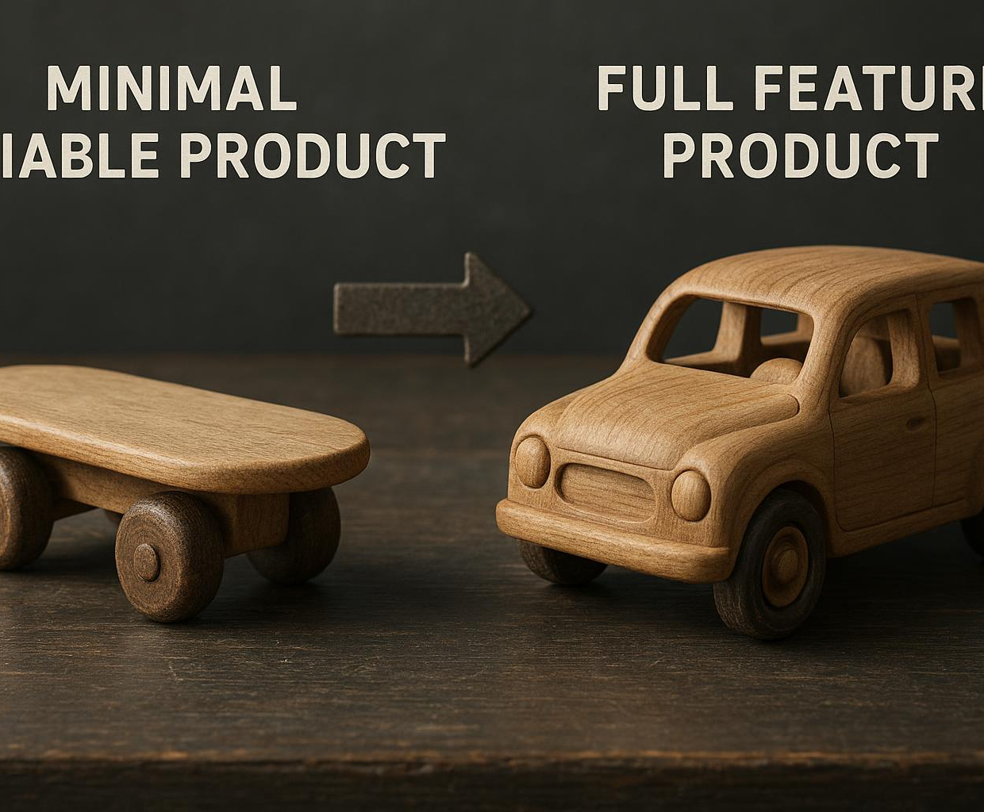
MVP versus a full-scale product
MVP Characteristics
An MVP is lean and minimal, focusing on essential features to quickly test hypotheses.
Full-scale Product
A full-scale product aims to be feature-complete, providing all planned functionalities before launch.
Purpose of MVP
The MVP helps validate market demand early without over-investing in development.
Notes:
--- Unlike a full-scale product which aims to be feature-complete, an MVP is lean and minimal. The goal is to test hypotheses quickly without over-investing in development before market validation. Image source: AI-generated

Slide 6
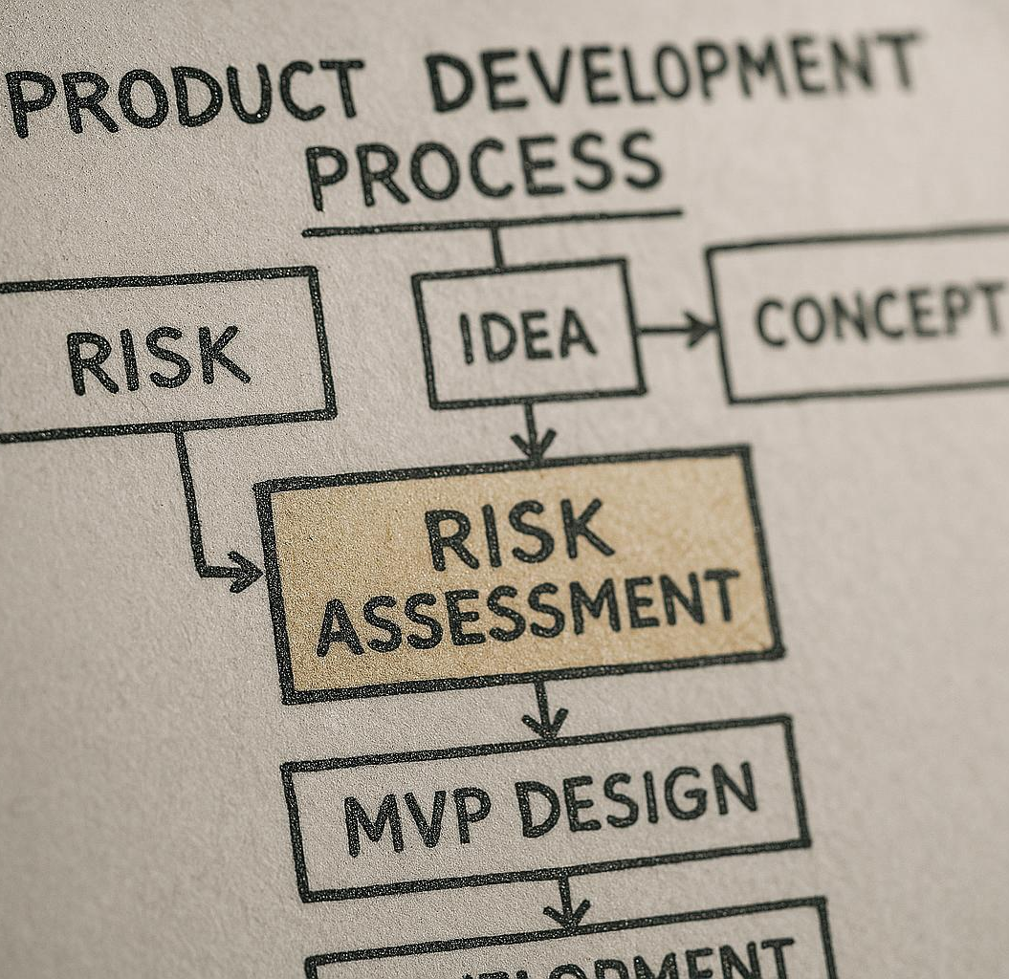
Designing MVPs based on risk assessment
Focus on Riskiest Assumptions
Target the riskiest assumptions first to address critical uncertainties in technology, market, or user behaviour.
Early Uncertainty Reduction
Designing MVPs around risk reduces uncertainty early in the development cycle, improving decision-making.
Guided Development Process
Risk-focused MVP design guides subsequent development phases with clearer priorities and validated assumptions.
Notes:
--- Design your MVP to target the riskiest assumptions first, whether they relate to technology, market demand, or user behaviour. This approach reduces uncertainty early on and guides subsequent development. Image source: AI-generated

Slide 7
Selecting and Building Your MVP
Notes:
Next, we explore various types of MVPs, criteria to choose the best approach, and an introduction to prototyping tools and platforms to bring your ideas to life efficiently.

Slide 8
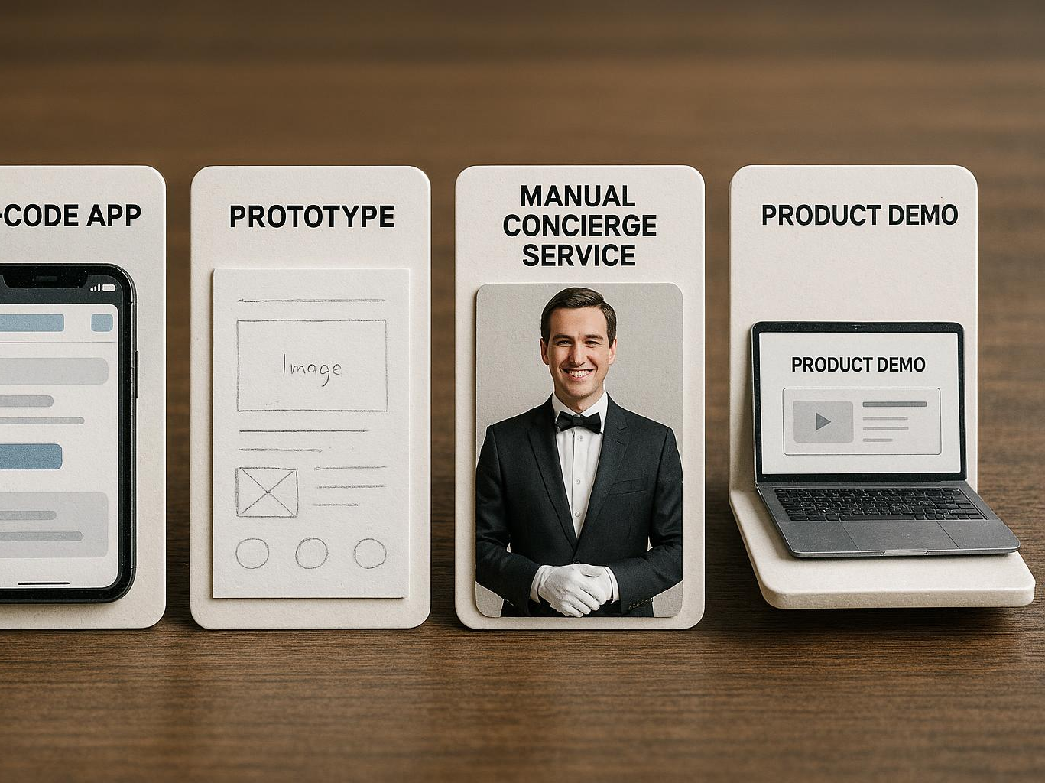
Exploring different types of MVPs: no-code, prototype, concierge, demo
No-Code MVPs
No-code MVPs allow rapid deployment of functional solutions without programming, ideal for testing ideas quickly.
Prototypes
Prototypes help visualise and test product ideas early by creating simplified, interactive models.
Concierge MVPs
Concierge MVPs provide manual, personalised services to validate demand before automation.
Demo MVPs
Demo MVPs showcase concepts through presentations or videos to gather feedback and interest.
Notes:
--- MVPs can take many forms such as no-code solutions for rapid deployment, prototypes to visualise ideas, concierge MVPs offering manual service, and demos to showcase concepts. Select based on resources and learning goals. Image source: AI-generated

Slide 9

Criteria for choosing the best MVP approach
Development Cost
Consider the budget required for MVP development to optimize resources and minimize expenses.
Speed of Development
Evaluate how quickly the MVP can be built to accelerate the validation process and market entry.
Quality of Learning
Assess the MVP's effectiveness in gathering meaningful insights for future improvements.
Customer Engagement
Focus on involving customers early to validate assumptions and increase product adoption.
Notes:
--- Choose your MVP type considering factors such as development cost, speed, quality of learning, and customer engagement to ensure efficient validation and iteration. Image source: AI-generated

Slide 10
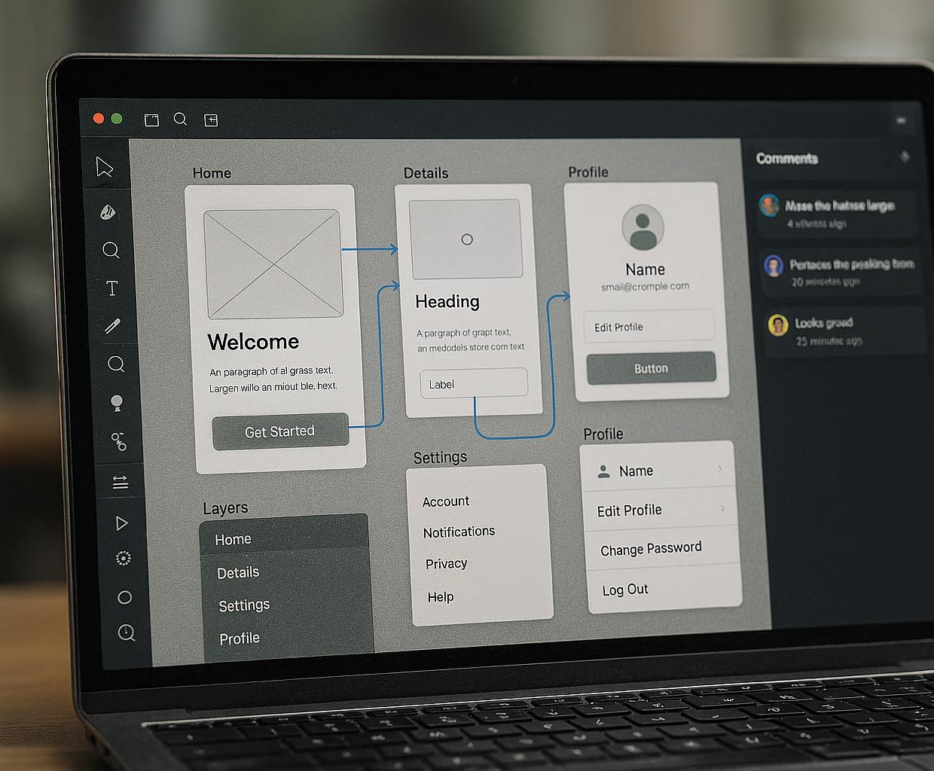
Introduction to prototyping tools and platforms
Popular Prototyping Tools
Figma, InVision, and Bubble are widely used for creating interactive prototypes without coding.
Rapid MVP Development
These tools enable quick build of Minimum Viable Products, facilitating fast iteration and feedback.
No Heavy Coding Required
Prototyping platforms reduce or eliminate the need for complex coding skills.
Notes:
--- Familiarise yourself with popular prototyping tools like Figma, InVision, and Bubble that help build interactive MVPs quickly without heavy coding, enabling fast feedback cycles. Image source: AI-generated

Slide 11
Validating Your MVP Through Metrics and Iteration
Notes:
Validation is key to successful MVP development. We discuss how to define success metrics, implement iteration and learning cycles, and avoid common pitfalls during MVP development.

Slide 12
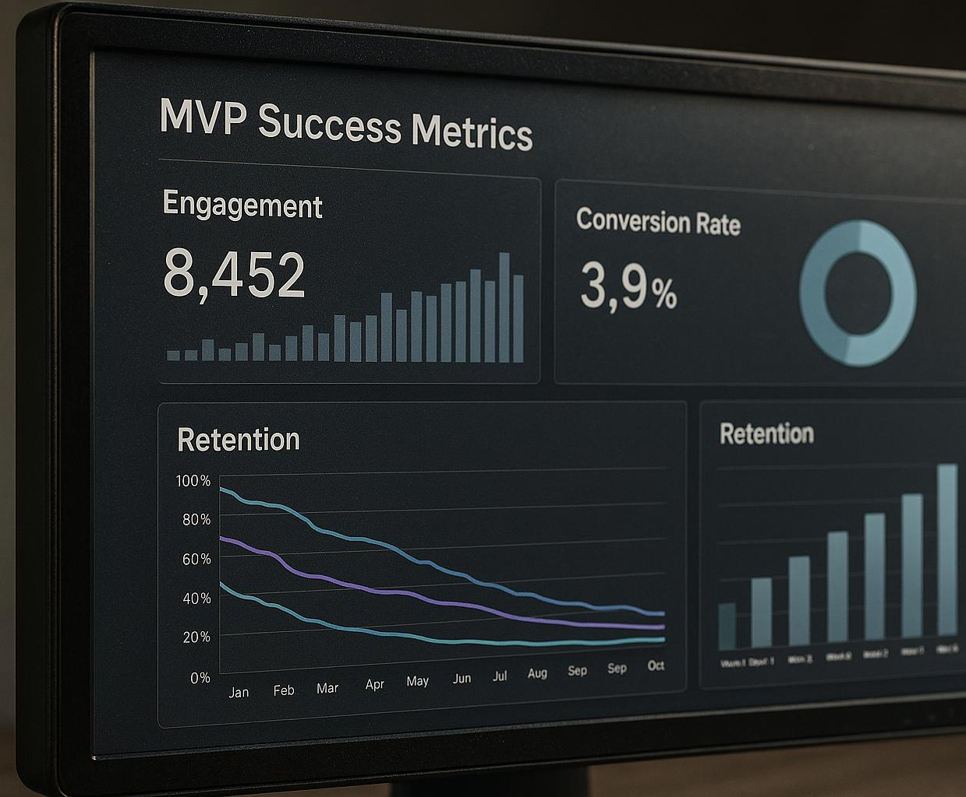
Defining and tracking MVP success metrics
User Engagement
Measure user interactions and activity levels to assess MVP adoption and interest over time.
Conversion Rates
Track how many users perform desired actions to evaluate MVP effectiveness in achieving goals.
Retention Rates
Monitor the percentage of users who continue using the MVP to determine long-term value and satisfaction.
Notes:
--- Establish measurable goals such as user engagement, conversion rates, and retention to objectively evaluate your MVP’s performance and guide decision-making. Image source: AI-generated

Slide 13
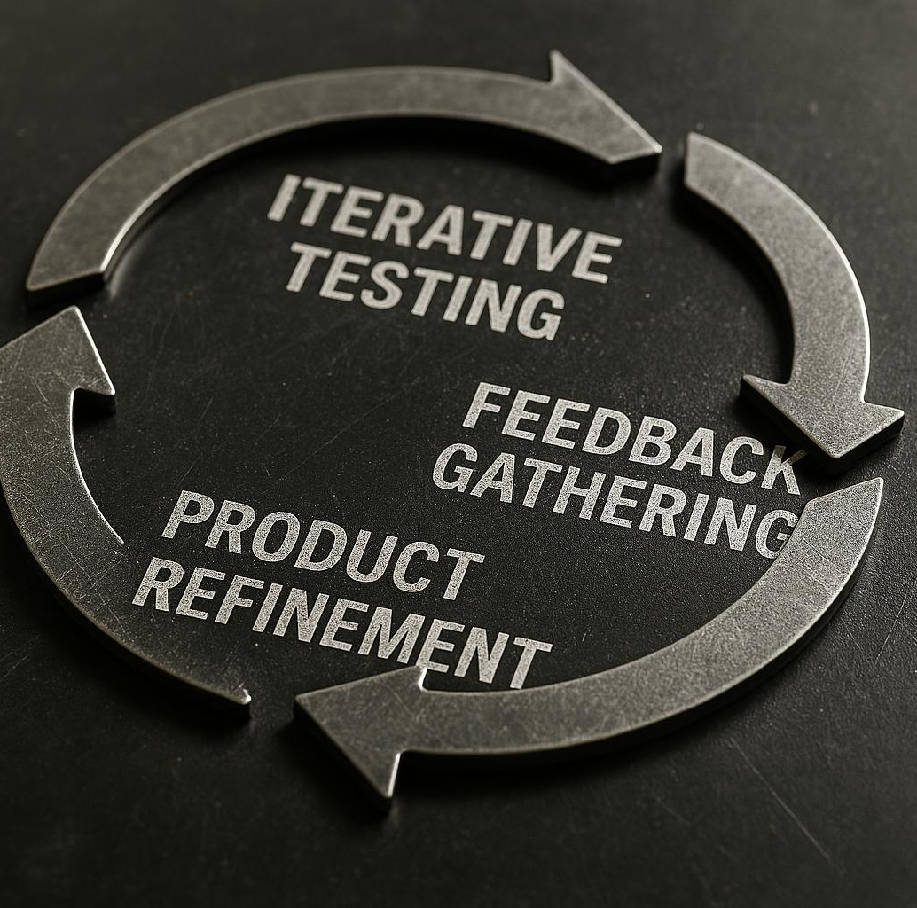
Implementing iteration and learning cycles
Iterative Testing
Use repeated testing phases to identify issues and validate features in the MVP.
Feedback Gathering
Collect and analyse customer feedback to understand needs and preferences clearly.
Product Refinement
Continuously improve the MVP based on feedback to better meet customer needs.
Notes:
--- Apply an iterative process of testing, gathering feedback, and refining your MVP. This cycle ensures continuous improvement and alignment with customer needs. Image source: AI-generated

Slide 14

Avoiding common MVP development mistakes
Avoid Overbuilding
Focus on essential features only to keep the MVP simple and avoid unnecessary complexity.
Emphasize Customer Feedback
Incorporate user feedback continuously to align the product with customer needs and expectations.
Pace Scaling Wisely
Avoid rushing to scale before validating the product’s value and market fit.
Focus on Learning and Adaptability
Prioritize continuous learning and adaptability to prevent costly errors and improve product success.
Notes:
--- Beware of overbuilding, ignoring customer feedback, or rushing to scale. Staying focused on learning and adaptability prevents costly errors. Image source: AI-generated

Slide 15
Crafting a Go-To-Market Strategy for First User Acquisition
Notes:
We now turn to building a go-to-market (GTM) strategy, tailored for startups, covering differences between B2B and B2C markets, and effective customer acquisition channels.

Slide 16
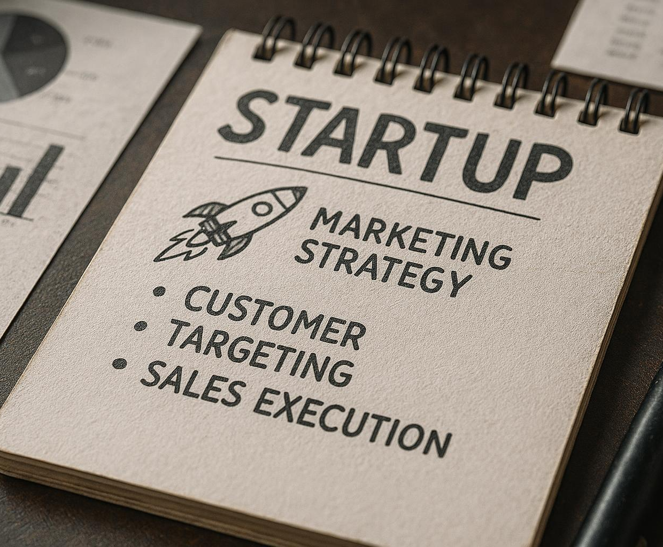
Overview of go-to-market strategy for startups
Product Positioning
Positioning defines how a product fits in the market to meet customer needs uniquely and compellingly.
Target Customer Identification
Identifying the ideal customers helps focus marketing and sales efforts on those most likely to adopt the product.
Sales and Marketing Execution
Executing coordinated sales and marketing initiatives drives user acquisition and builds early traction effectively.
Notes:
--- A GTM strategy outlines how you position your product, target customers, and execute sales and marketing to gain initial users and traction effectively. Image source: AI-generated

Slide 17
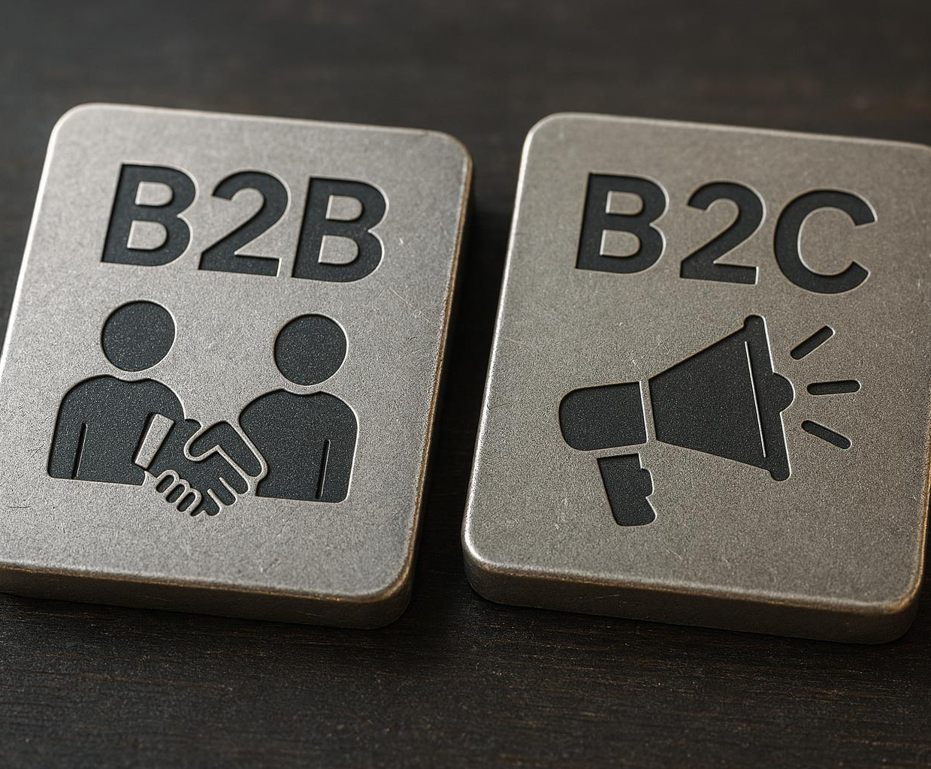
B2B versus B2C GTM differences
B2B Sales Cycle
B2B GTM involves longer sales cycles with emphasis on building strong client relationships.
B2B Targeted Outreach
Targeted outreach is essential in B2B to reach specific clients effectively.
B2C Marketing Approach
B2C GTM leverages broad marketing channels to build brand awareness and acquire users rapidly.
Notes:
--- B2B GTM usually involves longer sales cycles, relationship building, and targeted outreach, while B2C focuses on broad marketing channels, brand awareness, and faster user acquisition. Image source: AI-generated

Slide 18
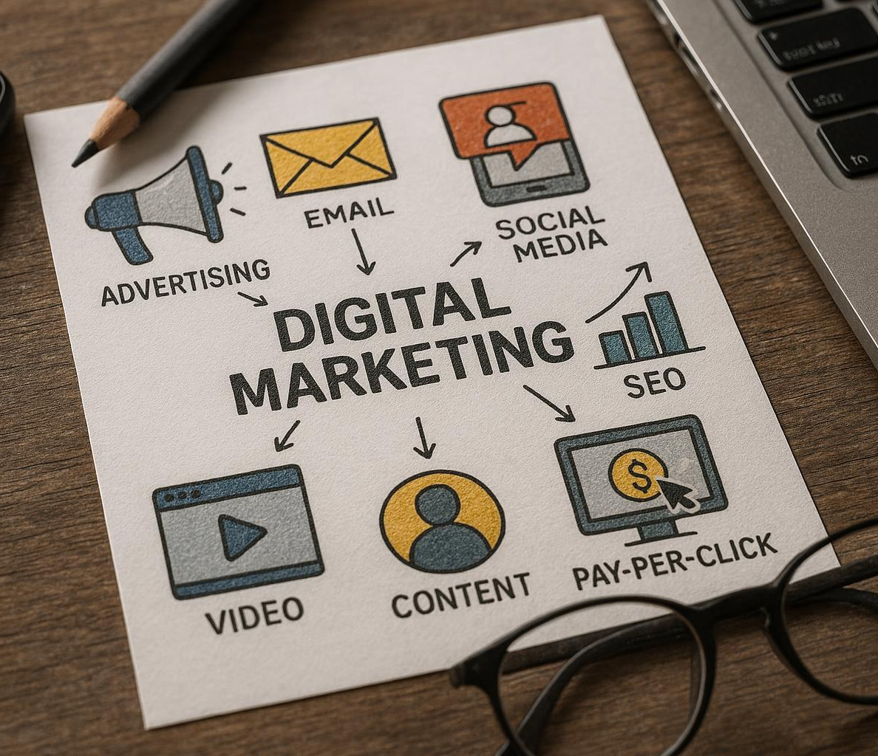
Customer acquisition channels and outreach strategies
Social Media Marketing
Social media platforms help engage customers and increase brand awareness effectively.
Content Marketing
Creating valuable content attracts and retains customers by addressing their needs and interests.
Partnerships and Referrals
Collaborations and customer referrals amplify reach and build trust among potential customers.
Direct Sales Outreach
Direct sales involve personalised communication tailored to the customer profile for maximum impact.
Notes:
--- Explore channels like social media, content marketing, partnerships, referrals, and direct sales. Tailor outreach to your customer profile for maximum impact. Image source: AI-generated

Slide 19
Building Traction and Demonstrating Early Success
Notes:
Generating traction validates your business potential. Here we discuss recognising early success, leveraging pilot projects, and using funnel thinking for measurement.

Slide 20
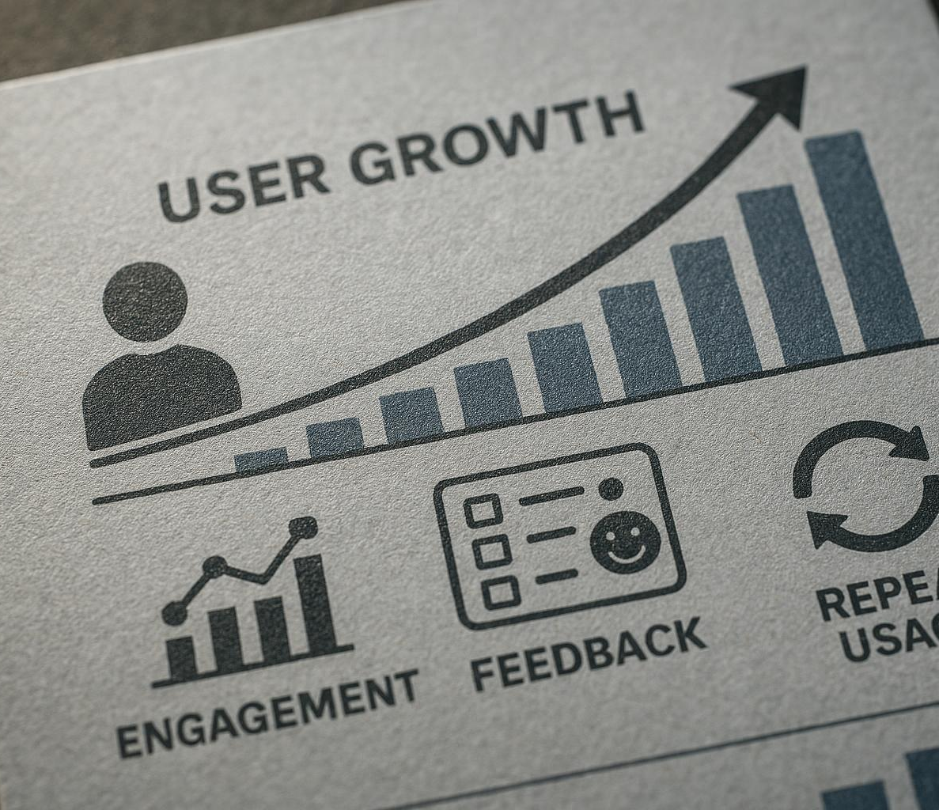
Recognising early traction and success indicators
User Growth
Increasing number of users signifies early adoption and market interest in your product or service.
Engagement Metrics
High engagement rates such as active sessions and time spent reflect strong user involvement.
Feedback Quality
Positive and constructive user feedback validates your value proposition and guides improvements.
Repeat Usage
Consistent repeat usage indicates customer satisfaction and product reliability.
Notes:
--- Early traction can be seen in user growth, engagement metrics, feedback quality, and repeat usage, indicating validation of your value proposition. Image source: AI-generated

Slide 21

Utilising pilot projects and securing letters of intent
Pilot Projects
Pilot projects enable real-world testing and validation with key customers before full-scale launch.
Letters of Intent
Letters of intent show commitment and help build confidence among investors and stakeholders.
Notes:
--- Pilot projects allow real-world testing with key customers, while letters of intent demonstrate commitment and build investor confidence. Image source: AI-generated

Slide 22
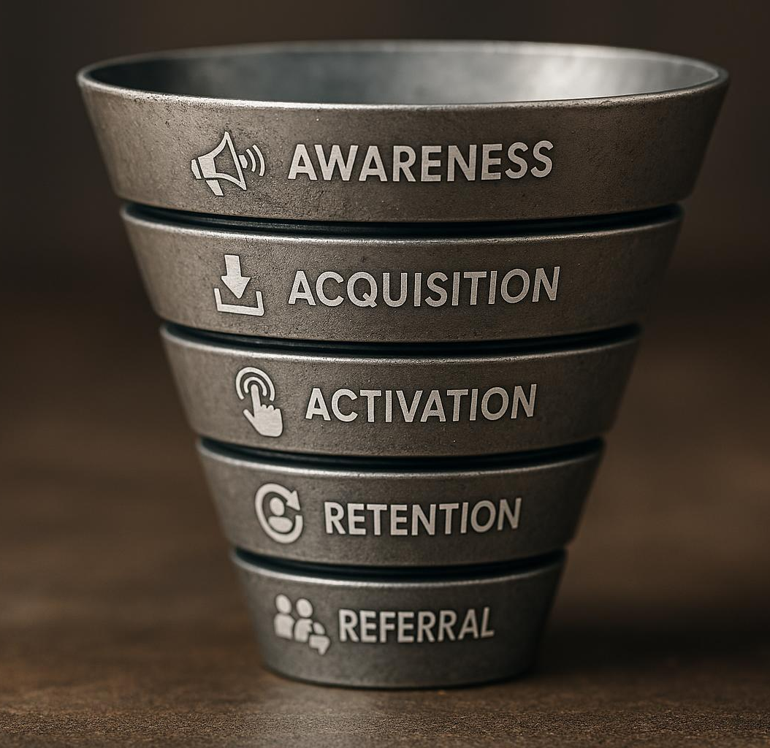
Applying funnel thinking and measuring early success
Funnel Metrics Overview
Funnel metrics track user journey stages to identify opportunities for improving conversion rates.
Key Funnel Stages
Important stages include awareness, acquisition, activation, retention, and referral to monitor success.
Optimising Conversion
Measuring early success helps optimise conversion rates by focusing on each funnel stage's performance.
Notes:
--- Use funnel metrics such as awareness, acquisition, activation, retention, and referral to monitor progress and optimise conversion at each stage. Image source: AI-generated

Slide 23
Preparing For Investment and Strategic Growth
Notes:
The final section focuses on preparing for investment by showing MVP progress, understanding investor expectations, and transitioning into financial planning for growth.

Slide 24

Weekly student tasks for MVP progress
Customer Interviews
Regular customer interviews provide feedback to improve the MVP and align it with user needs.
Prototype Refinement
Ongoing prototype refinement enhances the MVP based on insights and testing results.
Metrics Review
Reviewing metrics weekly helps track progress and demonstrates development discipline to investors.
Notes:
--- Consistent weekly tasks like customer interviews, prototype refinement, and metrics review keep MVP development on track and demonstrate discipline to investors. Image source: AI-generated

Slide 25
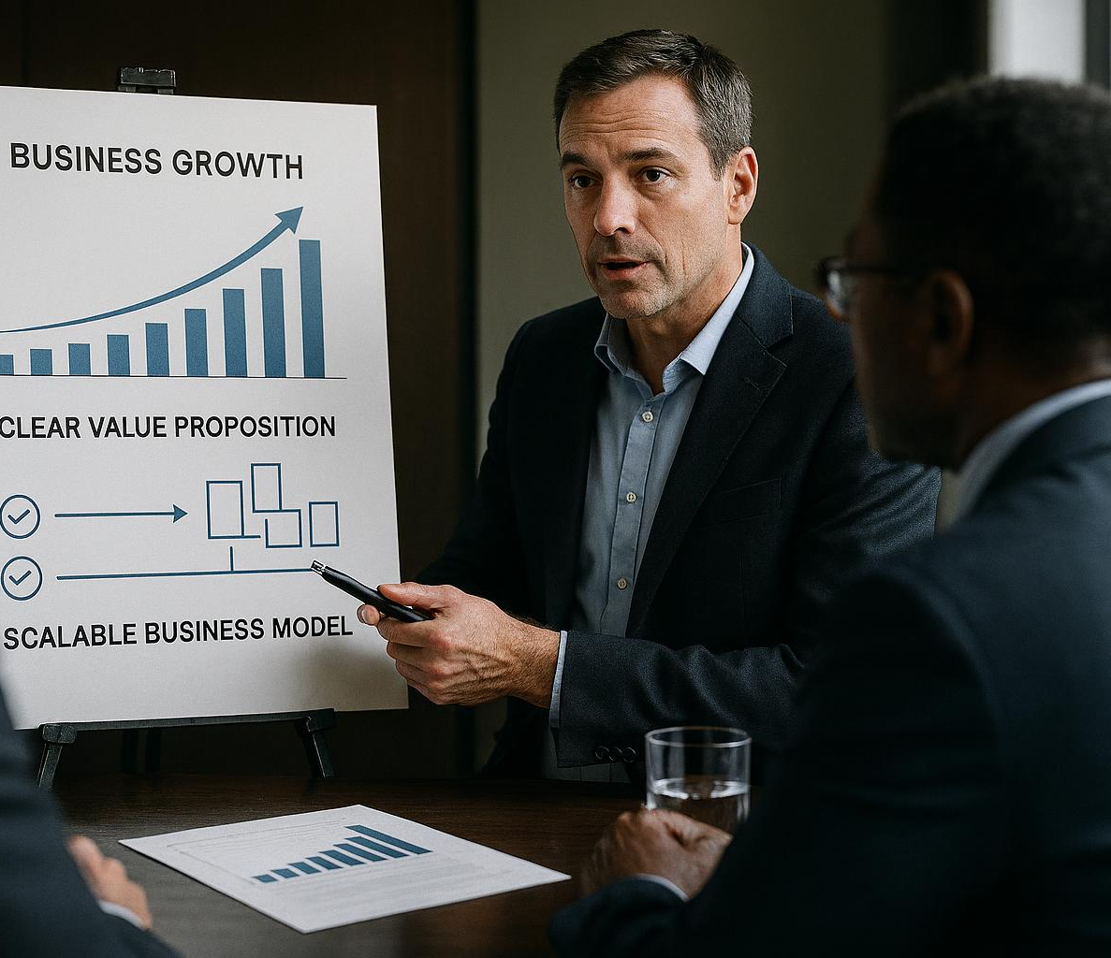
Understanding evidence investors expect
Validated Learning
Investors expect evidence of validated learning to confirm the business concept's viability and market fit.
Traction Evidence
Showing traction through customer growth or sales helps convince investors of business momentum and potential.
Clear Value Proposition
A clear value proposition highlights the unique benefits that attract and retain customers.
Scalable Business Model
Investors want to see a scalable business model capable of expanding profitably over time.
Notes:
--- Investors look for validated learning, traction evidence, a clear value proposition, and a scalable business model before committing funds. Image source: AI-generated

Slide 26
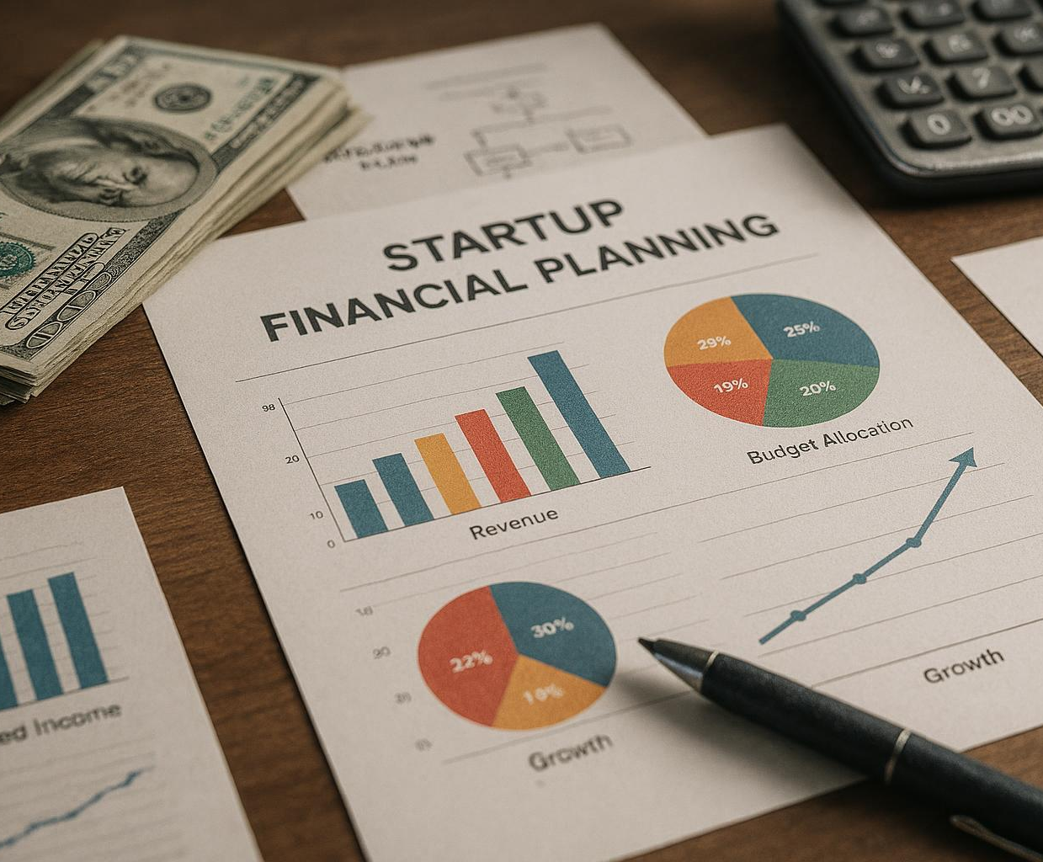
Transitioning from MVP validation to financial planning
Post-Validation Financial Forecasts
Develop detailed financial forecasts to project revenues and expenses after MVP validation.
Budgeting for Scaling
Create budgets that allocate resources efficiently for sustainable startup growth.
Strategic Planning
Formulate strategic plans that guide decision-making and support business scaling efforts.
Notes:
--- Once validation is achieved, prepare financial forecasts, budgeting, and strategic plans to support scaling your startup sustainably. Image source: AI-generated

Slide 27
Conclusion
Minimum Viable Product
Developing an MVP helps validate ideas with minimal resources and tests the market early on.
User Feedback Iteration
Iterating based on real user feedback ensures product improvements align with customer needs.
Go-to-Market Strategy
A strong go-to-market strategy effectively positions the product and targets the right customers.
Investment Preparation
Preparing for investment is crucial to secure funding and scale the startup successfully.
Notes:
Developing an MVP, iterating with real user feedback, crafting a strong go-to-market strategy, and preparing for investment are critical steps for startup success. Stay focused, flexible, and customer-centric to bring your ideas to life and grow your venture.

