Slide 1
Pricing and Unit Economics for Startup Businesses: Strategic Foundations for Revenue Models
Key strategies and metrics for effective startup revenue
Dr. Zornitsa Yordanova
Notes:
---
This presentation covers foundational strategies for pricing and unit economics in startups. We explore how pricing decisions impact success, common pitfalls, various pricing models, and key financial metrics to help build robust revenue models.

Slide 2
Today's Discussion Overview
The Strategic Importance of Pricing in Startups
Common Startup Pricing Mistakes to Avoid
Overview of Popular Startup Pricing Models
Value-Based Versus Cost-Based Pricing Strategies
Freemium and Free Trial Strategies for Startups
Subscription and Usage-Based Pricing Models
Comparing One-Time and Recurring Revenue Streams
Understanding Unit Economics for Startups
Key Metrics: Customer Acquisition Cost, Lifetime Value, Gross Margin
Early-Stage Pricing Assumptions and Financial Estimates
Notes:
We will discuss the strategic importance of pricing, common mistakes, popular pricing models, value-based versus cost-based pricing, freemium and subscription strategies, revenue stream comparisons, unit economics, key financial metrics, and early-stage financial planning.

Slide 3
The Strategic Importance of Pricing in Startups
Notes:
Pricing decisions are critical for startup success. This section examines how pricing influences business outcomes, market positioning, and brand perception, setting the foundation for revenue strategy.

Slide 4

Why Pricing Decisions Define Business Success
Impact on Growth Trajectory
  Correct pricing influences a startup's potential for growth and scalability in the market.
Profitability and Viability
  Pricing decisions directly affect the profitability and sustainability of a company’s operations.
Customer Acquisition and Competition
  Pricing strategies help attract customers and create a competitive advantage in the marketplace.
Notes:
---
Choosing the right price can determine a startup’s growth trajectory, profitability, and overall viability. Pricing affects customer acquisition, revenue generation, and competitive advantage.
Image source: AI-generated

Slide 5

Linking Pricing to Market Positioning
Pricing Alignment
  Pricing strategies must match the startup's target market to ensure relevance and appeal.
Value Proposition Reflection
  Pricing should reflect the perceived value to customers and support the startup's unique offering.
Market Differentiation
  Effective pricing differentiates the product or service within the competitive landscape.
Notes:
---
Pricing must align with the startup’s target market and value proposition. Effective positioning ensures the price reflects perceived value and differentiates the product or service.
Image source: AI-generated

Slide 6

Pricing’s Effect on Brand Perception
Price as Quality Signal
  Pricing communicates perceived quality and helps shape customers' views of the brand's value.
Impact on Brand Equity
  Strategic pricing enhances brand equity by aligning price with brand identity and market positioning.
Customer Loyalty and Trust
  Consistent pricing strategies foster customer loyalty and build long-term trust with the brand.
Notes:
---
Price signals quality and brand identity to customers. Strategic pricing can strengthen brand equity and influence customer loyalty and trust.
Image source: AI-generated

Slide 7
Common Startup Pricing Mistakes to Avoid
Notes:
Many startups stumble due to pricing errors. This section highlights frequent pitfalls such as mispricing and ignoring customer and competitive insights.

Slide 8
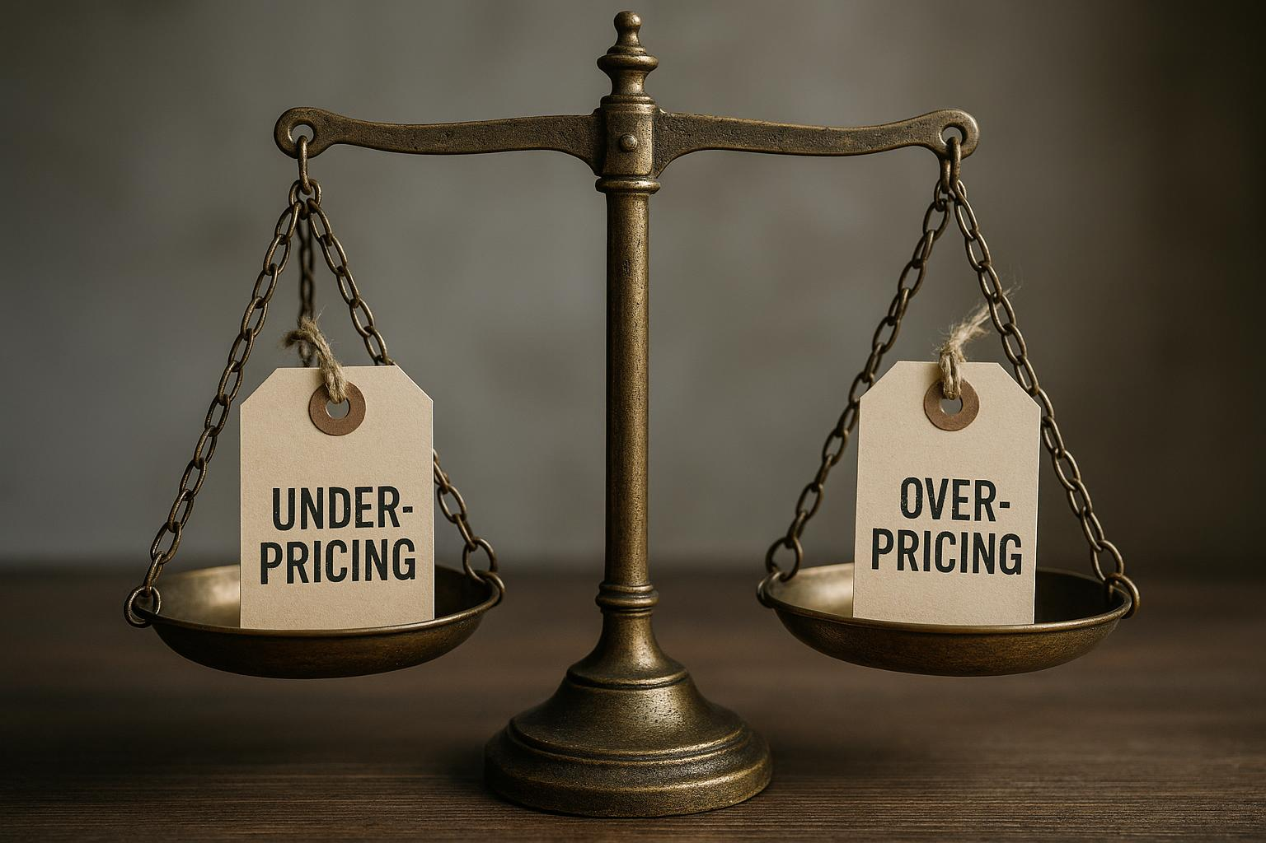
Underpricing and Overpricing Risks
Risks of Underpricing
  Underpricing reduces profit margins and can damage brand perception among consumers.
Risks of Overpricing
  Overpricing restricts market acceptance and lowers potential customer base.
Need for Balance
  Striking the right price balance ensures sustainable growth and brand value preservation.
Notes:
---
Pricing too low can erode margins and brand value, while pricing too high may limit market adoption. Finding a balance is essential for sustainable growth.
Image source: AI-generated

Slide 9

Neglecting Customer Value Perception
Customer Value Misunderstanding
  Ignoring customer value perception leads to misaligned pricing and product benefits.
Impact on Sales
  Incorrect pricing due to neglected value perception reduces sales and profitability.
Notes:
---
Failing to understand how customers perceive value can result in pricing that does not match willingness to pay or product benefits, reducing sales and profitability.
Image source: AI-generated

Slide 10

Ignoring Competitive Landscape
Risk of Uncompetitive Pricing
  Ignoring competitors' pricing leads to setting prices that are too high or too low compared to the market.
Market Share Loss
  Setting prices without competitor insight risks losing customers and decreasing market share.
Notes:
---
Ignoring what competitors charge or offer can result in pricing that is uncompetitive or out of sync with market expectations, risking market share loss.
Image source: AI-generated

Slide 11
Overview of Popular Startup Pricing Models
Notes:
This section reviews common pricing models, their strengths and weaknesses, and how to select a model suitable for your startup’s business type.

Slide 12

Menu of Standard Pricing Approaches
Cost-Plus Pricing
  Adds a fixed percentage margin to the production cost to determine the selling price.
Value-Based Pricing
  Prices set based on the perceived value to the customer rather than the cost of production.
Freemium Model
  Offers basic services for free while charging for premium features or upgrades.
Subscription & Usage-Based
  Subscription charges recurring fees; usage-based charges based on consumption or usage levels.
Notes:
---
Common models include cost-plus, value-based, freemium, subscription, usage-based, and one-time fees. Each serves different business goals and customer needs.
Image source: AI-generated

Slide 13

Strengths and Limitations of Each Model
Cost-Plus Pricing Strength
  Cost-plus pricing guarantees a profit margin by adding a fixed markup to costs but may overlook customer perceived value.
Value-Based Pricing Benefit
  Value-based pricing captures greater customer surplus by aligning price with perceived value and willingness to pay.
Freemium Model Challenge
  Freemium models increase user adoption but face challenges converting free users to paying customers.
Subscription Model Advantage
  Subscription pricing offers predictable recurring revenue but requires strong customer retention strategies.
Notes:
---
Cost-plus pricing ensures margin but may ignore value, while value-based pricing captures more customer surplus. Freemium drives adoption but challenges conversion, and subscription offers recurring revenue with retention demands.
Image source: AI-generated

Slide 14

Selecting the Right Model for Your Business Type
Consider Product Nature
  The product's characteristics strongly influence the choice of the most suitable business model.
Understand Customer Preferences
  Knowing customer needs and preferences is essential for selecting an effective business model.
Align with Revenue Goals
  Choose a model that best supports your revenue targets and business profitability.
Adapt to Market Dynamics
  Market trends and competitive environment must be considered to maintain relevance and success.
Notes:
---
Choice depends on product nature, customer preferences, revenue goals, and market dynamics. A tailored pricing model maximises growth and profitability.
Image source: AI-generated

Slide 15
Value-Based Versus Cost-Based Pricing Strategies
Notes:
We compare two fundamental pricing philosophies, exploring when and how to apply each along with their trade-offs.

Slide 16

Defining Value-Based Pricing
Pricing Based on Customer Value
  Value-based pricing focuses on the perceived worth of a product or service to customers rather than production costs.
Maximising Willingness to Pay
  The goal is to capture the maximum amount customers are willing to pay by aligning price with perceived benefits.
Notes:
---
Value-based pricing sets prices according to the perceived value to customers rather than costs, aiming to capture maximum willingness to pay.
Image source: AI-generated

Slide 17

Implementing Cost-Based Pricing
Definition of Cost-Based Pricing
  Cost-based pricing involves setting prices by adding a fixed margin over the production cost, ensuring predictable profits.
Advantages
  This pricing method offers predictable margins and simplicity in pricing decisions, aiding in financial planning.
Limitations
  Cost-based pricing can overlook customer value perception, potentially missing higher profit opportunities.
Notes:
---
Cost-based pricing calculates prices by adding a margin over production costs, providing predictable margins but potentially missing value opportunities.
Image source: AI-generated

Slide 18

Situational Use Cases and Trade-Offs
Strategy Combination
  Startups often blend multiple strategies to adapt to varying market conditions and competitive pressures effectively.
Market Maturity Impact
  Market maturity significantly influences strategic choices, affecting how startups prioritise growth and profitability.
Product Lifecycle Role
  Product lifecycle stage guides startups in adjusting strategies for maximising market penetration and profits.
Notes:
---
Startups may combine strategies depending on market maturity, competition, and product lifecycle stage to optimise profitability and market penetration.
Image source: AI-generated

Slide 19
Freemium and Free Trial Strategies for Startups
Notes:
This section explores how offering free access models can boost adoption and outlines key design and conversion considerations.

Slide 20
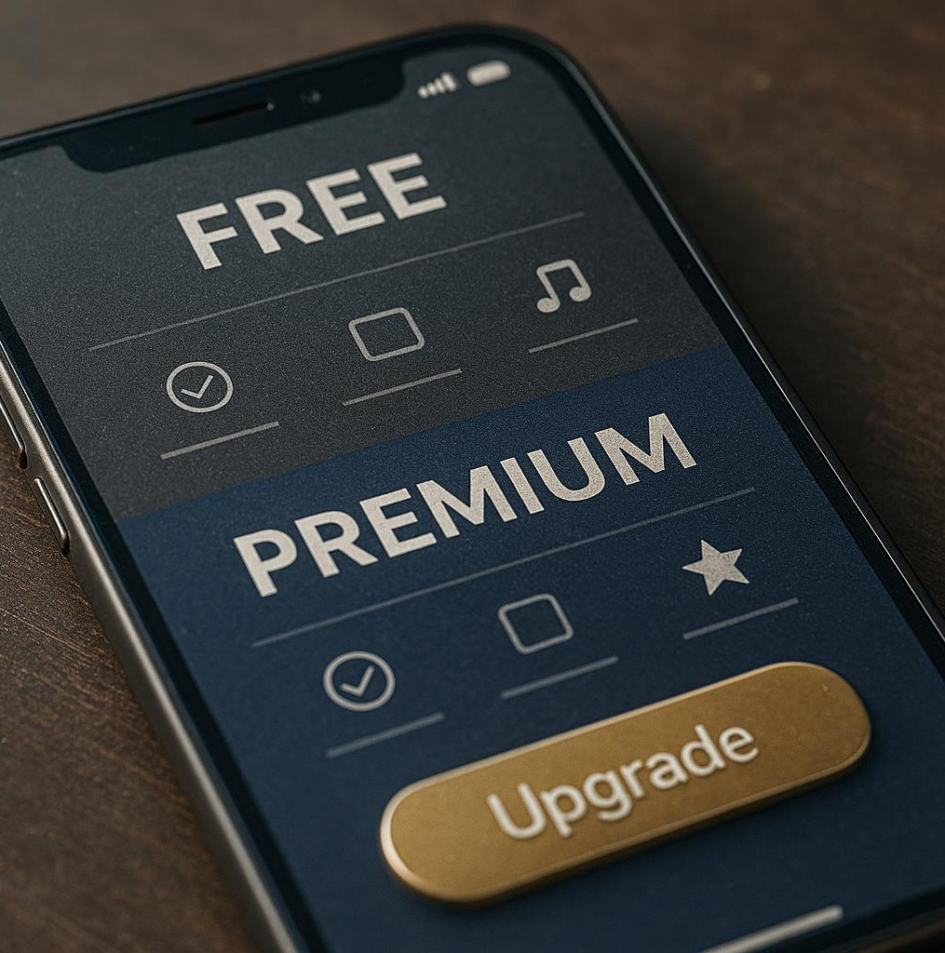
How Freemium Drives Adoption
User Attraction with Free Features
  Freemium models offer valuable free features that attract a wide range of users to try the product.
Encouraging Premium Upgrades
  The model encourages users to upgrade for enhanced functionalities and premium benefits.
Facilitating Viral Growth
  Freemium drives viral growth by increasing product awareness through widespread free usage.
Notes:
---
Freemium models attract users by providing valuable free features while encouraging upgrades, facilitating viral growth and product awareness.
Image source: AI-generated

Slide 21
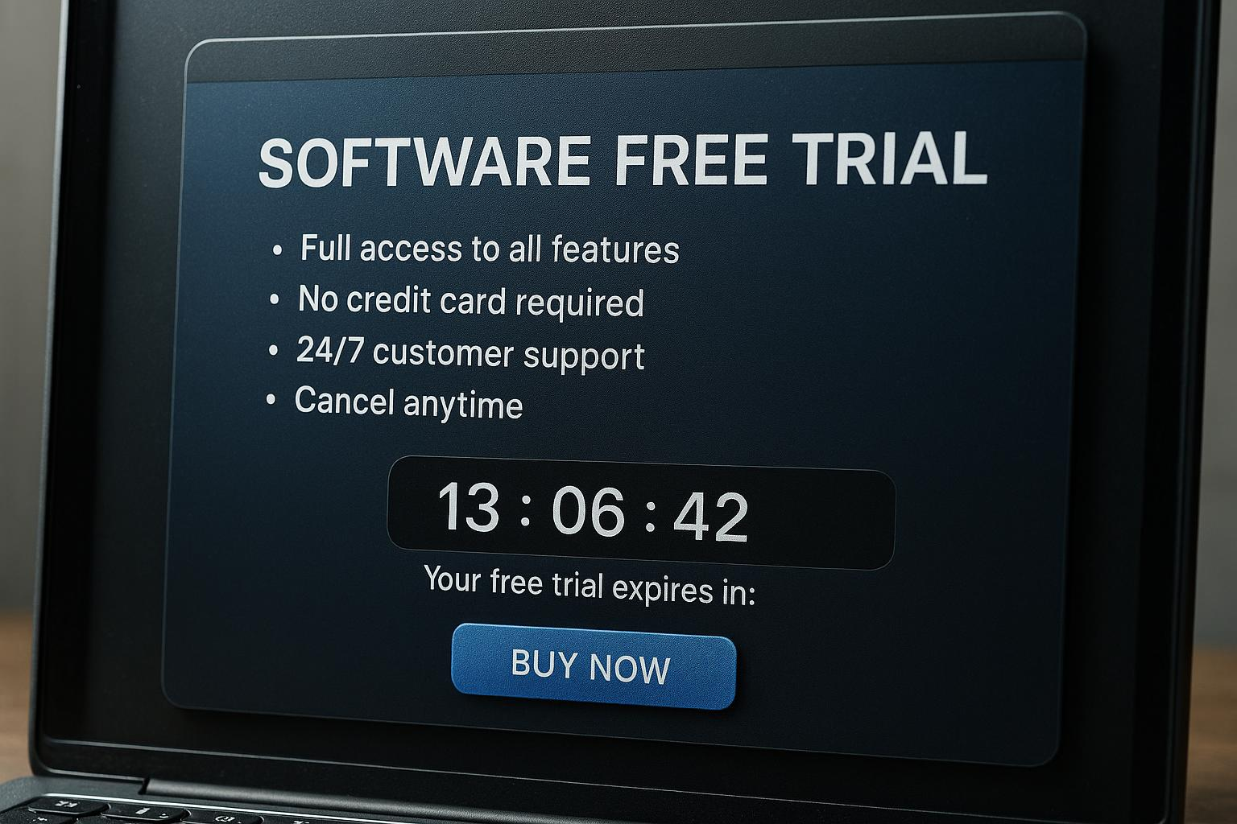
Designing Effective Free Trials
Balance Feature Access
  Provide enough features during the trial to demonstrate product value without giving full access.
Set Time Limits
  Implement a clear time limit to encourage users to evaluate quickly and decide on conversion.
Motivate Conversion
  Design trials to reduce barriers and motivate users to upgrade after experiencing the product.
Notes:
---
Free trials should balance feature access and time limits to showcase value, reduce barriers, and motivate conversion without undue cost.
Image source: AI-generated

Slide 22

Conversion Metrics and Pitfalls
Trial-to-Paid Conversion Importance
  Monitoring how many trial users convert to paid customers is essential for business growth.
Offering Too Much for Free
  Providing excessive free features can reduce the incentive for users to upgrade to paid plans.
Unclear Upgrade Paths
  Confusing or unclear upgrade options can discourage users from becoming paying customers.
Notes:
---
Tracking trial-to-paid conversion rates is critical. Pitfalls include offering too much for free or unclear upgrade paths, which can hurt revenue.
Image source: AI-generated

Slide 23
Subscription and Usage-Based Pricing Models
Notes:
We examine recurring revenue models, how usage-based pricing works, and the flexibility of hybrid approaches.

Slide 24

Recurring Revenue Fundamentals
Predictable Cash Flow
  Subscription models create steady and predictable cash flow through regular recurring payments.
Customer Retention
  Recurring billing encourages customer loyalty by maintaining ongoing value delivery over time.
Notes:
---
Subscription models provide predictable cash flow and encourage customer retention through recurring billing cycles and continuous value delivery.
Image source: AI-generated

Slide 25
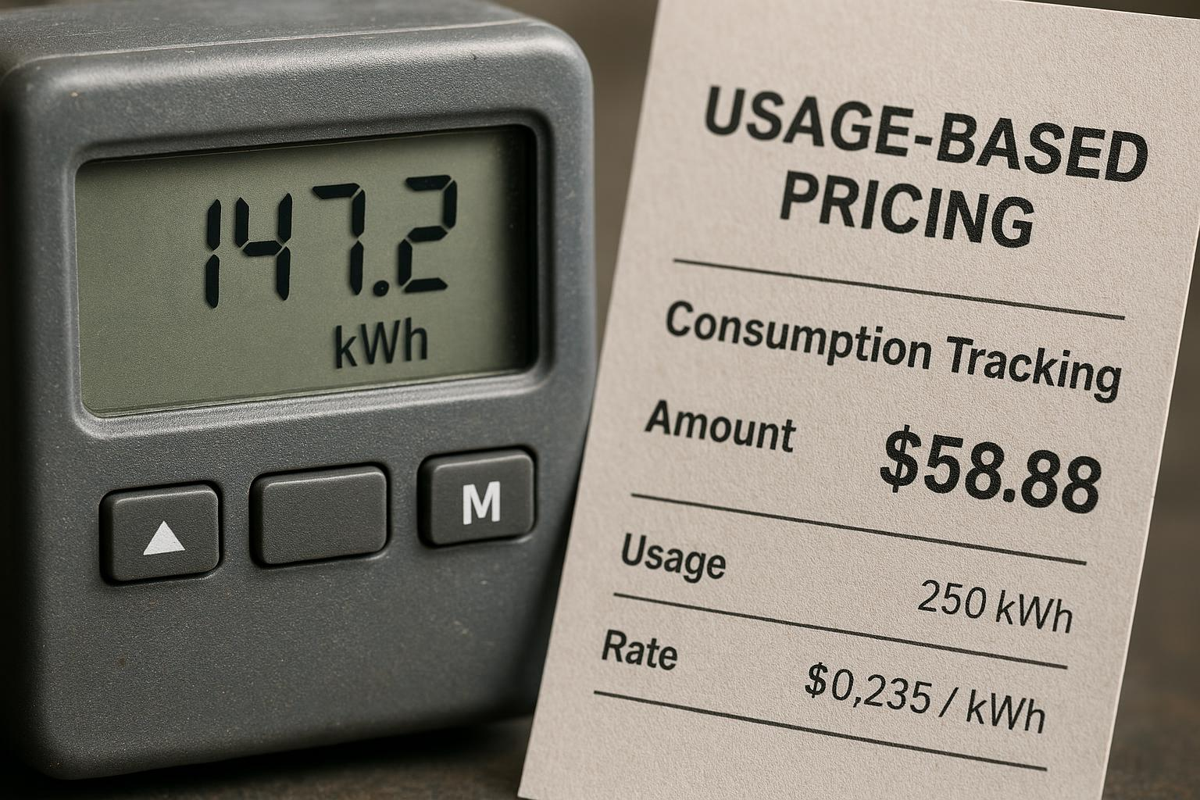
Usage-Driven Pricing Mechanics
Consumption-Based Charges
  Pricing is determined by actual customer usage, promoting fairness and aligning cost with value received.
Scalability and Flexibility
  This model supports scalable pricing adapting to changing customer consumption patterns effectively.
Monitoring and Billing Infrastructure
  Accurate monitoring and robust billing systems are essential to implement usage-driven pricing successfully.
Notes:
---
Usage-based pricing charges customers based on consumption, offering fairness and scalability but requiring careful monitoring and billing infrastructure.
Image source: AI-generated

Slide 26
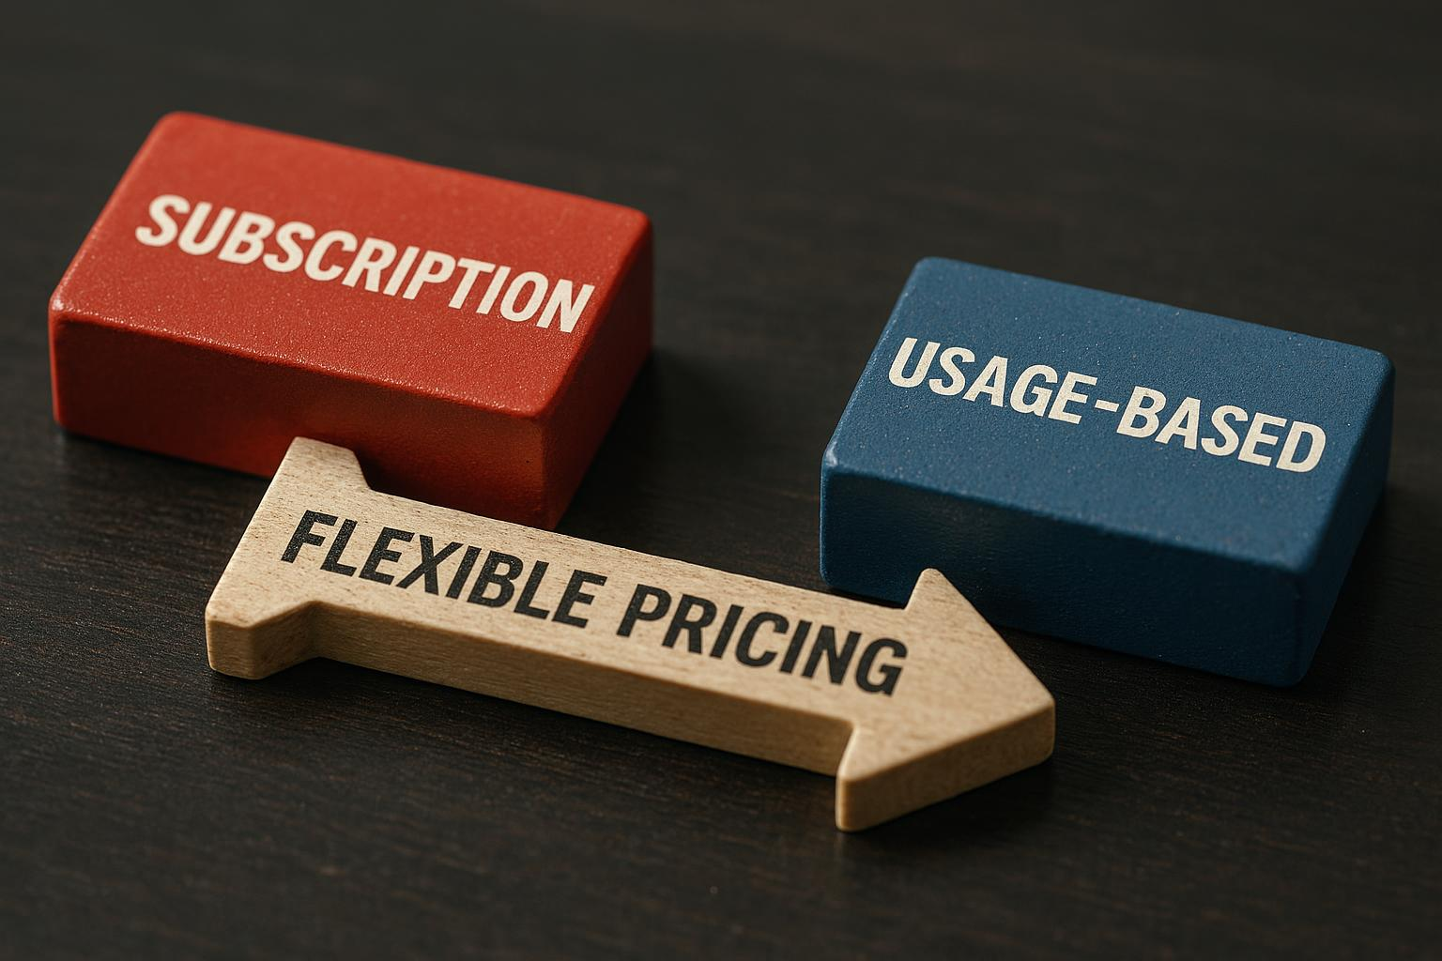
Hybrid Models and Flexibility
Subscription-Based Model
  Subscription models provide predictable recurring revenue and simplify customer billing with fixed periodic charges.
Usage-Based Model
  Usage-based pricing allows charges to reflect actual consumption, promoting fairness and encouraging efficient use.
Hybrid Pricing Flexibility
  Combining subscription and usage-based pricing creates flexible plans that adapt to customer behaviour and business goals.
Notes:
---
Combining subscription with usage-based elements offers flexibility to align charges with customer behaviour and business goals.
Image source: AI-generated

Slide 27
Comparing One-Time and Recurring Revenue Streams
Notes:
This section contrasts the benefits and challenges of different revenue models and their impact on financial planning.

Slide 28

Advantages and Drawbacks of Each
One-time Sales Benefits
  One-time sales deliver immediate cash influx, supporting short-term business needs and quick revenue generation.
One-time Sales Limitations
  These sales offer less revenue predictability and require constant acquisition of new customers for sustained income.
Recurring Revenue Advantages
  Recurring revenue ensures long-term financial stability through ongoing customer subscriptions and retention.
Recurring Revenue Challenges
  Maintaining recurring revenue demands continuous customer retention efforts and quality service delivery.
Notes:
---
One-time sales provide immediate cash but less predictability, while recurring revenue drives long-term stability but requires retention efforts.
Image source: AI-generated

Slide 29

Impact on Cash Flow and Forecasting
Recurring Revenue Benefits
  Recurring revenue models enhance forecasting accuracy and support stronger business valuations over time.
One-Time Sales Challenges
  Sales that occur once can create revenue volatility, necessitating more conservative and cautious financial planning.
Notes:
---
Recurring models improve forecasting accuracy and valuation, whereas one-time sales may cause revenue volatility requiring more conservative planning.
Image source: AI-generated

Slide 30

Matching Revenue Streams to Product Type
Product Nature Impact
  The inherent characteristics of a product determine the most effective revenue stream to pursue for maximum growth.
Customer Usage Patterns
  Understanding how customers use a product helps tailor revenue models to increase satisfaction and long-term loyalty.
Revenue Model Suitability
  Selecting revenue models aligned with product and usage patterns optimises profitability and customer experience.
Notes:
---
Product nature and customer usage patterns influence revenue model suitability to maximise growth and customer satisfaction.
Image source: AI-generated

Slide 31
Understanding Unit Economics for Startups
Notes:
Unit economics analysis helps startups evaluate profitability at a granular level, informing strategic decisions.

Slide 32
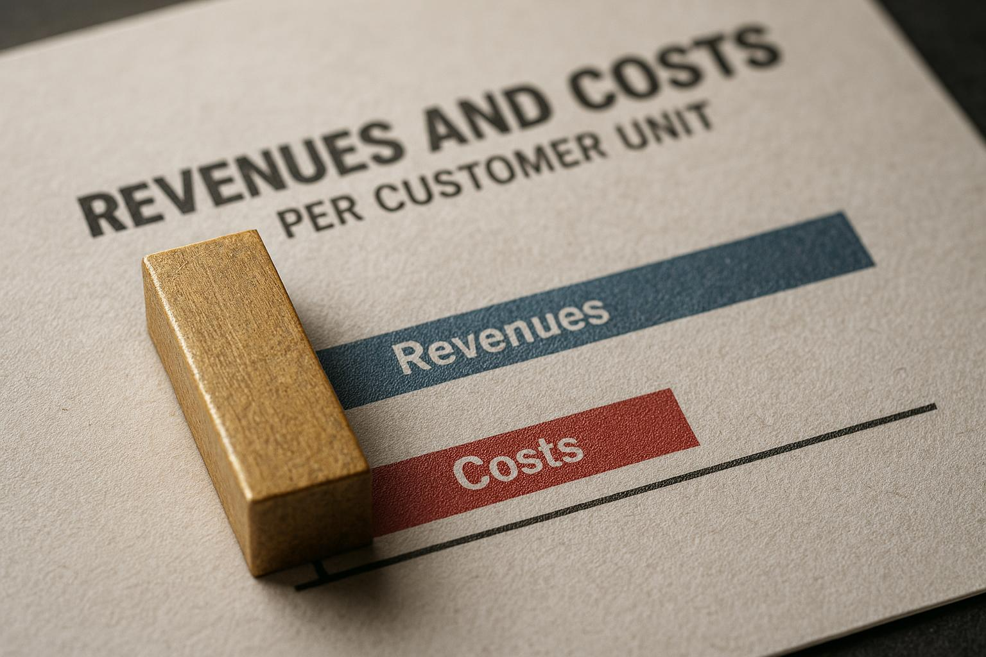
Defining Unit Economics
Understanding Unit Economics
  Unit economics focuses on the revenues and costs tied to acquiring and servicing one customer or unit.
Insight into Business Viability
  Examining unit economics provides crucial insights into the overall viability and profitability of a business.
Notes:
---
Unit economics examines the revenues and costs associated with acquiring and serving a single customer or unit, providing insight into business viability.
Image source: AI-generated

Slide 33
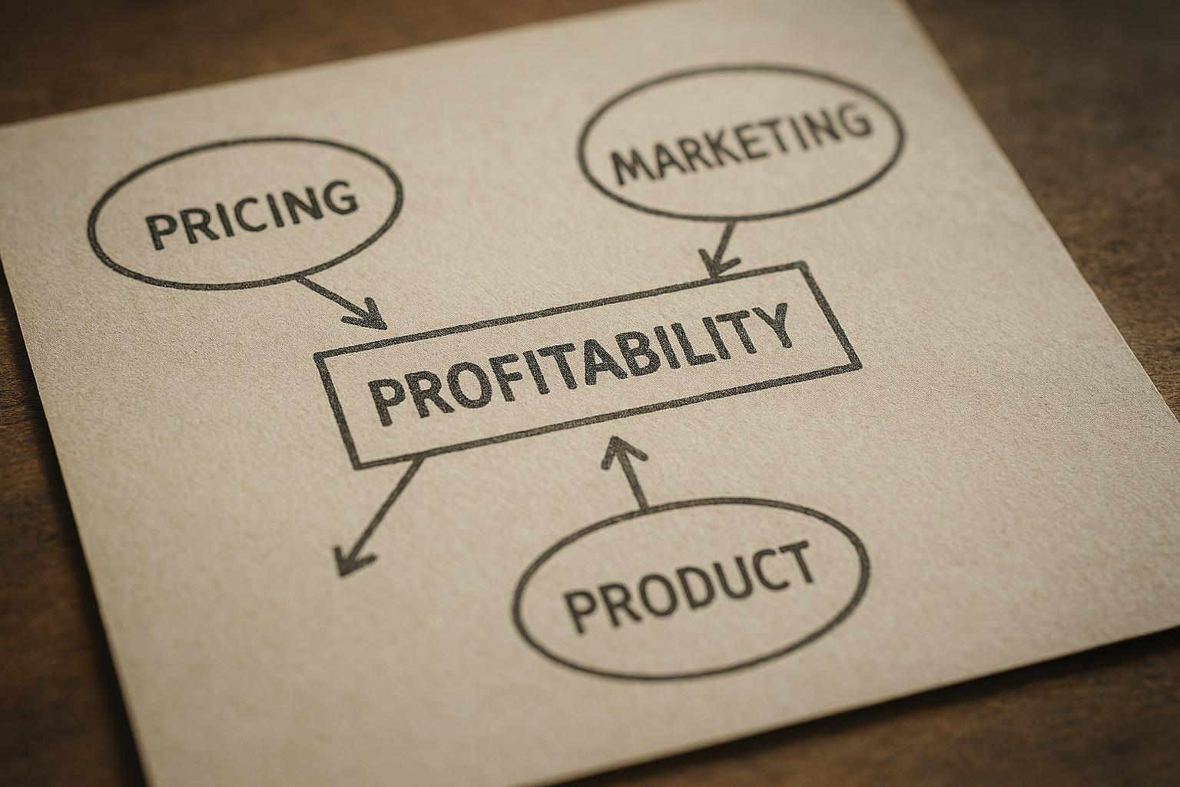
How Unit Economics Inform Strategy
Guiding Pricing Decisions
  Unit economics helps determine optimal pricing to maximise profitability per customer.
Optimising Marketing Spend
  Understanding unit economics ensures marketing budgets focus on profitable customer acquisition.
Informing Product Decisions
  Unit economics guides product features and improvements to enhance customer value and growth.
Notes:
---
Understanding unit economics guides pricing, marketing spend, and product decisions to optimise customer profitability and growth.
Image source: AI-generated

Slide 34
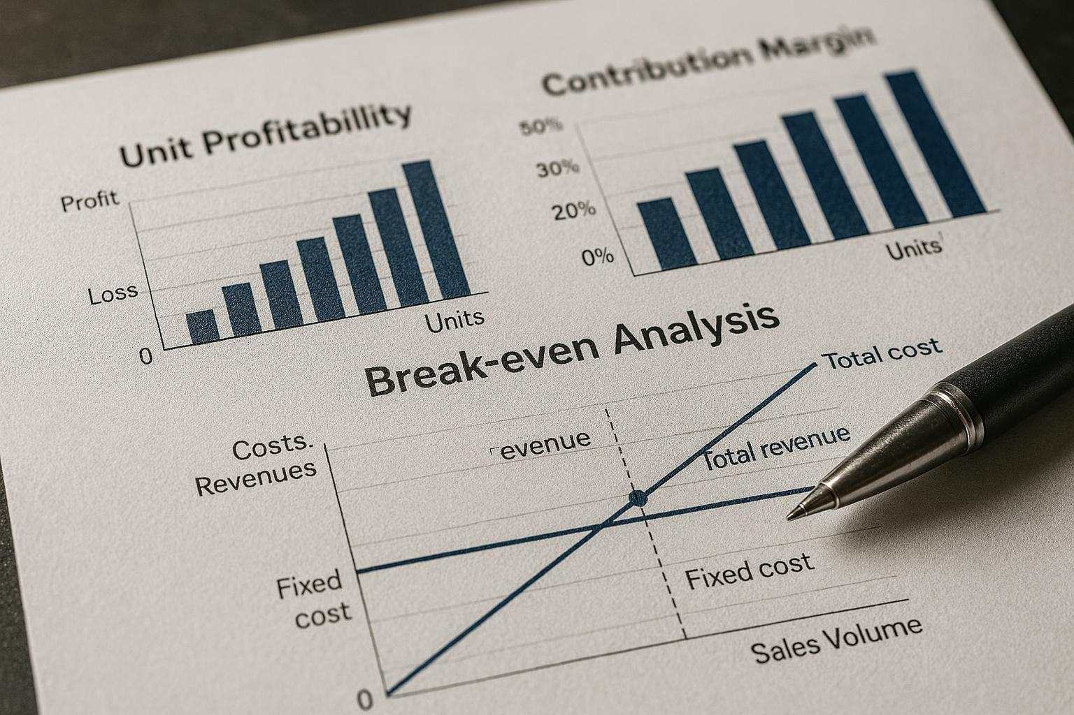
Analysing Unit Profitability
Contribution Margin Evaluation
  Assessing contribution margin per unit highlights profitability and supports strategic decision-making.
Breakeven Point Analysis
  Calculating breakeven points at the unit level helps determine minimum sales for cost recovery.
Customer Segments and Cost Optimisation
  Identifying profitable customer segments and areas for cost optimisation enhances business efficiency.
Notes:
---
Evaluating contribution margin and breakeven points at the unit level helps identify profitable customer segments and cost optimisation areas.
Image source: AI-generated

Slide 35
Key Metrics: Customer Acquisition Cost, Lifetime Value, Gross Margin
Notes:
Critical financial metrics enable startups to measure marketing efficiency, customer value, and profitability.

Slide 36
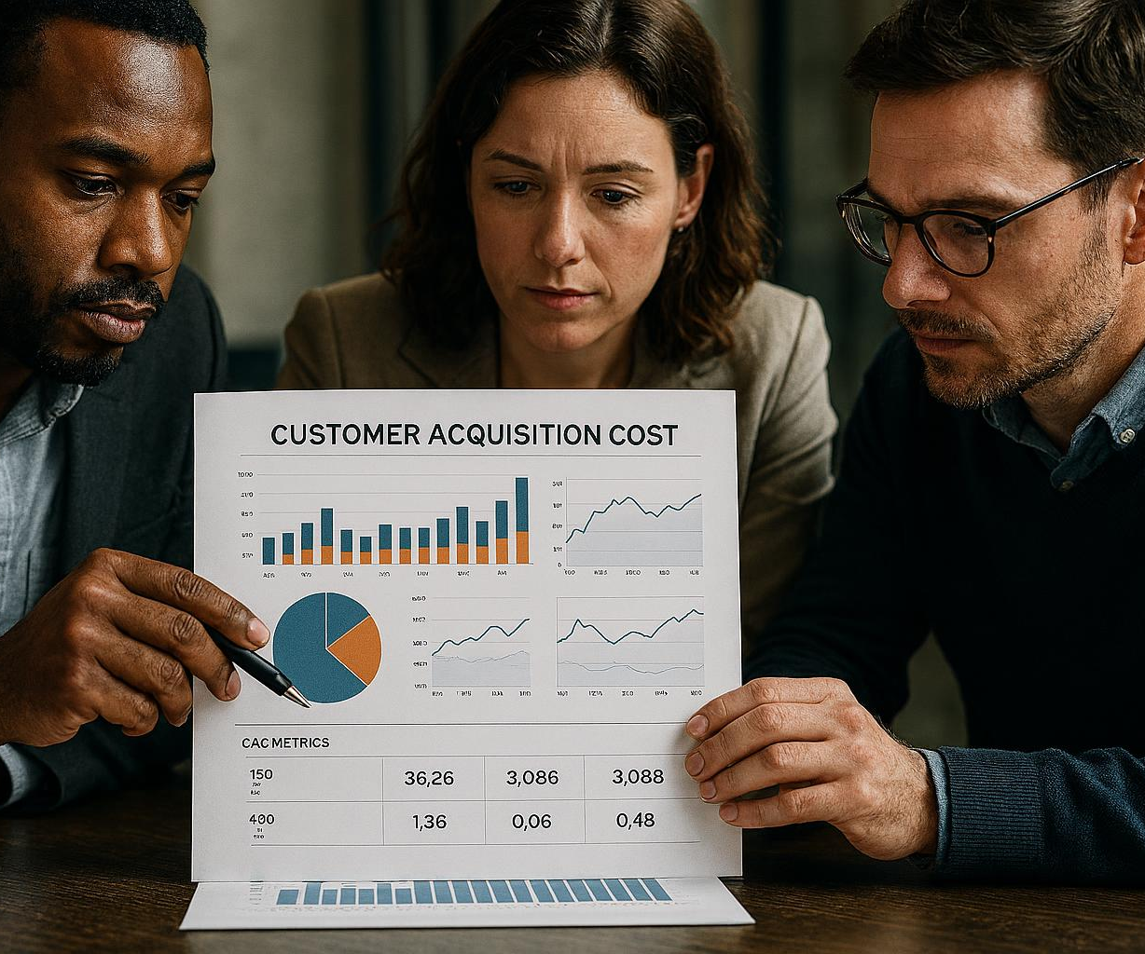
Calculating CAC and Its Importance
Definition of CAC
  Customer Acquisition Cost is the average expense incurred to acquire a new customer for a business.
Importance of Minimising CAC
  Reducing CAC while maintaining service quality is crucial for achieving sustainable business growth.
Notes:
---
Customer Acquisition Cost represents the average expense to gain a customer. Minimising CAC while maintaining quality leads to sustainable growth.
Image source: AI-generated

Slide 37
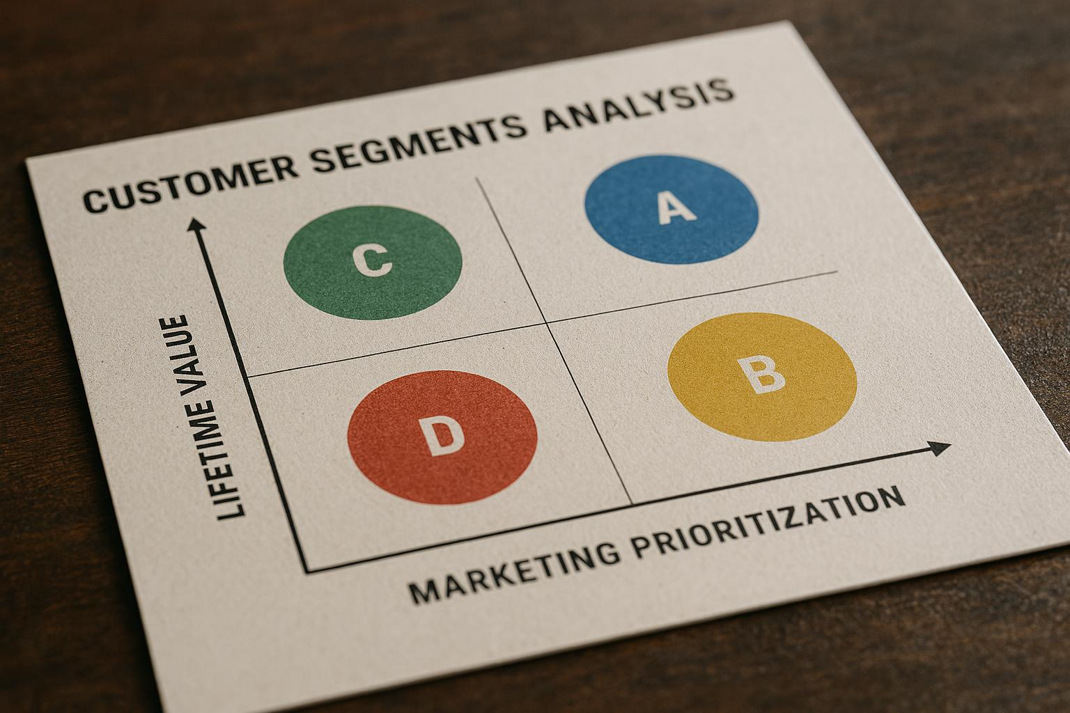
Determining LTV for Customer Segments
Definition of Lifetime Value
  Lifetime Value estimates the total revenue a customer generates over the course of their relationship with a business.
Importance of LTV
  Understanding LTV allows businesses to prioritise marketing and retention efforts effectively toward high-value customer segments.
Notes:
---
Lifetime Value estimates the total revenue a customer generates. Understanding LTV helps prioritise marketing and retention efforts for high-value segments.
Image source: AI-generated

Slide 38
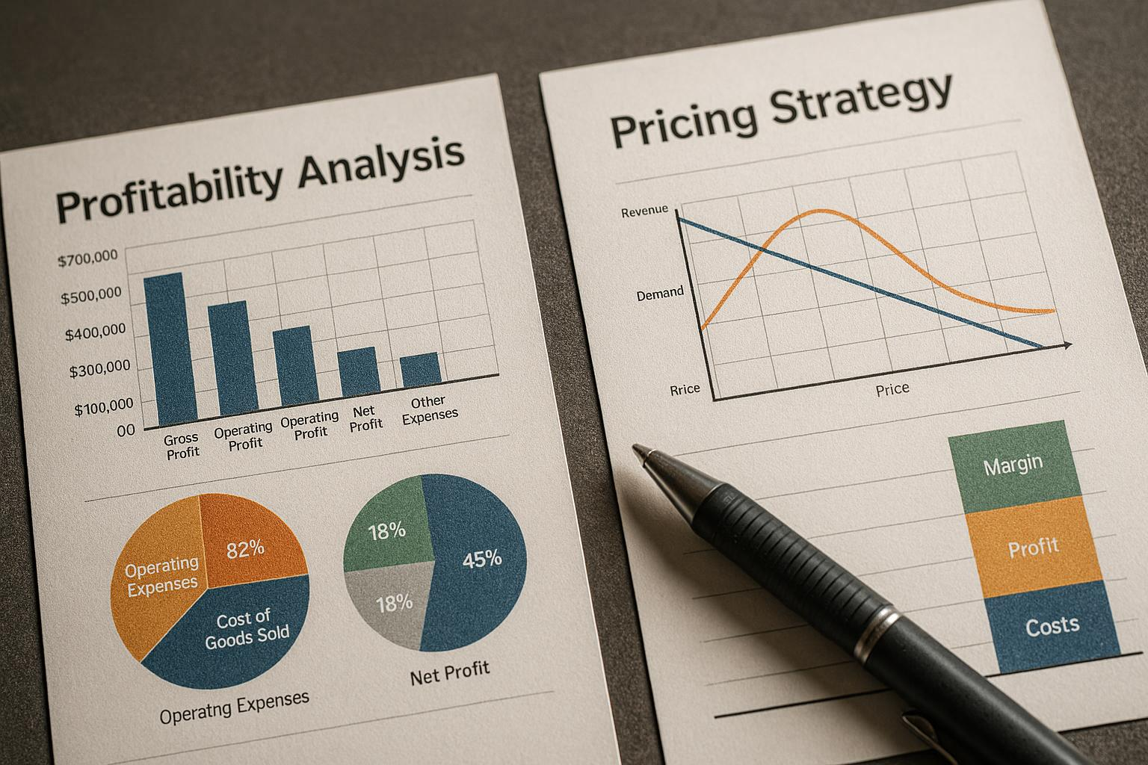
Gross Margin Analysis and Implications
Definition of Gross Margin
  Gross margin indicates profitability after subtracting direct costs from revenue, essential for financial health assessment.
Pricing Strategy Impact
  Gross margin informs pricing decisions to ensure products remain profitable and competitive in the market.
Investment Capacity
  Higher gross margins increase a company's capacity to invest in growth and innovation opportunities.
Notes:
---
Gross margin reflects profitability after direct costs, influencing pricing strategy and investment capacity.
Image source: AI-generated

Slide 39
Early-Stage Pricing Assumptions and Financial Estimates
Notes:
This section outlines how to develop initial pricing hypotheses, estimate costs and margins, and conduct scenario planning to support financial projections.

Slide 40

Building Initial Pricing Hypotheses
Market Research Importance
  Market research helps startups understand pricing trends and customer willingness to pay.
Customer Feedback Role
  Customer feedback provides insights into perceived value and pricing acceptability.
Competitive Analysis Impact
  Competitive analysis helps position pricing relative to market alternatives.
Notes:
---
Startups should base early pricing assumptions on market research, customer feedback and competitive analysis to inform testing and iteration.
Image source: AI-generated

Slide 41
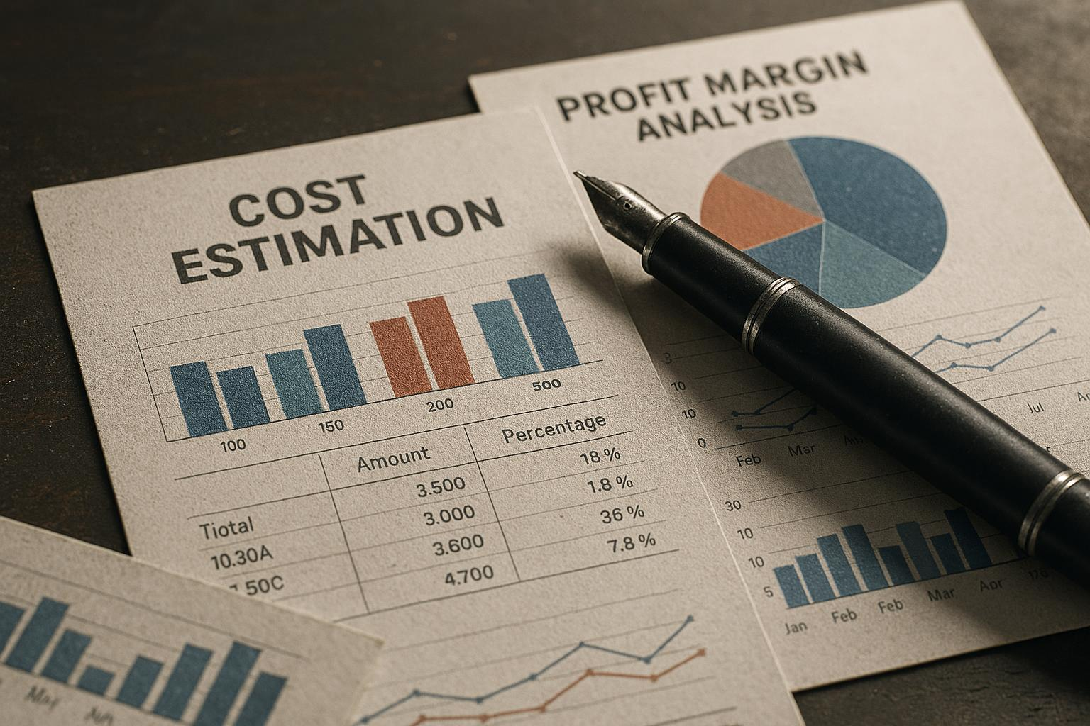
Estimating Costs and Margins
Forecasting Costs
  Accurate cost forecasting is essential for setting prices that cover expenses and enable growth.
Calculating Margins
  Estimating expected margins ensures profitability and supports strategic pricing decisions.
Notes:
---
Accurately forecasting costs and expected margins helps ensure pricing supports profitability and investment needs.
Image source: AI-generated

Slide 42
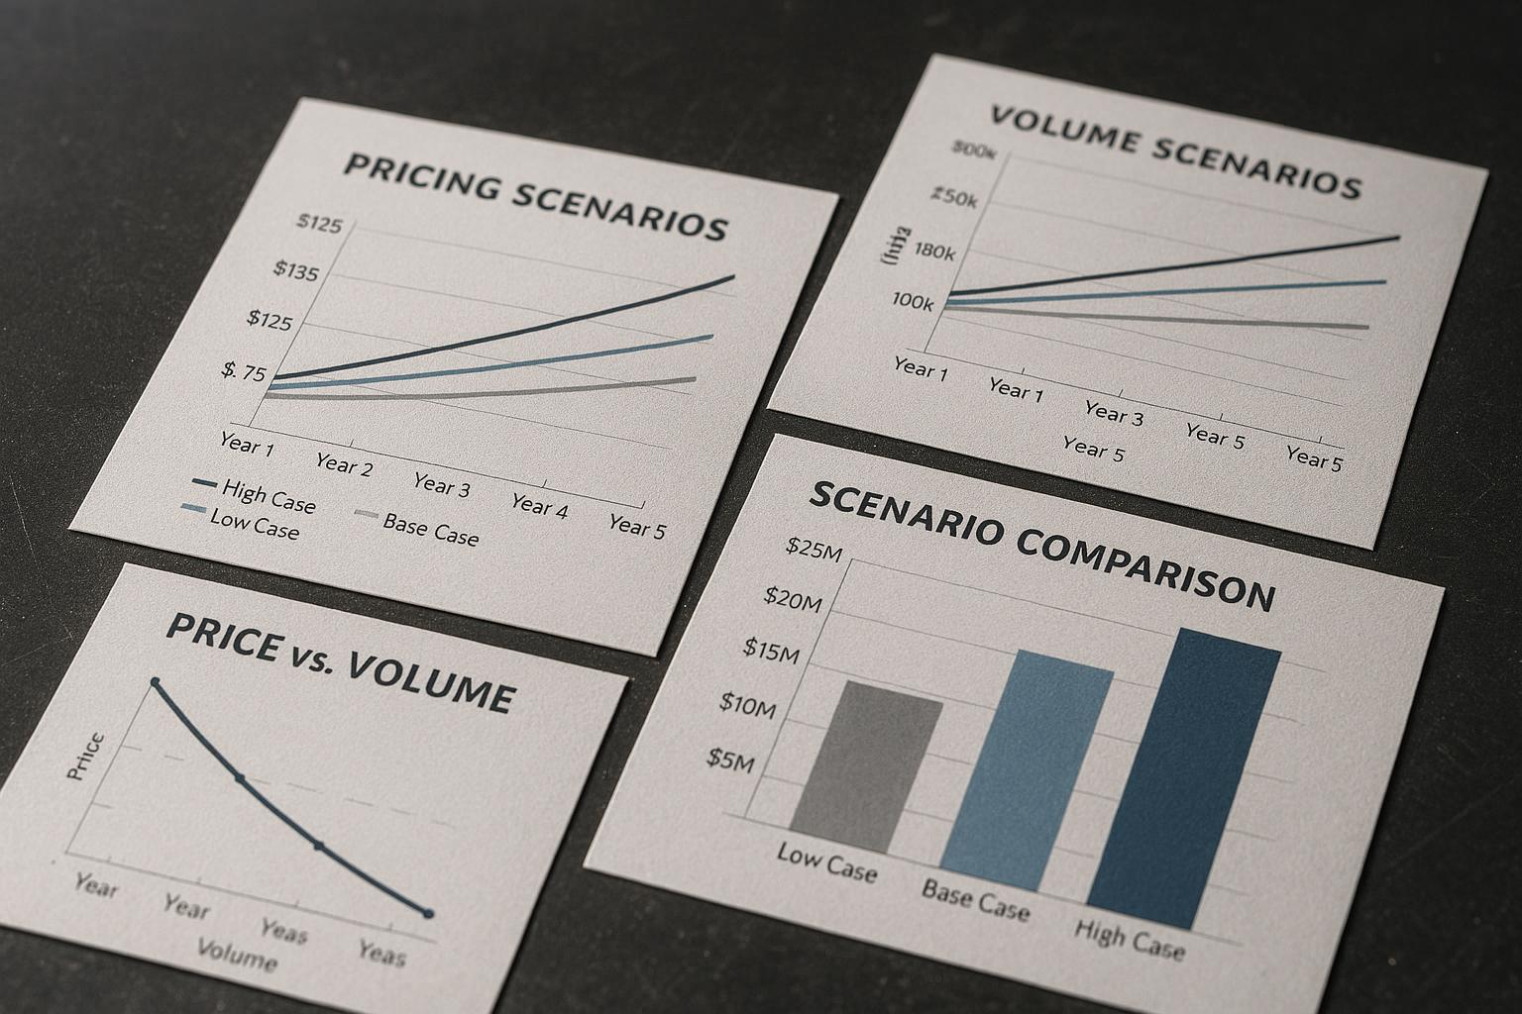
Scenario Planning for Pricing
Multiple Pricing Scenarios
  Exploring different pricing models helps startups anticipate market reactions and optimize revenue strategies.
Volume Projections
  Forecasting sales volumes under different conditions supports informed decision-making and risk management.
Strategic Decision-Making
  Scenario planning enables startups to navigate uncertainties and make data-driven strategic choices.
Notes:
---
Modeling multiple pricing and volume scenarios prepares startups for market uncertainties and aids strategic decision-making.
Image source: AI-generated

Slide 43
Conclusion
Importance of Pricing
Effective pricing strategies are crucial for the financial success of startups and market competitiveness.
Understanding Unit Economics
Unit economics provide insight into cost structures and profitability critical for sustainable business growth.
Avoiding Common Mistakes
Startups should avoid frequent pricing mistakes by carefully selecting models and analysing metrics to ensure success.
Notes:
Effective pricing and understanding unit economics are essential to startup success. By avoiding common mistakes, choosing appropriate pricing models, and analysing key metrics, startups can build sustainable revenue foundations.

