Slide 1
Prototyping and MVP Strategies for Startups: A Comprehensive Guide for Startup Students
Essential concepts and approaches to accelerate startup learning
Dr. Zornitsa Yordanova
Notes:
AI-generated content may be incorrect. --- This presentation explores the critical role of prototyping and Minimum Viable Products (MVPs) in the startup journey. Designed for startup students, it covers key concepts, common misconceptions, and practical approaches to help accelerate learning and resource efficiency.

Slide 2
Agenda: Prototyping and MVP Insights
The Importance of Prototyping in the Startup Journey
Understanding MVPs: Definitions and Common Misconceptions
MVPs, Prototypes, and Products: Key Differences
Embracing Risk-Based MVP Thinking
Exploring Types of MVPs
Choosing the Right MVP Type for Your Startup
Prototyping Tools and Platforms Overview
Balancing Speed and Quality in Prototyping
Defining Success Criteria for MVPs
Learning Metrics Versus Vanity Metrics
Notes:
We will cover the importance of prototyping, definitions and misconceptions around MVPs, differences between prototypes, MVPs and full products, risk-based MVP thinking, types of MVPs, how to choose the right MVP, tools and platforms, balancing speed and quality, defining success, and learning versus vanity metrics.

Slide 3
The Importance of Prototyping in the Startup Journey
Notes:
Prototyping plays a vital role in startups by accelerating learning, reducing uncertainty, saving resources through early validation, and helping align stakeholders and teams around shared goals.

Slide 4

Accelerating Learning and Reducing Uncertainty
Rapid Hypothesis Testing
Prototyping enables quick validation of ideas by testing hypotheses early in the development process.
Gathering Feedback
Early user feedback supports iterative improvements and informed decision-making for startups.
Risk Reduction
Testing prototypes early helps minimise risks and reduces uncertainties during product development.
Notes:
--- Prototyping allows startups to quickly test hypotheses and gather feedback, speeding up the learning process while minimising risks and unknowns early in the development cycle. Image source: AI-generated

Slide 5
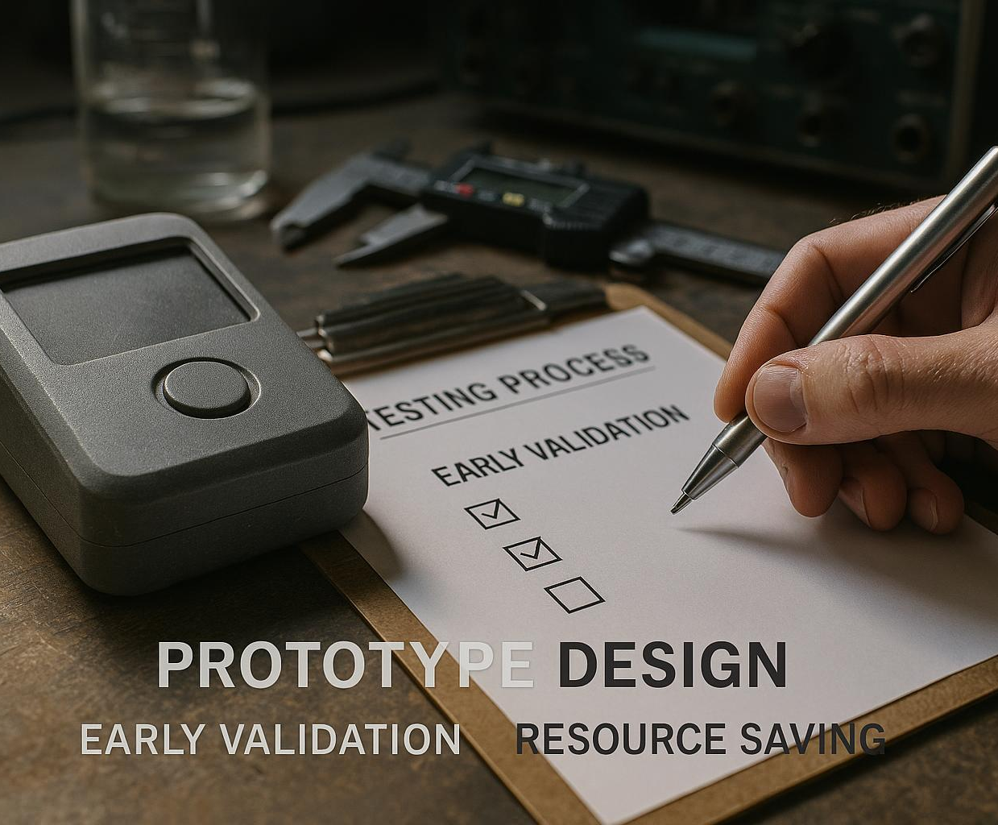
Saving Resources Through Early Validation
Purpose of Early Prototypes
Early prototypes allow testing of ideas before heavy investment, saving resources and reducing risks.
Cost and Time Efficiency
Validating concepts early reduces wasted time and costs by identifying failures promptly.
Notes:
--- Early-stage prototypes help validate ideas before significant investment, reducing wasted time and costs by identifying what works and what doesn’t early on. Image source: AI-generated

Slide 6

Facilitating Stakeholder and Team Alignment
Tangible Vision
Prototypes create a concrete representation of ideas, making concepts clear to all stakeholders.
Improved Communication
Prototypes enhance communication by providing a reference point for discussion among team members and investors.
Aligned Expectations
Using prototypes helps align expectations across customers, investors, and teams, reducing misunderstandings.
Notes:
--- Prototypes provide a tangible vision that enables better communication and alignment among team members, investors, and customers, fostering collaboration and clearer expectations. Image source: AI-generated

Slide 7
Understanding MVPs: Definitions and Common Misconceptions
Notes:
We explore what exactly defines a Minimum Viable Product, common misunderstandings about MVPs, and how they differ from fully developed products.

Slide 8
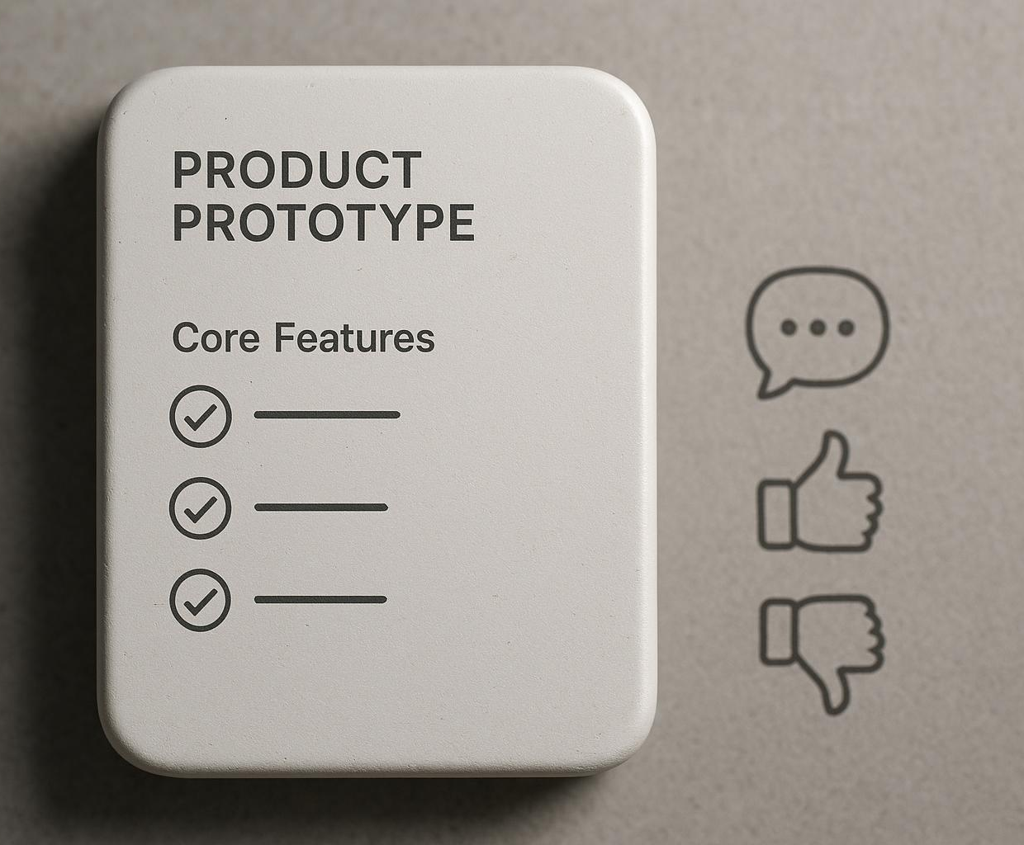
What is a Minimum Viable Product (MVP)?
Definition of MVP
An MVP is a basic version of a product designed to test key assumptions with minimal resources.
Purpose of MVP
It enables startups to learn from customers through validated feedback early in development.
Focus on Core Functionalities
MVP focuses on solving the main problem with just enough features to satisfy early users.
Notes:
--- An MVP is the simplest version of a product that allows a startup to collect validated learning about customers with the least effort, focusing on core functionalities to solve a problem. Image source: AI-generated

Slide 9

Common Misconceptions and Pitfalls
MVP Quality Misconception
MVPs are often mistaken for low-quality or incomplete products, which misrepresents their true purpose.
Revenue Expectations
Expecting MVPs to generate revenue immediately is a common pitfall that leads to unrealistic business goals.
Setting Realistic Expectations
Clarifying what MVPs represent helps teams set realistic goals for product development and market testing.
Notes:
--- Many confuse MVPs with incomplete or low-quality products, or expect MVPs to be revenue-generating. We clarify these misconceptions to help set realistic expectations. Image source: AI-generated

Slide 10
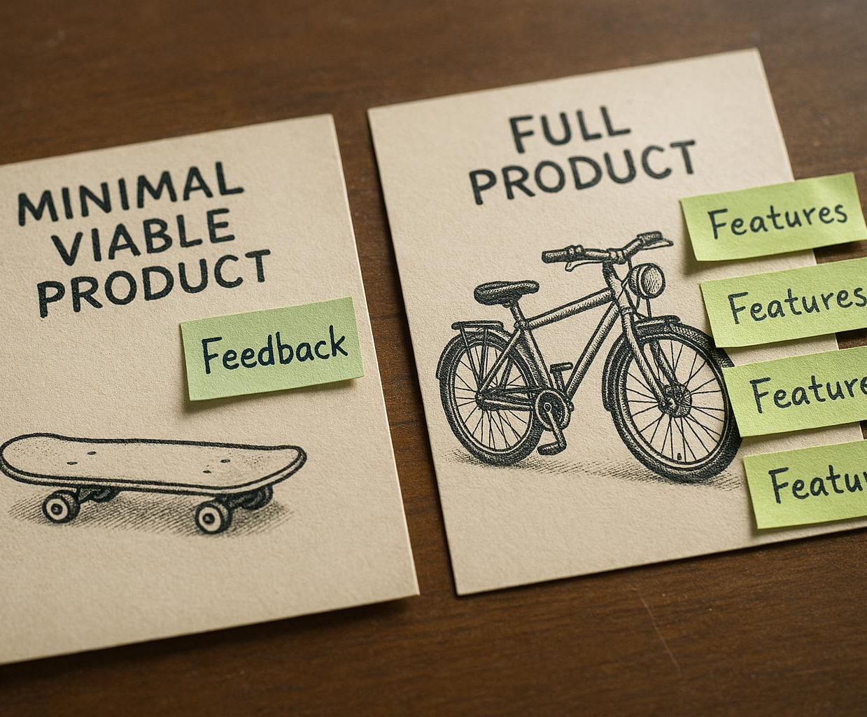
Differentiating MVPs from Full Products
MVP Focus on Learning
MVPs emphasise gathering user feedback and learning rather than complete features or design polish.
Full Product Characteristics
Full products offer polished features and a complete user experience as final versions.
Purpose of MVPs
MVPs serve as learning tools to guide development rather than finished products.
Notes:
--- Unlike full products, MVPs prioritise learning and feedback over features and polish. They are not final versions but learning tools to guide product development. Image source: AI-generated

Slide 11
MVPs, Prototypes, and Products: Key Differences
Notes:
This section clarifies the functional goals and limitations of prototypes and MVPs and explains the transition towards a full product.

Slide 12

Functional Goals of Prototypes
Purpose of Prototypes
Prototypes serve as early models to test and explore specific design concepts and interactions effectively.
Limited Functionality
Prototypes often lack full functionality but are useful in visualising and refining ideas before final development.
Iterative Design Process
Prototypes enable iterative improvements by allowing designers to test and modify ideas based on feedback.
Notes:
--- Prototypes are early models designed to test specific concepts or interactions, often lacking full functionality but valuable for visualising and iterating ideas. Image source: AI-generated

Slide 13
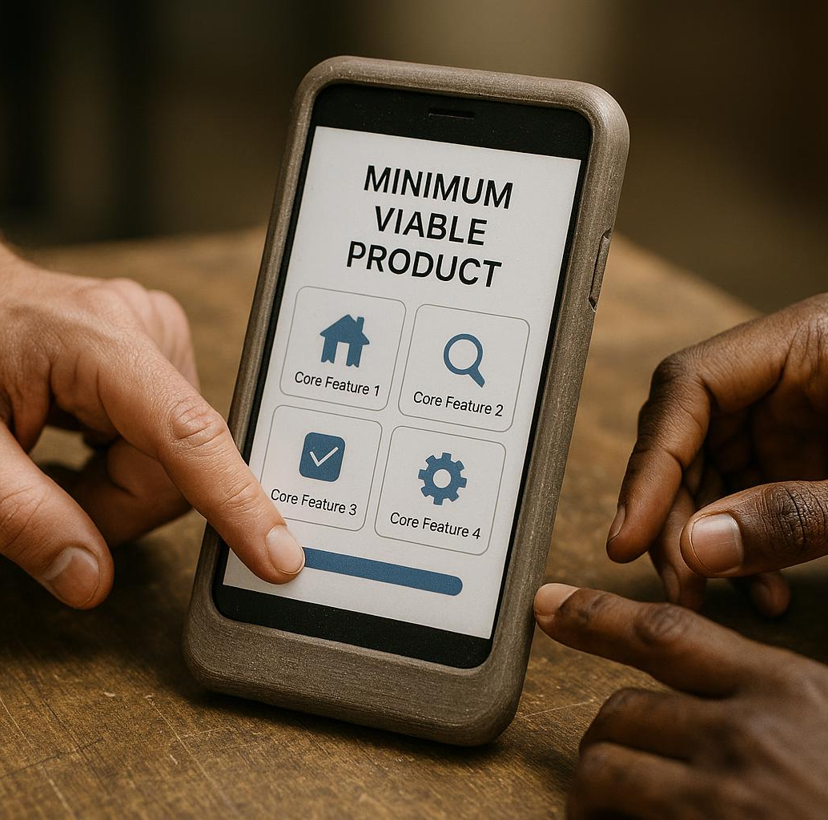
Objectives and Limitations of MVPs
Core Hypothesis Validation
MVPs focus on validating key business assumptions with real user feedback through functional products.
Minimal Feature Set
MVPs contain only essential features necessary to deliver value and test assumptions effectively.
Testing Assumptions
MVPs provide enough value to gain insights and validate assumptions before full product development.
Notes:
--- MVPs aim to validate core hypotheses with actual users through functional, though minimal, products. They have limited features but must deliver enough value to test assumptions. Image source: AI-generated

Slide 14

Transitioning from MVP to Full Product
MVP Validation
Validating the MVP ensures the product meets initial user needs and confirms market demand.
Feature Iteration
Startups expand and refine product features to enhance functionality and user experience.
Market Fit Improvement
Improving market fit aligns the product closely with customer needs and business goals.
Scaling Ready Product
Evolving the MVP into a full product prepares it for scaling and wider market adoption.
Notes:
--- After validating the MVP, startups iterate and expand features, improving quality and market fit to evolve the MVP into a full product ready for scale. Image source: AI-generated

Slide 15
Embracing Risk-Based MVP Thinking
Notes:
Focusing MVP development on addressing the riskiest assumptions helps startups efficiently reduce uncertainty and prioritise learning.

Slide 16

Identifying and Addressing the Riskiest Assumptions
Mapping Highest Risks
Startups should identify and prioritise their most critical risks to focus resources effectively early on.
Designing MVPs for Testing
Creating minimum viable products allows testing key assumptions quickly to validate ideas with minimal cost.
Avoiding Costly Failures
Early testing of riskiest assumptions helps prevent expensive mistakes and guides better decision making.
Notes:
--- Startups must map out their highest risks and design MVPs specifically to test those assumptions early to avoid costly failures. Image source: AI-generated

Slide 17

Mapping MVPs to Startup Risk Profiles
Unique Startup Risks
Startups encounter different risks that influence their product development and market entry strategies.
Tailoring MVPs
Customising MVPs to address specific startup risks improves validation and enhances product-market fit.
Effective Validation
Risk-aligned MVPs enable startups to validate assumptions effectively and reduce uncertainty.
Notes:
--- Different startups face unique risks; tailoring MVPs based on these profiles ensures relevant and effective validation. Image source: AI-generated

Slide 18

Prioritising Experiments Based on Risk
Focus on Critical Risks
Startups should prioritise experiments that address the highest risks to gain valuable insights early.
Maximise Learning
Prioritising key risks helps startups learn faster and make informed decisions to guide development.
Reduce Uncertainty Efficiently
Addressing critical uncertainties early reduces overall risk and improves business outcomes.
Notes:
--- By focusing on the most critical risks first, startups maximise learning and reduce uncertainty efficiently. Image source: AI-generated

Slide 19
Exploring Types of MVPs
Notes:
There are various approaches to MVPs, including no-code solutions, clickable prototypes, concierge models, wizard-of-oz, and demo MVPs, each suited for different contexts.

Slide 20
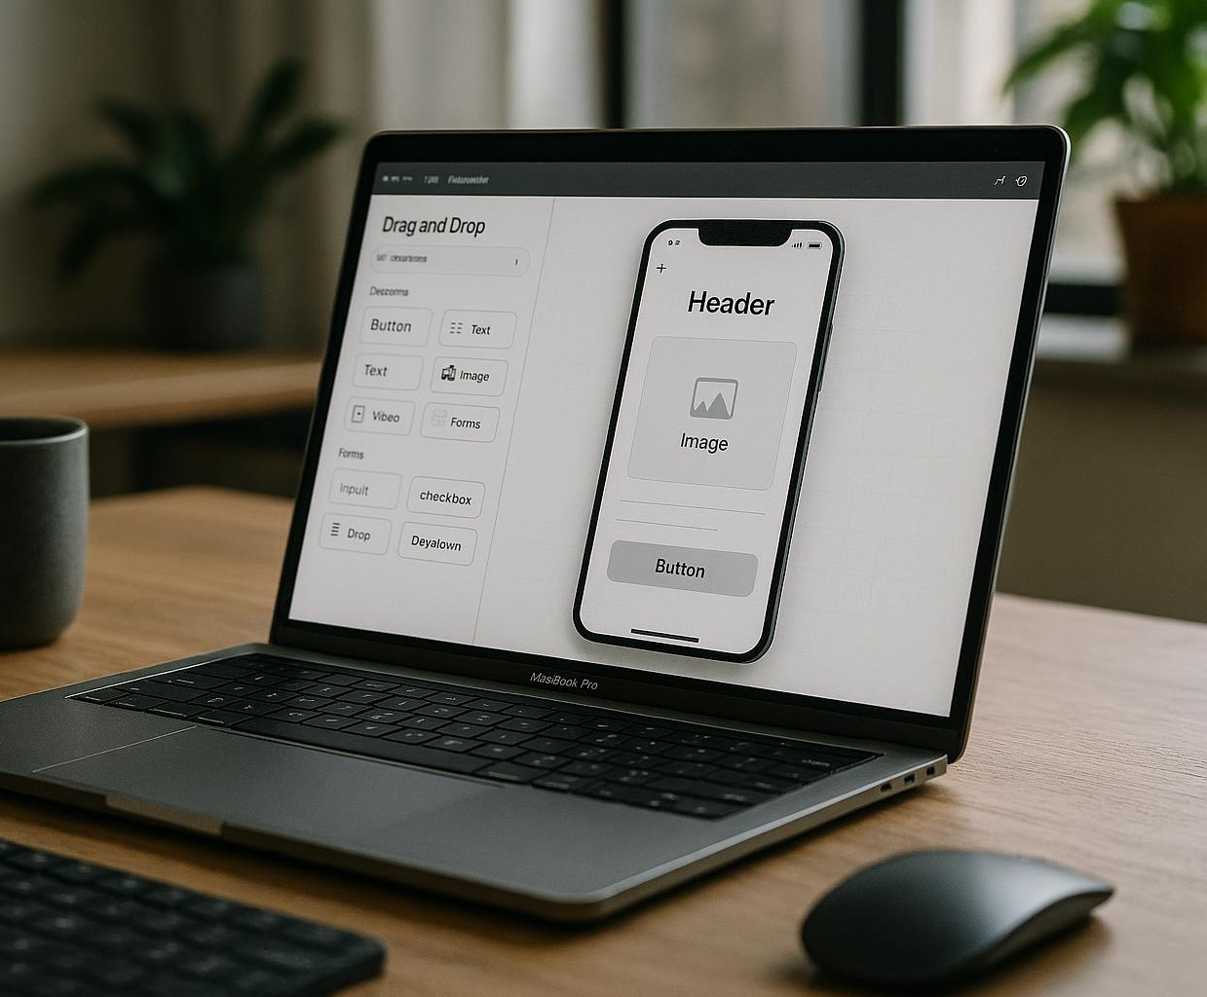
No-code Solutions and Their Applications
Rapid MVP Development
No-code platforms accelerate minimum viable product creation, allowing faster testing and iteration.
No Programming Required
These platforms eliminate the need for coding skills, making development accessible to non-technical users.
Business Model Testing
No-code solutions are ideal for rapidly testing and validating new business ideas and user interfaces.
Notes:
--- No-code platforms enable rapid MVP development without programming, ideal for testing business models or interfaces quickly. Image source: AI-generated

Slide 21
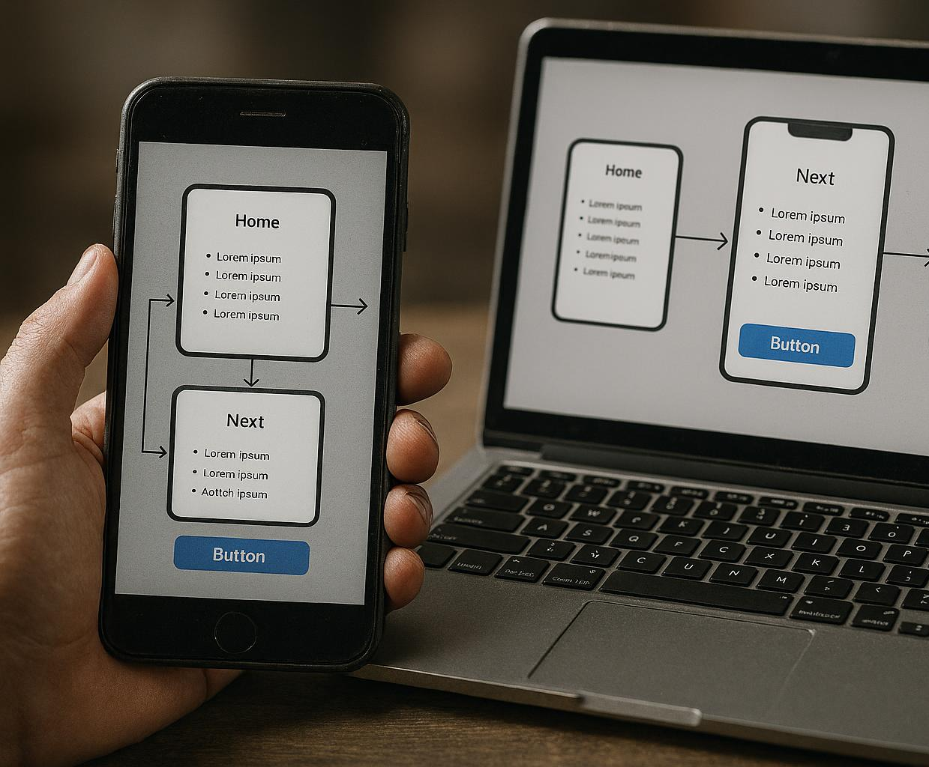
Clickable Prototypes and User Flow Simulations
Interactive User Models
Clickable prototypes replicate user interactions to test design functionality early in development.
User Flow Simulations
Simulations map user journeys to identify usability issues before coding begins.
Early Usability Feedback
These models enable collecting user feedback early, reducing costly revisions later.
Notes:
--- These interactive models simulate user experience allowing early usability feedback without backend development. Image source: AI-generated

Slide 22
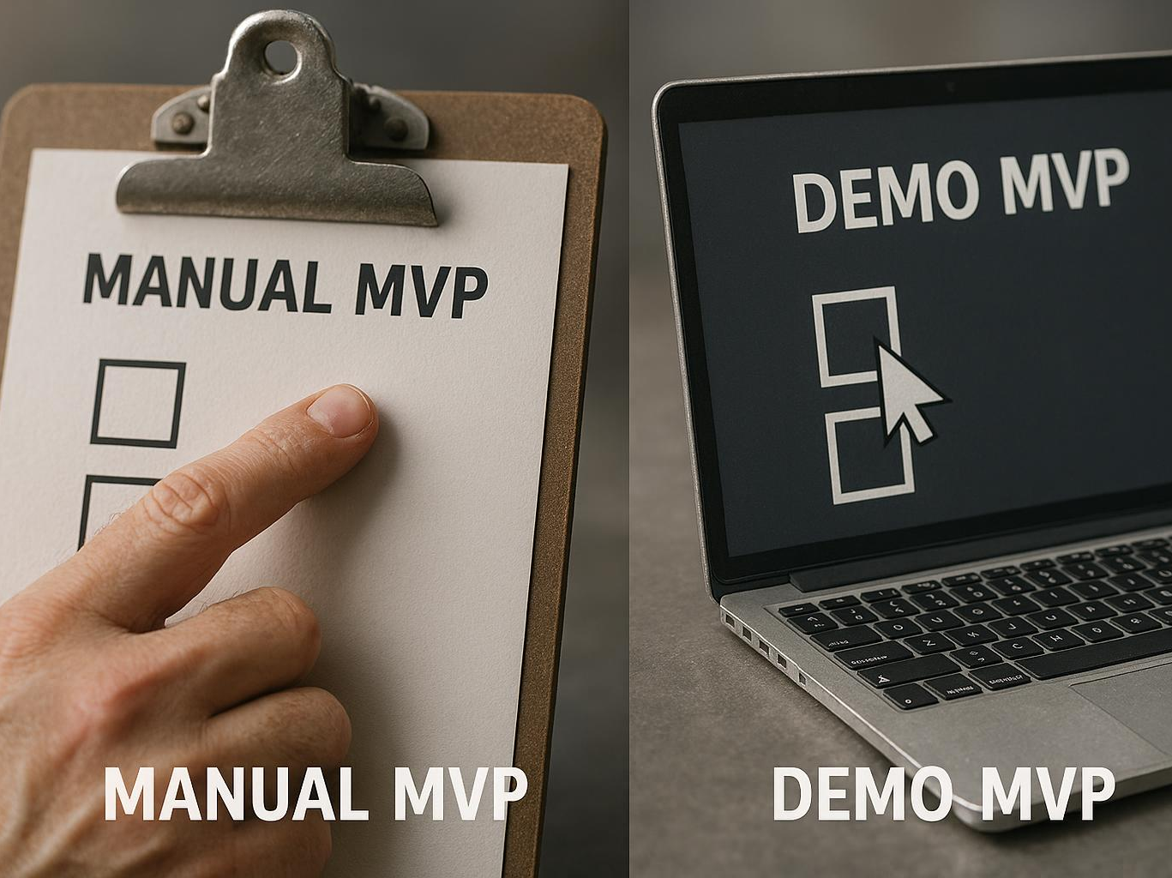
Concierge, Wizard-of-Oz, and Demo MVPs
Concierge MVP
Concierge MVP manually delivers the service, simulating the full user experience behind the scenes.
Wizard-of-Oz MVP
Wizard-of-Oz MVP simulates automated features secretly operated by humans to test user interaction.
Demo MVP
Demo MVP showcases potential product features visually to gauge user interest and feedback.
Notes:
--- Manual or semi-manual MVPs like concierge or wizard-of-oz simulate functionalities behind the scenes to test concepts before automation, while demo MVPs showcase potential features to gauge interest. Image source: AI-generated

Slide 23
Choosing the Right MVP Type for Your Startup
Notes:
Selecting the appropriate MVP depends on criteria including objectives, resources, speed, cost, and desired learning outcomes.

Slide 24

Criteria for Selecting MVP Approaches
Assess Risk Profile
Evaluating the startup's risk tolerance helps determine appropriate MVP strategies.
Evaluate Technical Capabilities
Understanding technical skills influences the complexity of the MVP to develop.
Consider Time Constraints
Time available affects the MVP scope and delivery speed decisions.
Identify Customer Segments
Knowing the target customers guides MVP feature prioritisation and design.
Notes:
--- Startups should consider their risk profile, technical capabilities, time constraints, and customer segments when choosing MVP types. Image source: AI-generated

Slide 25
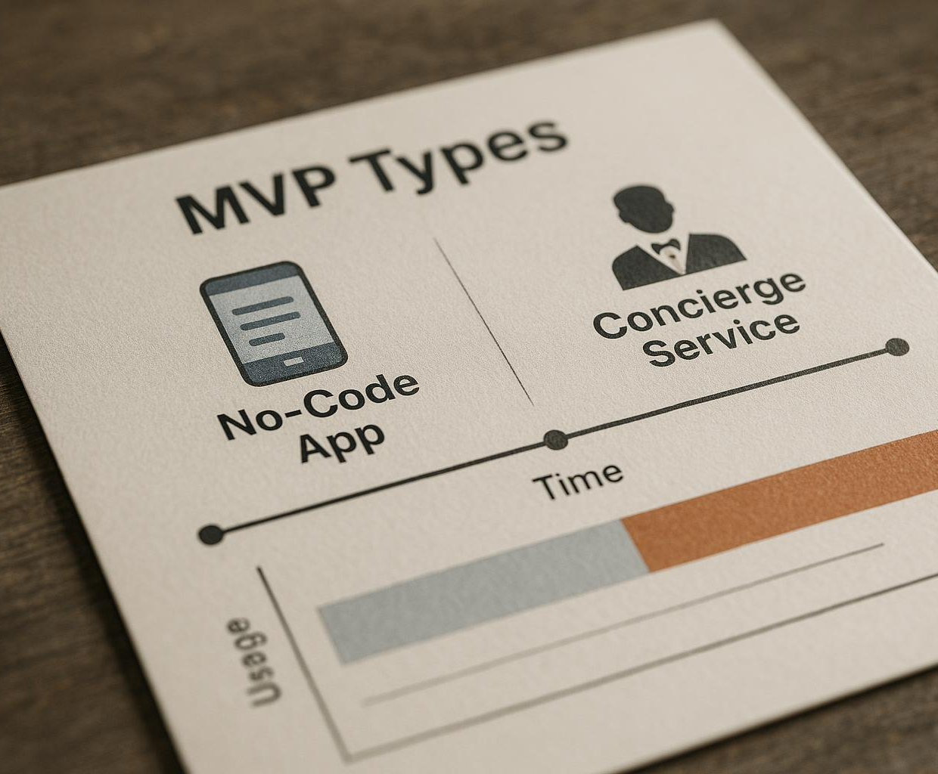
When to Use Each MVP Type
No-Code MVPs for Early Testing
No-code MVPs enable quick and cost-effective product testing during early development stages.
Concierge MVPs for Service Validation
Concierge MVPs are ideal for validating service concepts by providing personalized manual support.
Notes:
--- Different MVP types fit various stages and needs; for example, no-code MVPs are great for early testing, while concierge models suit service validation. Image source: AI-generated

Slide 26

Balancing Speed, Cost, and Learning
Trade-Off Importance
Startups need to balance speed, cost, and learning to validate ideas efficiently and avoid waste.
Speed in Validation
Moving quickly allows startups to test ideas and adapt before competitors do.
Cost Management
Controlling expenses prevents overspending during early development stages.
Learning and Adaptation
Learning from early tests helps improve products and make informed decisions.
Notes:
--- Startups must find the right trade-off to quickly validate ideas without overspending or overbuilding. Image source: AI-generated

Slide 27
Prototyping Tools and Platforms Overview
Notes:
An overview of popular no-code and low-code tools, design platforms, and collaboration software to facilitate prototyping and MVP development.

Slide 28
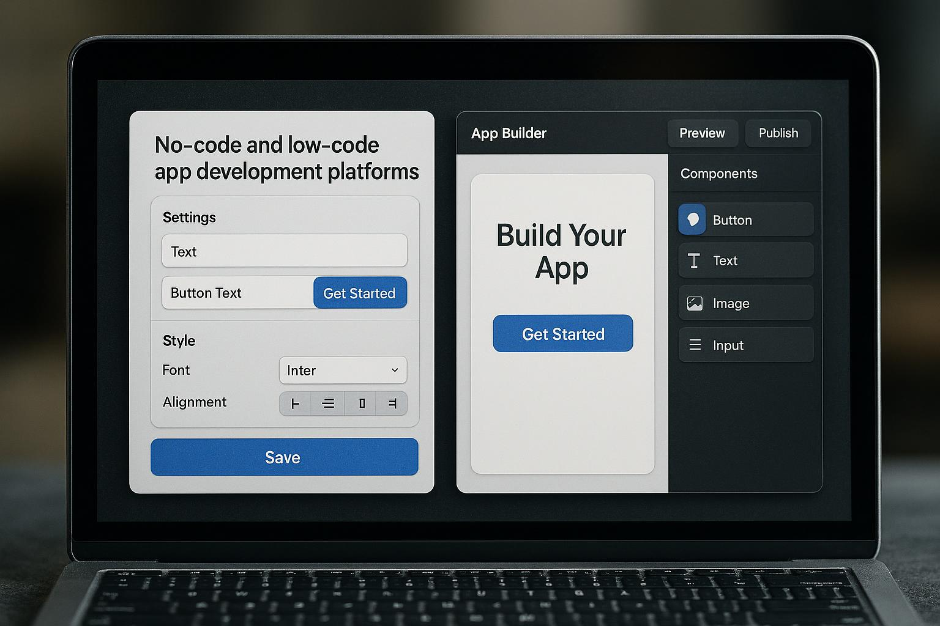
Popular No-code and Low-code Tools
Rapid MVP Creation
No-code tools allow quick development of minimum viable products without deep coding knowledge.
Popular Platforms
Platforms like Bubble, Webflow, and Airtable simplify app and website creation for non-technical users.
Notes:
--- Tools like Bubble, Webflow, and Airtable enable rapid MVP creation with minimal technical expertise. Image source: AI-generated

Slide 29
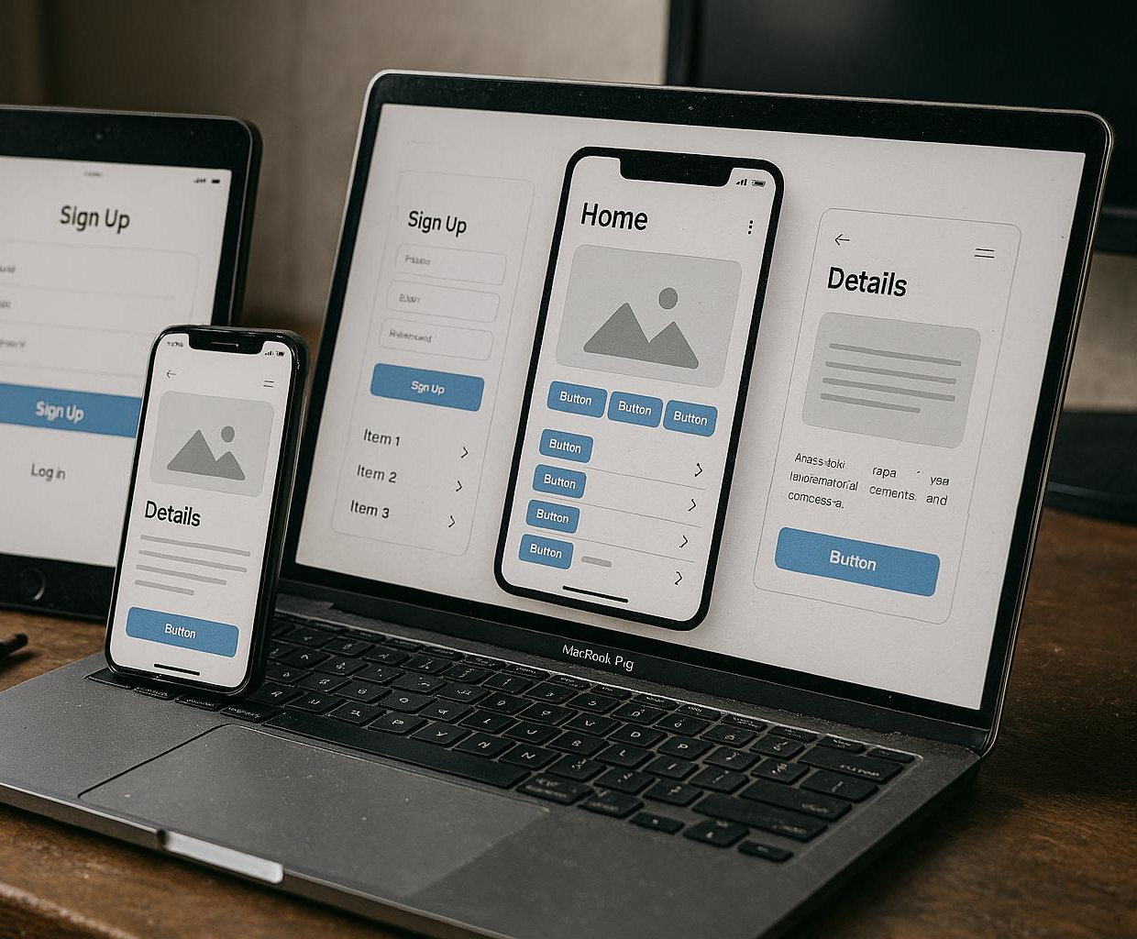
Design and Interactive Prototype Platforms
Prototyping Tools Overview
Platforms like Figma, Adobe XD, and InVision offer tools to create interactive design prototypes.
User Testing and Feedback
These platforms enable sharing of prototypes for user testing and collecting valuable feedback.
Notes:
--- Platforms such as Figma, Adobe XD, and InVision help design and share interactive prototypes for user testing and feedback. Image source: AI-generated

Slide 30
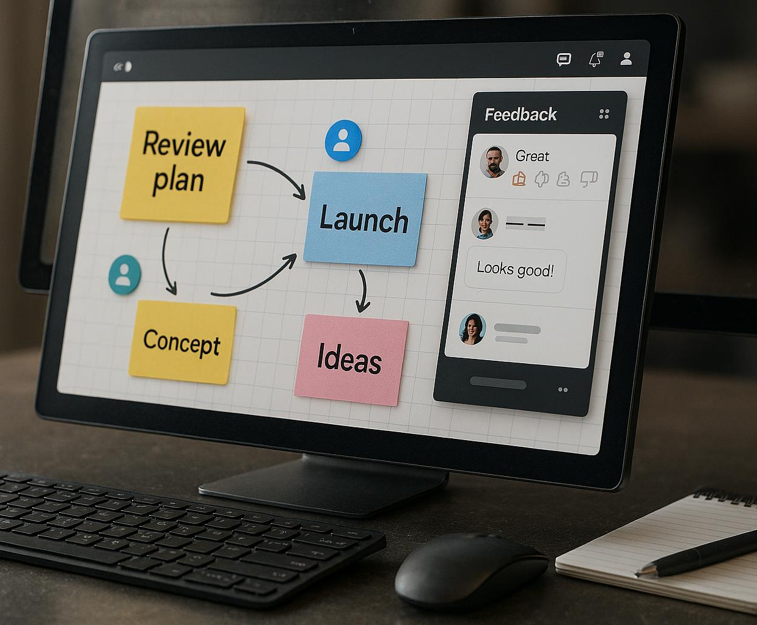
Collaboration and Feedback Collection Tools
Team Collaboration Platforms
Collaboration tools enable seamless communication and coordination among team members during project development.
User Feedback Collection
Feedback platforms gather valuable user insights to improve prototypes and product designs effectively.
Notes:
--- Tools like Miro, Slack, and UserTesting streamline team collaboration and gather user insights effectively during prototyping phases. Image source: AI-generated

Slide 31
Balancing Speed and Quality in Prototyping
Notes:
Startups must navigate trade-offs between rapid prototyping and delivering sufficient quality to gain meaningful feedback.

Slide 32
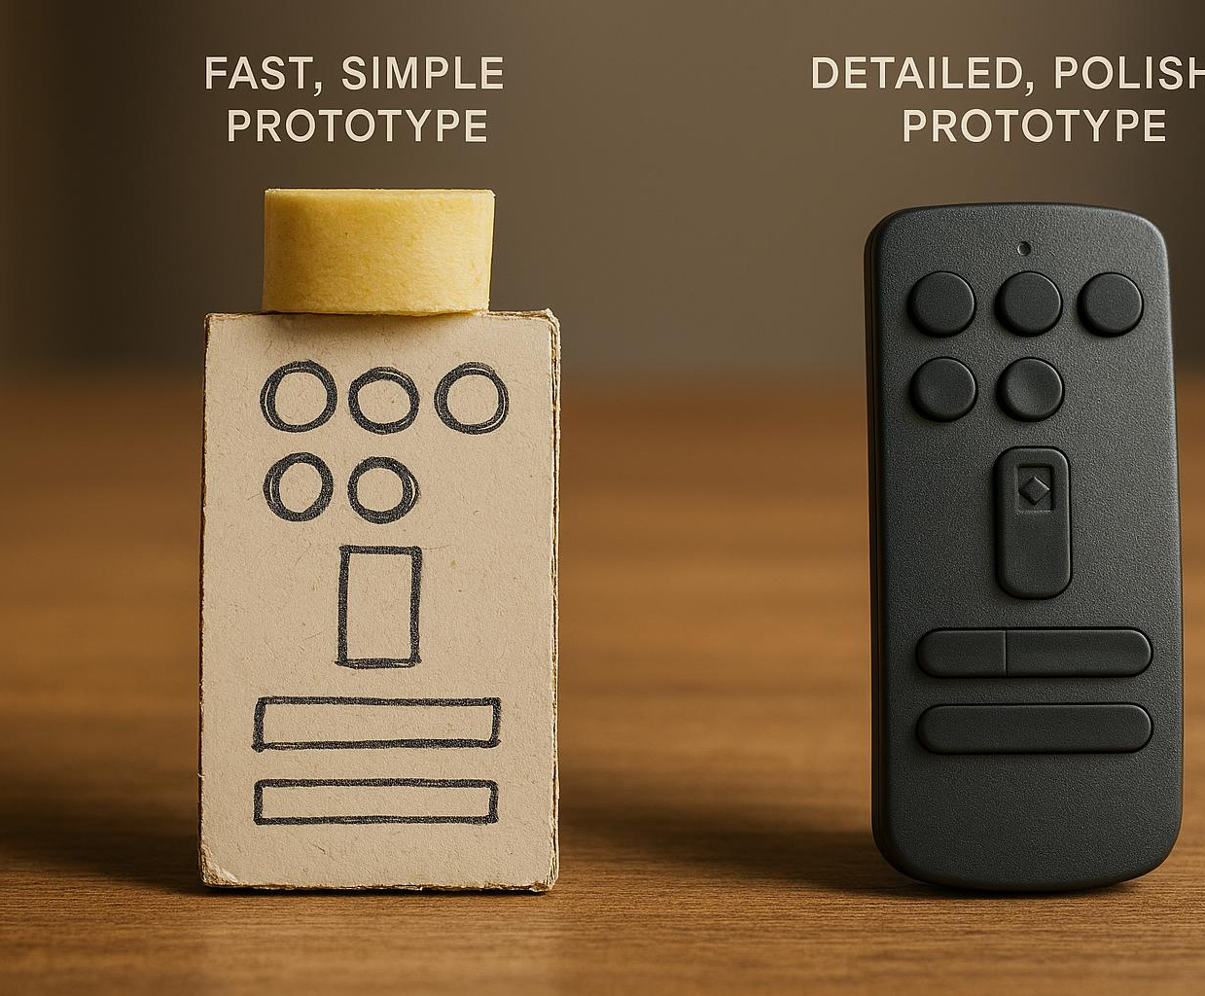
The Trade-offs Between Speed and Fidelity
Speed Enables Quick Learning
Faster prototypes accelerate learning by quickly testing concepts despite lacking polish or detail.
Fidelity Provides Better Insights
Higher fidelity prototypes offer detailed feedback and user insights but require more resources and time.
Notes:
--- Faster prototypes may lack polish but speed learning, while higher fidelity prototypes provide better insights but require more time and resources. Image source: AI-generated

Slide 33

When to Invest in Polish
Critical User Experience Elements
Invest in polish when refining features that significantly impact how users interact with the product.
Market Acceptance Testing
Applying detailed design is essential when evaluating how well the product is received by the market.
Notes:
--- Investing in detailed design is justified when testing elements critical to user experience or market acceptance. Image source: AI-generated

Slide 34
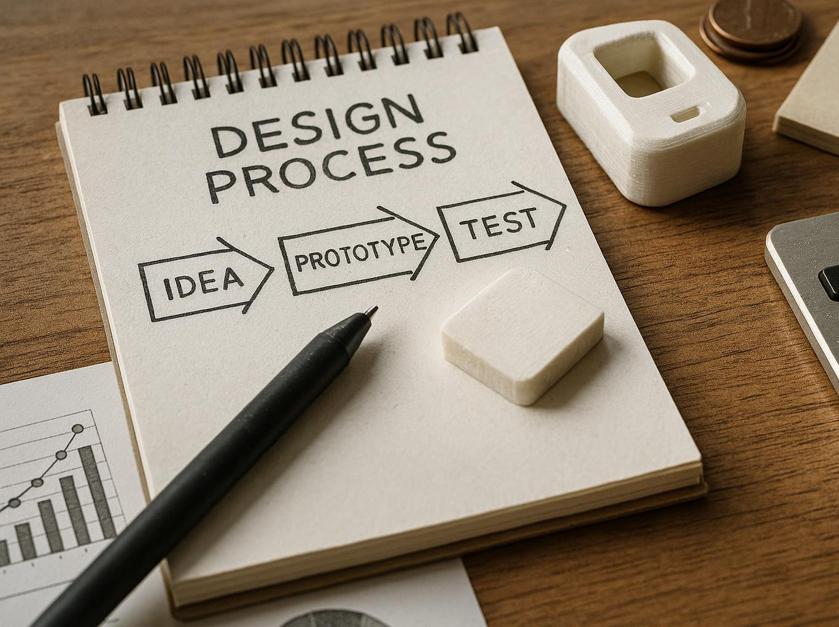
Lean Prototyping Tactics
Iterative Approach
Continuous cycles of prototyping and feedback help refine ideas efficiently.
Minimalist Design
Focusing on essential features reduces complexity and accelerates development.
Resource Management
Managing resources carefully ensures sustainability during the prototyping phase.
Notes:
--- Employing iterative, minimalist approaches helps maintain momentum and learning while managing resource constraints. Image source: AI-generated

Slide 35
Defining Success Criteria for MVPs
Notes:
Clear, measurable success criteria guide MVP development and evaluation, ensuring learning aligns with startup goals.

Slide 36

Setting Measurable Objectives
Define Specific Targets
Set clear and specific goals to measure the success of your MVP effectively.
User Engagement Metrics
Measure how users interact with your MVP through engagement statistics and behaviour.
Conversion Rate Tracking
Monitor conversion rates to evaluate how well your MVP turns visitors into customers.
Feedback Quality Assessment
Collect and assess user feedback to gauge satisfaction and areas for improvement.
Notes:
--- Establish specific targets such as user engagement, conversion rates, or feedback quality to evaluate MVP effectiveness objectively. Image source: AI-generated

Slide 37
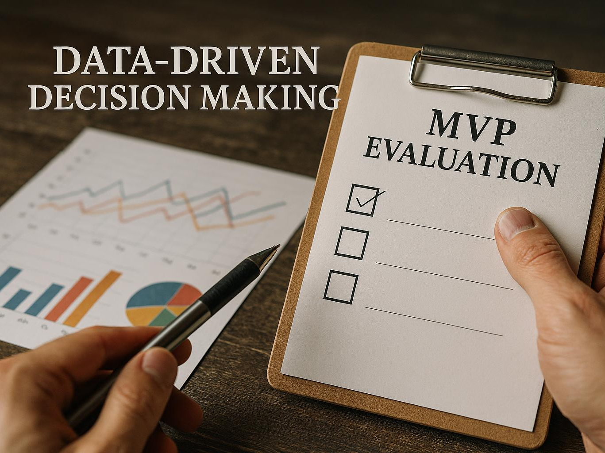
Establishing Actionable Benchmarks
Purpose of Benchmarks
Benchmarks provide clear criteria to evaluate if the MVP meets defined learning objectives effectively.
Pivot or Persevere
Benchmarks inform decision-making on whether to pivot strategies or persevere with current MVP development.
Notes:
--- Benchmarks help determine if the MVP meets learning needs and when to pivot or persevere based on data. Image source: AI-generated

Slide 38

Aligning Success with Learning Goals
Defining Success
Success is measured through validated learning, emphasizing real knowledge over superficial metrics.
Focus on Insights
Insights gained from learning direct product development more effectively than traditional metrics.
Notes:
--- Success should be defined by validated learning rather than just product metrics, focusing on insights gained to guide development. Image source: AI-generated

Slide 39
Learning Metrics Versus Vanity Metrics
Notes:
Distinguishing between metrics that drive informed decisions and those that only look good is crucial for effective iteration.

Slide 40
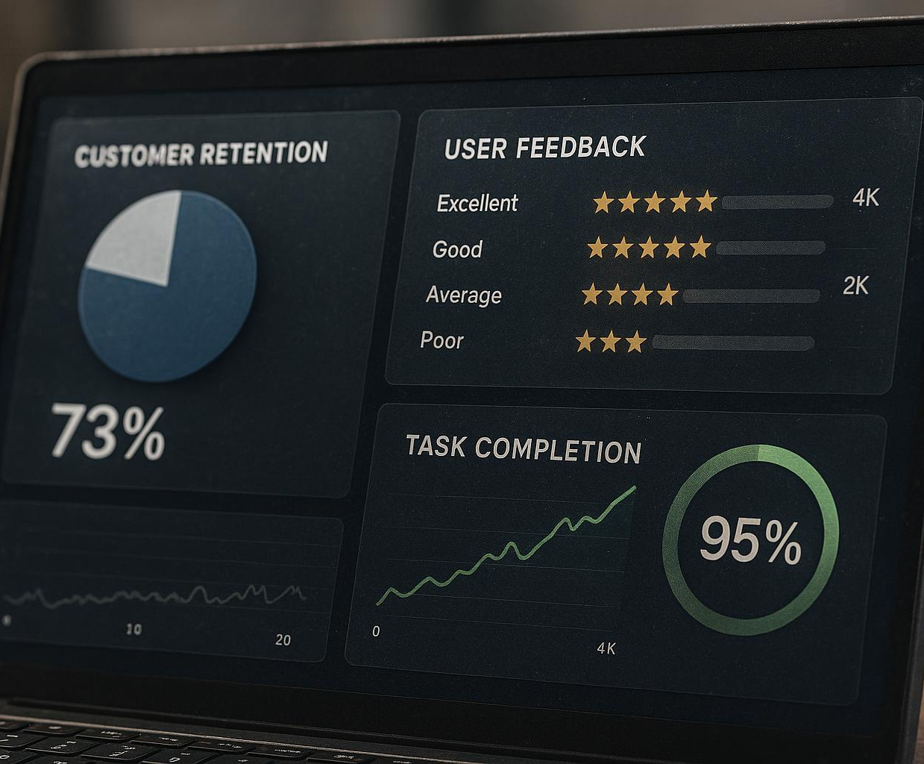
Identifying Actionable Learning Metrics
Customer Retention Metrics
Tracking customer retention helps understand user loyalty and product satisfaction over time.
User Feedback Analysis
Collecting and analysing user feedback provides qualitative insights for product improvements.
Task Completion Rates
Measuring task completion rates reveals usability and effectiveness of product features.
Notes:
--- Metrics like customer retention, user feedback, and task completion rates provide meaningful insights to guide product decisions. Image source: AI-generated

Slide 41

Common Vanity Metrics to Avoid
Misleading Metrics Explained
Certain metrics can exaggerate success without reflecting true business growth or customer engagement.
Limitations of Downloads and Views
Total downloads or page views may not translate to product-market fit or sustained user engagement.
Notes:
--- Metrics such as total downloads or page views may inflate perceived success but do not necessarily indicate real progress or product-market fit. Image source: AI-generated

Slide 42

Leveraging Metrics for Informed Iteration
Importance of Learning Metrics
Learning metrics provide critical insights that guide product improvements and strategic decisions for startups.
Iterative Product Refinement
Startups use metrics to iteratively refine their MVP, enhancing features and user experience based on evidence.
Evidence-Based Strategy
Metrics enable informed strategic decisions by providing evidence to validate assumptions and guide growth.
Notes:
--- Using learning metrics effectively enables startups to iterate their MVP intelligently, refining the product and strategy based on evidence. Image source: AI-generated

Slide 43
Conclusion: Mastering Prototyping and MVP Strategies
Prototyping for Risk Reduction
Startups use prototyping to identify and mitigate risks early in the product development process.
Understanding MVP Types
Knowing different MVP types helps teams choose the best approach to validate assumptions and gather user feedback.
Risk-Based Thinking
Adopting risk-based thinking allows startups to prioritise efforts and resources on the highest-impact areas.
Focusing on Actionable Metrics
Measuring actionable metrics enables startups to make informed decisions and refine their product strategy effectively.
Notes:
Successful startups embrace prototyping and MVPs as tools to reduce risk, accelerate learning, and align teams. By understanding different MVP types, adopting risk-based thinking, and focusing on actionable metrics, startup students can confidently navigate the journey from idea to viable product.

