Slide 1
Startup Validation: Methods, Metrics, and Evidence
Essential strategies to ensure startup success
Dr. Zornitsa Yordanova
Notes:
AI-generated content may be incorrect. --- This presentation explores startup validation—its methods, metrics, and the evidence needed to secure investor confidence. We will cover the fundamentals of validation, practical tools, and how to interpret results to guide your startup journey effectively.

Slide 2
Today's Agenda: Mastering Startup Validation
Understanding Validation in the Startup Context
The Importance of Evidence for Investors
Key Types of Validation
Qualitative Versus Quantitative Validation Approaches
Practical Validation Tools and Experiments
Prototypes, Demos, and Rapid Experimentation
Metrics for Early-Stage Validation
Making Sense of Validation Results
Common Validation Pitfalls and Lessons from Real Startups
Validation in Practice: Student Exercises and Documentation
Notes:
We will begin by understanding what validation means in the startup context, discuss its importance to investors, explore key validation types, compare qualitative and quantitative methods, and review practical tools and metrics. Finally, we'll look at common pitfalls, lessons, and exercises to apply in practice.

Slide 3
Understanding Validation in the Startup Context
Notes:
Validation ensures that your startup idea addresses a real problem and has market potential. We will clarify what validation means, why it is essential at the idea and MVP stages, and debunk common myths surrounding the process.

Slide 4

Definition of Validation for Startups
Market Need Confirmation
Validation confirms your product or service addresses a genuine market demand.
Customer Engagement
It ensures customers are willing to pay or engage with your offering.
Reducing Uncertainty
Validation reduces uncertainty, helping to guide effective product development.
Notes:
--- Validation is the process of confirming that your product or service meets a real market need and that customers are willing to pay or engage. It reduces uncertainty and guides product development effectively. Image source: AI-generated

Slide 5

Why Validation is Essential at the Idea and MVP Stage
Avoiding Wasted Effort
Validating early prevents investing time and resources into ideas that do not meet customer needs.
Ensuring Customer Resonance
Early validation confirms that your idea aligns with customer expectations and market demand.
Refining MVP and Strategy
Feedback from validation helps improve the minimum viable product and business strategy effectively.
Notes:
--- Early validation helps avoid wasted effort by ensuring your idea resonates with customers before scaling. It provides critical feedback to refine your minimum viable product and strategy. Image source: AI-generated

Slide 6

Common Myths and Misconceptions about Validation
Myth of Immediate Product-Market Fit
Validation does not require instant perfect product-market fit; it is an iterative learning process.
Surveys Alone Are Insufficient
Surveys are useful but cannot replace comprehensive validation involving multiple data sources and testing methods.
Promoting Realistic Validation
Adopting a realistic view of validation encourages continuous improvement and better product development.
Notes:
--- Many believe validation means having perfect product-market fit immediately or that surveys alone suffice. We will explore and correct these misunderstandings to promote a realistic approach. Image source: AI-generated

Slide 7
The Importance of Evidence for Investors
Notes:
Investors look for tangible proof that a startup’s idea has market potential and reduced risk. This section explores why evidence matters, the types that build confidence, and how validation helps de-risk investment.

Slide 8

Why Investors Demand Evidence of Validation
Market Demand Proof
Validation shows clear market demand, reassuring investors of product relevance and customer interest.
Product Feasibility
Demonstrating product feasibility confirms the solution works effectively and meets technical requirements.
Team Execution Ability
Investors look for teams with proven ability to execute plans and drive the project to success.
Notes:
--- Investors seek reassurance that their capital is well-placed. Evidence of validation demonstrates market demand, product feasibility, and the team’s ability to execute. Image source: AI-generated

Slide 9

Types of Evidence that Build Investor Confidence
Customer Testimonials
Customer testimonials provide direct social proof, enhancing trust in the product or service.
Pilot Results
Pilot results demonstrate the practical viability and potential impact of a product or service.
Early User Metrics
Early user metrics show engagement and adoption trends essential for forecasting growth.
Revenue Indicators
Revenue figures highlight financial progress and market acceptance of the offering.
Notes:
--- Evidence ranges from customer testimonials and pilot results to early user metrics and revenue. Diverse evidence strengthens credibility and shows progress. Image source: AI-generated

Slide 10

How Validation De-risks Startup Investment
Confirming Market Need
Validation helps verify that the startup’s product addresses a real market need, reducing investor doubts.
Demonstrating Early Traction
Showing early customer adoption builds confidence and lowers perceived investment risk.
Reducing Investment Uncertainty
Validation decreases uncertainty, making startups more appealing to potential investors.
Notes:
--- By confirming market need and early traction, validation reduces uncertainty, lowering perceived risk and making the startup more attractive to investors. Image source: AI-generated

Slide 11
Key Types of Validation
Notes:
There are three critical validation types: problem validation, solution validation, and market/traction validation. Understanding and applying each guides product-market fit.

Slide 12

Problem Validation: Confirming a Real Pain Point
Purpose of Problem Validation
Ensures the identified issue truly exists and is significant enough to require a solution.
Impact Assessment
Confirms the problem affects a sufficient number of people to justify developing a solution.
Notes:
--- Problem validation ensures the issue you aim to solve genuinely exists and affects enough people to justify a solution. Image source: AI-generated

Slide 13

Solution Validation: Testing Desirability of Your Idea
Customer Appeal Testing
Assess if the solution resonates with the target audience by gathering direct customer feedback.
Addressing Pain Points
Ensure the solution effectively solves the customer's key problems and meets their needs.
Notes:
--- This step tests whether your proposed solution appeals to customers and effectively addresses their pain points. Image source: AI-generated

Slide 14

Market and Traction Validation: Gauging Demand and Early Adoption
Market Validation Importance
Market validation assesses genuine user interest and helps confirm product demand before full launch.
Early Sales and Sign-ups
Tracking early sales and sign-ups provides key insights into product traction and market acceptance.
Sustainable Traction
Sustainable traction indicates long-term product viability through consistent user adoption and growth.
Notes:
--- Market validation measures user interest and early sales or sign-ups, indicating if your product can gain sustainable traction. Image source: AI-generated

Slide 15
Qualitative Versus Quantitative Validation Approaches
Notes:
We will compare qualitative methods like interviews and observations to quantitative methods such as surveys and analytics, helping you select the best approach for your stage.

Slide 16

Qualitative Methods: Interviews, Observations, and Feedback
Interviews for Insights
Interviews enable understanding of customer motivations through direct, personal conversations and open-ended questions.
Observations in Context
Observing customers in real environments reveals authentic behaviours and decision-making patterns.
Gathering Feedback
Collecting feedback helps identify user experiences and areas for improvement through direct communication.
Notes:
--- Qualitative approaches provide deep insights into customer motivations and behaviours through conversations and direct observations. Image source: AI-generated

Slide 17

Quantitative Methods: Surveys, Analytics, and Experiments
Survey Data Collection
Surveys gather quantifiable data by asking structured questions to large groups for pattern analysis.
Web Analytics Insights
Web analytics track and quantify user behaviour to improve digital strategies and validate hypotheses.
Controlled Experiments
Experiments use controlled conditions to test hypotheses and measure effect sizes with quantitative data.
Notes:
--- Quantitative methods measure patterns and validate hypotheses using data such as survey results, web analytics, and controlled experiments. Image source: AI-generated

Slide 18

Choosing the Right Approach for Your Stage
Early Stage Focus
Qualitative insights provide depth and understanding during early stages of development and decision-making.
Later Stage Focus
Quantitative data drives scaling and optimisation in later stages through measurable results.
Strategic Timing
Knowing when to apply qualitative or quantitative methods is essential for successful growth and optimisation.
Notes:
--- Early stages benefit more from qualitative insights, while later stages require quantitative data to scale and optimise. Knowing when to use each is vital. Image source: AI-generated

Slide 19
Practical Validation Tools and Experiments
Notes:
This section covers actionable tools such as customer interviews, smoke tests, landing pages, fake-door tests, and waitlists to validate ideas quickly and cost-effectively.

Slide 20

Conducting Effective Customer Interviews
Designing Interviews
Create interview questions that encourage honest feedback and reveal true customer needs without leading them.
Unbiased Questioning
Use neutral language and avoid assumptions to prevent biasing customer responses during interviews.
Active Listening
Focus on attentive listening and note-taking to accurately capture customer reactions and needs.
Notes:
--- Learn how to design and conduct interviews that uncover genuine customer needs and reactions without biasing responses. Image source: AI-generated

Slide 21

Using Smoke Tests and Landing Pages
Purpose of Smoke Tests
Smoke tests help assess customer interest early by tracking engagement before product development.
Role of Landing Pages
Landing pages capture clicks and sign-ups to validate demand prior to building the complete product.
Notes:
--- Smoke tests and landing pages test customer interest by measuring clicks and sign-ups before building a full product. Image source: AI-generated

Slide 22
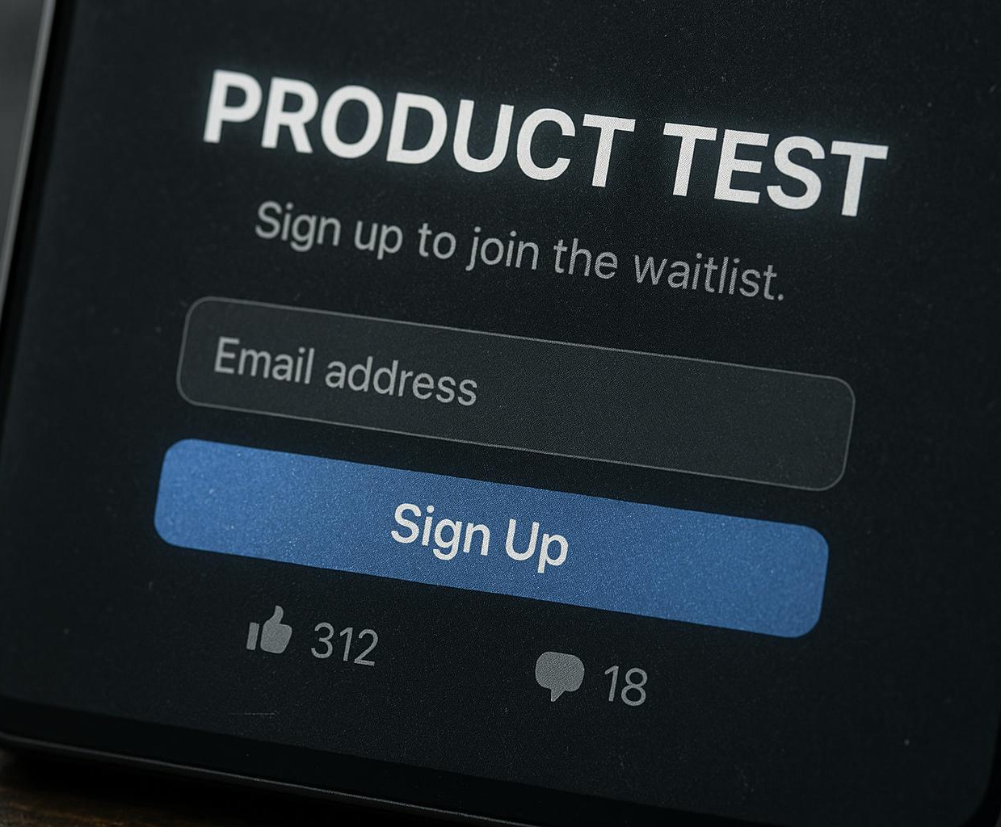
Running Fake-Door Tests and Building Waitlists
Purpose of Fake-Door Tests
Fake-door tests help measure user interest before product development begins by simulating availability.
Building a Waitlist
Waitlists gather potential users who express interest, enabling prioritized product rollout and feedback.
Notes:
--- Fake-door tests gauge demand by offering a product or feature that doesn’t yet exist, capturing interested users for future launch. Image source: AI-generated

Slide 23
Prototypes, Demos, and Rapid Experimentation
Notes:
Explore how to build minimum viable prototypes, gather real user feedback via demos, and structure experiments to validate assumptions efficiently.

Slide 24

Building Minimum Viable Prototypes
Simple Prototype Models
Design basic, cost-effective versions of your product to focus on essential features.
Core Functionality Testing
Use prototypes to quickly test and validate key product functionalities with users.
Rapid Feedback Cycle
Gather fast user feedback to iterate and improve the product efficiently.
Notes:
--- Create simple, cost-effective models of your product to test core functionalities with users quickly. Image source: AI-generated

Slide 25

Gathering Real Feedback with Demos
Showcase Prototype
Demos provide a practical way to present your prototype directly to potential customers and stakeholders.
Collect Valuable Feedback
Gathering feedback through demos helps identify areas for improvement and enhances product refinement.
Notes:
--- Use demos to showcase your prototype to potential customers and stakeholders, collecting valuable feedback for refinement. Image source: AI-generated

Slide 26

Structuring Surveys and Experiments for Validation
Define Clear Objectives
Establish specific goals for surveys and experiments to ensure focused and relevant validation.
Ensure Measurable Outcomes
Design experiments with quantifiable results to facilitate accurate and reliable validation.
Obtain Reliable Data
Use structured methods to collect consistent and dependable data for validation purposes.
Notes:
--- Design surveys and experiments with clear objectives and measurable outcomes to obtain reliable validation data. Image source: AI-generated

Slide 27
Metrics for Early-Stage Validation
Notes:
Identify and track key metrics like sign-ups, conversion rates, and engagement to measure validation progress and inform iterations.

Slide 28

Key Metrics: Sign-Ups, Conversion Rates, and Engagement
Customer Interest Measurement
Sign-ups indicate the level of customer interest and initial attraction to the product.
Funnel Effectiveness
Conversion rates measure how effectively visitors become active customers within the sales funnel.
Usage Patterns
Engagement metrics reveal how users interact with the product during early adoption phases.
Notes:
--- These metrics reveal customer interest, funnel effectiveness, and product usage patterns early in the startup lifecycle. Image source: AI-generated

Slide 29

Designing Metrics That Matter for Your Business Model
Align Metrics with Goals
Select metrics that directly support your specific business objectives for relevant performance tracking.
Focus on Actionable Data
Use data that provides clear insights to guide business decision-making and improvements.
Notes:
--- Choose metrics aligned with your business goals to ensure meaningful insights and actionable data. Image source: AI-generated

Slide 30
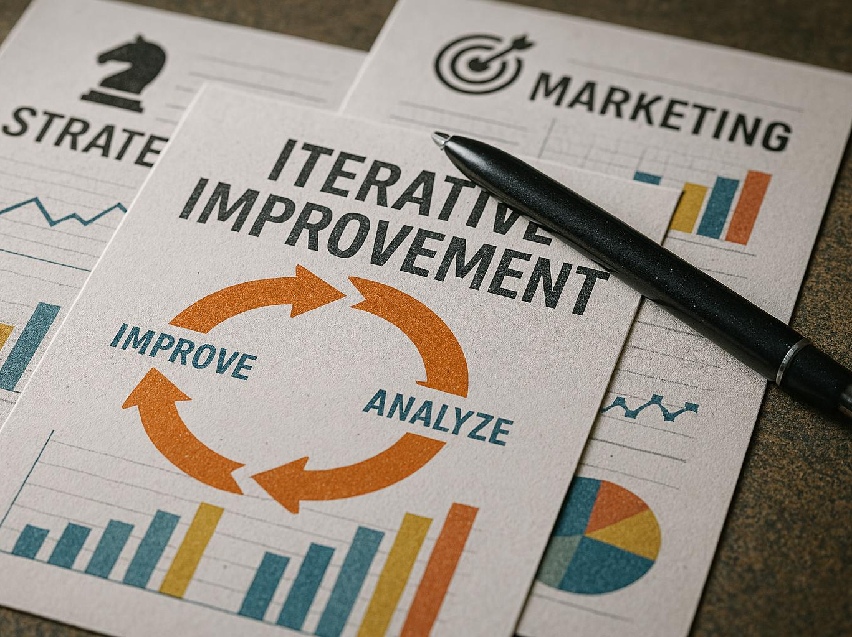
Tracking and Iterating Based on Early Data
Data-Driven Refinement
Use early collected data to continuously refine product features and enhance user experience.
Marketing Strategy Optimization
Leverage data insights to adjust marketing tactics for better audience targeting and engagement.
Continuous Strategy Improvement
Iterate business strategies based on early feedback to increase chances of overall success.
Notes:
--- Use collected data to refine your product, marketing, and strategy continuously, improving chances of success. Image source: AI-generated

Slide 31
Making Sense of Validation Results
Notes:
Learn to interpret both qualitative and quantitative results, recognise validation failures, and decide when to pivot or persevere.

Slide 32
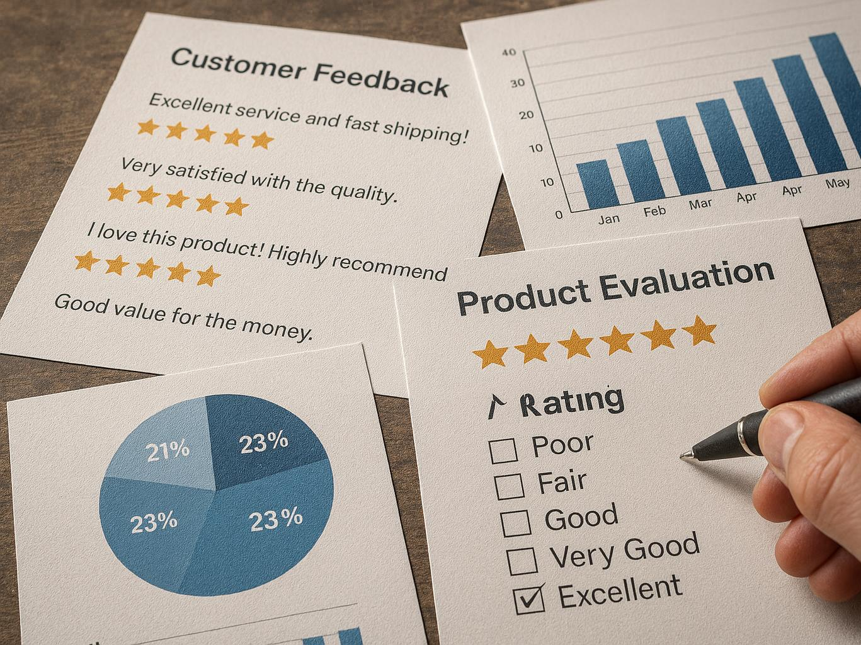
How to Interpret Qualitative and Quantitative Evidence
Integrate Customer Stories
Use qualitative data from customer experiences to understand needs and preferences deeply.
Analyze Quantitative Data
Evaluate numerical data to identify market trends and measure product performance objectively.
Form Comprehensive Insights
Combine qualitative and quantitative findings to assess market fit and product viability effectively.
Notes:
--- Combine insights from customer stories and data to form a comprehensive view of market fit and product viability. Image source: AI-generated

Slide 33

Recognising When Validation Fails
Early Signal Identification
Recognising early signs like poor engagement is crucial to prevent costly errors in projects or products.
Negative Feedback Importance
Negative feedback provides valuable insights that inform necessary adjustments and improvements.
Preventing Mistakes
Timely recognition of validation failure helps avoid expensive mistakes and supports successful outcomes.
Notes:
--- Identifying signals like poor engagement or negative feedback early helps avoid costly mistakes and informs necessary changes. Image source: AI-generated

Slide 34

Deciding When to Pivot or Persevere
Importance of Validation
Validation results provide critical insights to guide strategic business decisions effectively.
When to Pivot
Consider pivoting when your current business model or product fails to meet key market needs.
When to Persevere
Persevere when validation confirms your approach is viable and shows potential for growth.
Notes:
--- Use validation results to make informed decisions on whether to adjust your business model, product, or market approach. Image source: AI-generated

Slide 35
Common Validation Pitfalls and Lessons from Real Startups
Notes:
Avoid frequent validation mistakes by learning from real startup successes and failures, highlighting key takeaways.

Slide 36

Validation Traps and How to Avoid Them
Confirmation Bias
Confirmation bias causes selective attention to information that supports existing beliefs, leading to skewed validation results.
Limited Data Reliance
Overreliance on limited or insufficient data can produce inaccurate conclusions and misguide validation efforts.
Ignoring Negative Feedback
Ignoring or dismissing negative feedback prevents identification of flaws and hinders effective validation.
Notes:
--- Beware of confirmation bias, overreliance on limited data, and ignoring negative feedback which can mislead validation efforts. Image source: AI-generated

Slide 37
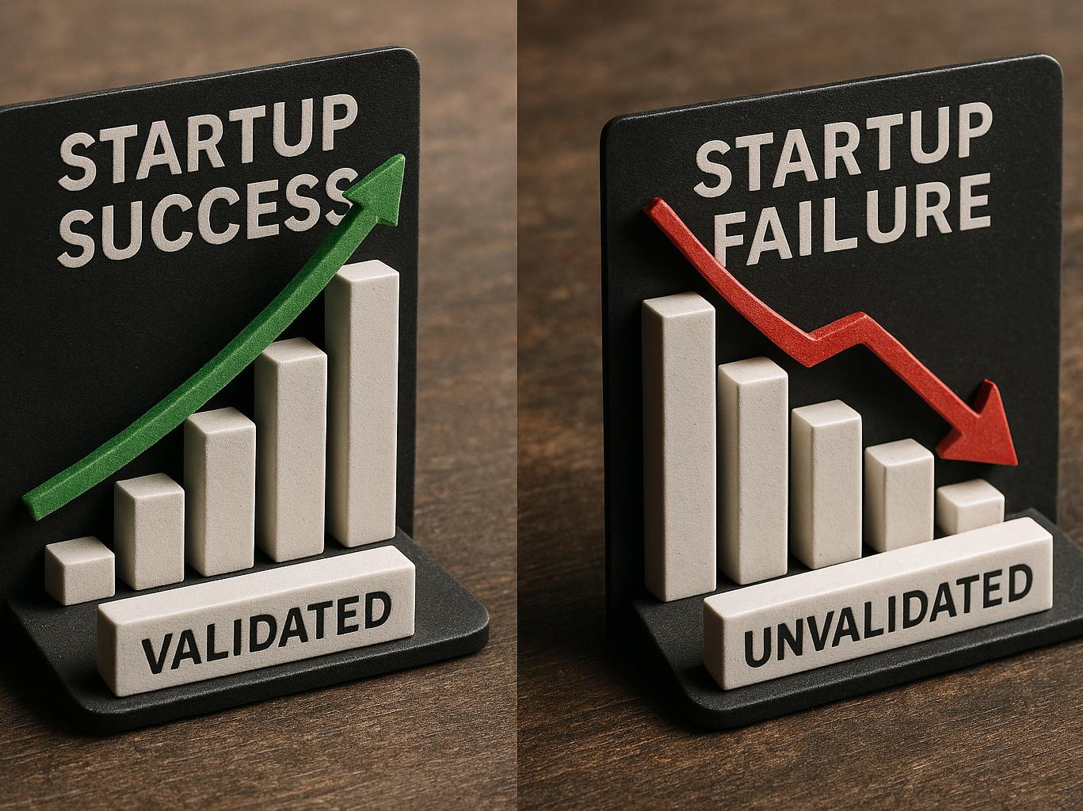
Case Studies: Successful and Failed Validation
Successful Validation Examples
Some startups achieved remarkable growth by validating ideas early, reducing risks and attracting investors.
Failed Validation Consequences
Other startups faced setbacks due to inadequate validation, resulting in lost resources and missed opportunities.
Lessons Learned
Analyzing these case studies provides practical insights for improving validation strategies and avoiding common pitfalls.
Notes:
--- Review examples of startups that either benefited greatly or suffered setbacks through their validation approaches to gain practical insights. Image source: AI-generated

Slide 38

Key Takeaways from Real-World Examples
Importance of Flexibility
Being adaptable and flexible is essential for successful validation in dynamic real-world scenarios.
Diversity of Evidence
Using a wide range of evidence strengthens validation by providing comprehensive insights.
Customer Focus
Prioritising customer needs and feedback drives validation success and product relevance.
Notes:
--- Summarise the lessons learned about flexibility, evidence diversity, and customer focus critical to validation success. Image source: AI-generated

Slide 39
Validation in Practice: Student Exercises and Documentation
Notes:
Practical exercises, checklists, and documentation strategies help founders apply validation concepts and communicate results effectively.

Slide 40

Practical Exercises and Assignments for Validation
Customer Interviews
Conducting customer interviews provides real insights and helps validate assumptions effectively.
Metric Tracking
Tracking metrics allows measurement of progress and assessment of the impact of validation activities.
Notes:
--- Engage in hands-on activities such as customer interviews and metric tracking to deepen your understanding and skills. Image source: AI-generated

Slide 41

Weekly Validation Checklist for Early-Stage Founders
Structured Validation Process
Using a structured checklist helps founders stay organized and focused on key validation tasks each week.
Maintain Momentum
Consistent use of a checklist ensures continuous progress and prevents loss of direction during early validation stages.
Focus on Key Efforts
A checklist helps prioritize critical validation activities, keeping founders focused on impactful actions.
Notes:
--- Use a structured checklist to maintain focus and momentum in validation efforts, ensuring consistent progress. Image source: AI-generated

Slide 42

How to Document Validation for Investor Presentations
Clear Validation Evidence
Present validation data transparently to build trust and credibility with investors.
Persuasive Presentation
Use compelling storytelling and visuals to engage investors and support funding requests.
Notes:
--- Learn to compile validation evidence clearly and persuasively to build investor confidence and support funding efforts. Image source: AI-generated

Slide 43
Conclusion: Validating for Startup Success
Continuous Validation Process
Startup validation must be ongoing to adapt to market changes and customer feedback effectively.
Reducing Risk
Validation helps minimize risks by confirming product-market fit before scaling the business.
Learning from Evidence
Founders use data-driven insights to make informed decisions and improve their ventures.
Notes:
Startup validation is a continuous, multi-faceted process critical to reducing risk and achieving product-market fit. By applying methods, tracking metrics, and learning from evidence, founders can navigate uncertainty and build successful ventures.

